Slide 1

2024 IOTA
2025 IOTA Industry Overview
Industry Overview

Slide 2
Welcome to the 2025 IOTA!
Here’s a sample of the enhancements we’ve made this year.
Painstaking forecast review
Custom Analytics
Revised Dashboard
Realizing the post-Covid state of the market, combined with new economic and technology dynamics, AVIXA and its research partners conducted a painstaking review of the IOTA forecast. The result is a lower overall growth rate as well as prior year revision to reflect the reality we now live in.
To provide greater value for IOTA subscribers, AVIXA launched a Custom Analytics solution in 2025. This solution, as an add-on to the IOTA, offers AVIXA Market Intelligence resources to provide a specific view of your company’s TAM, SAM, and SOM, incorporating IOTA and outside data as required.
To increase ease of use, AVIXA is introducing a revised IOTA Dashboard, available to subscribers through the Market Intelligence portal. The new Dashboard is simpler and more powerful with fewer tabs, allowing users to get to the data they need more efficiently.

Slide 3




What are the headlines?
Econ is currently challenged, leading to a saddle, with lower growth in the long term.
Uncertainty remains.
Slow but steady growth.
MEA, LA & APAC lead
Security & Events benefit
High interest rates, geo-politics, new policies, and poorer economic performance are creating a hedge effect in 2025 that should gradually abate.
While the pace of growth is slower, the 2030 outlook is still for a $402 billion Pro AV market, growing at 3.9% from 2025 to 2030.
Developing markets, MEA, LA, & APAC will lead growth, while mature markets like North America and Europe lag.
Security & Surveillance will exhibit the highest growth at 7% CAGR, while Live Events continue their comeback at 4.1% as Conferencing and Collaboration slows.

Slide 4
Copyright © 2024 AVIXA™, the Audiovisual and Integrated Experience Association
All rights reserved.
Printed in the United States of America
Published by AVIXA, the Audiovisual and Integrated Experience Association,
11242 Waples Mill Road, Suite 200, Fairfax, VA 22030-6079
No part of this work may be used, reproduced, or transmitted in any form or by any means, electronic or mechanical, including photocopying, recording, or by any information storage and retrieval system, without prior agreement and written permission from AVIXA. The contents of this work are subject to revision without notice due to continued progress in methodology, design, installation, and manufacturing in the audiovisual industry. This material is sold as is, without warranty of any kind, respecting the contents of this work, including but not limited to implied warranties for this work’s quality, performance, merchantability, or fitness for any particular purpose. AVIXA shall not be liable to the purchaser, user, or any other entity with respect to any liability, loss, or damage caused directly or indirectly by this work. AVIXA ™, the Audiovisual and Integrated Experience Association.

Slide 5
IOTA uses a blended estimation method.
Supply-side & demand-side data are collected and aligned with macroeconomic factors.
Stage 1
Stage 2
Stage 3
AVIXA works with Omdia, other industry sources, and its own surveys (MOAR, Channel Survey, etc.) to aggregate an expansive collection of Pro-AV data.
This data collection contains both supply and demand-side data in the form of interviews, feedback, forecasts, and industry trends.
All new and historical data are combined to create data models starting at the product level. Manufacturer and Channel inputs then help analysts allocate revenues to geographies, markets, and solutions.
The IOTA database is rigorously tested with discussions of assumptions, inputs, and overall trends. Only once fully vetted are the data released in the “Industry Overview” report and IOTA dashboard.

Slide 6
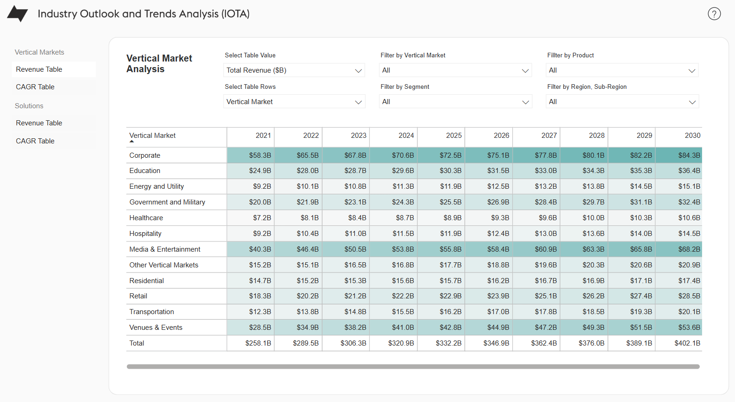
IOTA is available as self-service or custom.
IOTA sizes and forecasts the entire Pro AV market (2025-2030) across all regions, verticals, solutions, and product segments.
IOTA Self-Service
IOTA Custom Analytics
Subscribe to the annual forecast and receive access to our filterable dashboard, in depth analysis documents, and PowerPoint summary..
Anchored in IOTA, AVIXA market analysis will apply the full scope of available research to develop custom TAM/SAM/SOM for your strategic requirements.
SAM Example:
Drilling into Manufacturing SAM Segments
Traditional AV
Event Tech
2024 Raw Rev
Channel MU
2023 Growth
2024 Growth
5-year CAGR
$47.5 Billion
19% Margin
11.0%
8.5%
6.3%
$48.1 Billion
19% Margin
1.6%
3.2%
3.11%

Slide 7




AVIXA’s portfolio covers all participants.
Distributor
Reseller/Integrator
Manufacturer
End User
Manufacturer
Product volume, price & growth
Projects & solution trends
Projects & solution trends
Business/organization needs
Manufacturers require TAM data to benchmark performance with indication of areas of growth/ decline.
Distributors look at how products are bundled and who the customers are, also with an eye on TAM.
Integrators need to understand what specific end-users need and want, with focus on solutions and mix.
End user are the source of demand and want to understand options.
What macro trends will affect industry growth and how will they impact solutions and spaces?
MACRO ECONOMIC TREND ANALYSIS (META)
What solutions (products & services) and spaces do end users plan to invest in in the next quarter:
MARKET OPPORTUNITY ANALYSIS REPORT (MOAR) & Channel Index
How will economic, technology, industry & solution trends affect products now and in five years:
INDUSTRY OUTLOOK AND TRENDS ANALYSIS (IOTA) & Channel Survey

Slide 8
Table of Contents
What you’ll find in this year’s version of IOTA.
Economic Outlook and Implications…….9
  The macro-economic conditions set the overall context for the pro AV industry. We explore those conditions in general in this next section, with a brief look at GDP and other factors playing into the revenue forecasts.
Global Growth and Trends…………………20
  In this section, we explore the primary trends driving the Pro AV industry, provide a quick overview of the top-level forecasts, and review some of the differences by region.
Vertical Markets………………………………...28
  Vertical markets are where the ultimate application of pro AV solutions happen. Knowing which of these verticals is poised for greater growth then helps the channel prepare and plan accordingly. This next section reveals just that.
IV. Solution Bundles………………………36
  The solutions are the applications themselves. They represent the bundling of products and services into complete packages, scoped to solve specific needs within the markets.
V. Product Trends………………….…….43
  Having explored the larger market conditions, we now turn our attention to the products and services acting as the fundamental ingredients of the solutions. The distribution tiering data is also here.
VI. Questions & Resources……….….50
VII. Appendix: Definitions………….…51

Slide 9
Section I.
Economic Outlook and Growth Implications
A look at macroeconomic factors and how they set the stage for growth or decline globally.

Slide 10
We are settling into long-term trends
Fluctuations from COVID and its recovery are behind us, but waves persist.
You Are Here
Notes:
I think investors tend to like being farther to the left on this, putting money up in the disruption phase. Some may like to be more to the right. I would maybe note that for things like conf & collab, we’re probably still a fair bit to the left. Other sectors like, say, hospitality, I would say we’re more to the right. However, I would also emphasize here that as a tech sector, our baseline always involves a meaningful amount of disruption. So while we’re settling into long-term norms, that doesn’t mean an end to dynamism and innovation!

Slide 11
Global GDP Outlook : Uncertainty
Worldwide GDP Growth CAGR 2.1% for 2025-2030
Source: International Monetary Fund (IMF)

Slide 12
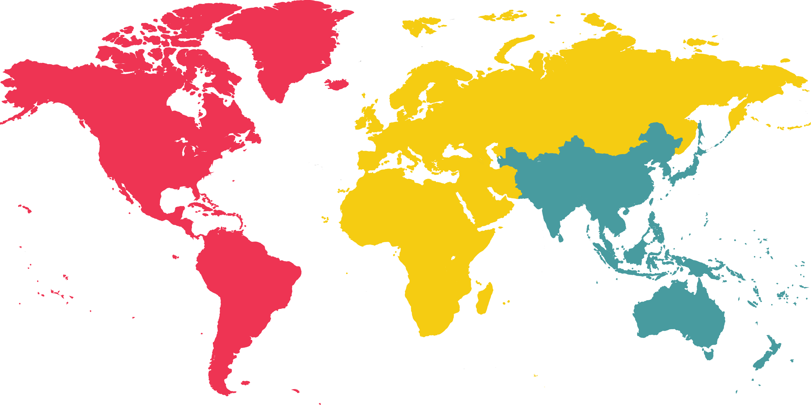
Growth engines are shifting.
World real GDP growth projections: February 2025 economic outlook - 2.7% 2024, 2.6% 2025, 2.6% 2026.
Western Europe
Canada
2024: 0.8%
2025: 0.9%
2026: 1.3%
Eastern Europe & Central Asia
2024: 1.3%
2025: 1.5%
2026: 1.7%
2024: 4.4%
2025: 3.1%
2026: 3.2%
China
USA
2024: 5.0%
2025: 4.2%
2026: 4.1%
2024: 2.8%
2025: 2.3%
2026: 2.0%
Latin America & Caribbean
APAC (Total, incl. Mainland China and India)
2024: 2.0%
2025: 2.1%
2026: 2.5%
2024: 4.1%
2025: 3.8%
2026: 3.8%
Middle East & Northern Africa
India
2024: 1.0%
2025: 3.3%
2026: 3.4%
2024: 6.4%
2025: 6.4%
2026: 6.2%
Source: Financial market reports.

Slide 13
Pro AV exceeds GDP Growth
Over the next 5 years, Pro AV growth will be well ahead of GDP.
Like other tech sectors, Pro AV is becoming a larger portion of GDP.
Why? Tech implementation is a core engine of growth for many markets.
Technology utilization serves as a differentiator and a statement of brand.
Unlike IT, pro AV is as much art as science, translating into margin.
Source: AVIXA 2025 IOTA forecast for Pro AV revenues and financial market reports.
Notes:
I would just note that our pro AV is nominal and GDP is real. If you convert GDP to nominal, that could close or overwhelm the gap. However, if you converted pro AV to real, I think the gap would stay.
Actually, another note: The GDP vs AV gap is bigger in Europe, where GDP growth is pretty anemic. The global GDP number looks better in part thanks to countries like India that are seeing big gains. So AV is relatively stronger in Europe. Also, European inflation is lower, so that mitigates the “real vs nominal” concern.

Slide 14
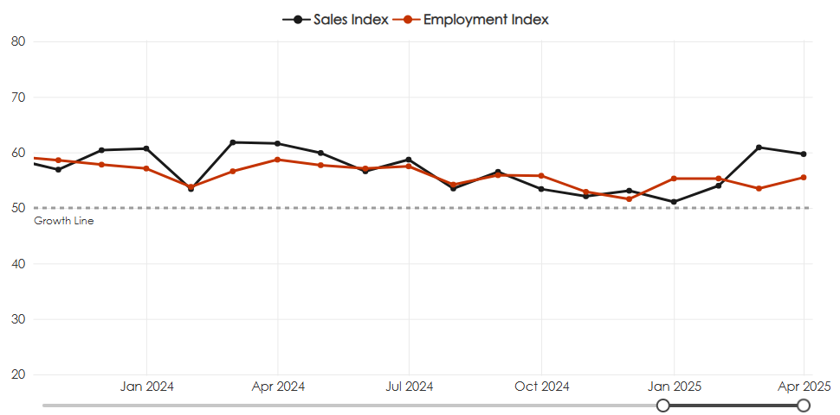
AVIXA’s Index shows slow and steady growth.
Both are diffusion indices:
Scores are the percentage of firms reporting a significant increase, plus half the percentage of firms reporting no change.
Source: AVIXA Monthly Pro AV Business Index.

Slide 15
New headwinds are emerging.
Supply constraints have given way to tariffs and political concerns.

Slide 16


Offices and experiences are still key drivers.
The bulk of the post-COVID recovery is over, which turns attention to the new norms.
Hybrid offices are the norm.
The experience economy is back.
Office spaces were a source of considerable fear for pro AV. It’s our biggest vertical market, and it was threatened by the possibility of full remote. But that fear can be put to rest. Now, it’s all about serving the hybrid future. That said, in firms rush to the opportunity, the segment is risking over-crowding amid price declines, leading to commoditization.
In the 2010s, the rise of the experience economy drove major pro AV revenue. The pandemic halted that trend completely—but now it’s back. Live Events is growing steadily, but other solutions including Media/Entertainment, Digital Signage, and Security/Surveillance/Life Safety also gain. Crucially, this a long-term trend that will drive revenue gains throughout the forecast period.

Slide 17
Majority of providers expect tariff impacts.
Over the next year, does your company expect to be impacted by new tariffs (either implemented by the US or in retaliation from other countries)
How do you expect these tariffs to impact your organization over the next year?
Source: AVIXA February Index Survey – 124 North American Pro AV Providers.

Slide 18
Short term: What’s your response?
Two reactions emerging: New cost of doing business vs. Play for competitive advantage.
Crestron Announces 5% Tariff Surcharge Effective May 1, 2025.
URC said it will not raise any prices and will absorb the current tariffs. The company has historically raised prices (10%) only once in 12 years — during the shortage of raw materials following the COVID pandemic.
Schneider Electric Announces Price Increases, Effective May 1, 2025 - (8-13%).
Kramer announced it will be adding a 15% tariff surcharge to all product lines sold in the U.S., effective May 9, 2025. Then suspended it as of July, but still increased prices due to inflation and overhead cost.
Symetrix said it not pass on any price increases, tariffs, duties or other costs through the end of May 2025.
Atlona Keeps Q2 Prices Steady Amid Tariff Uncertainty.
Netgear said when products are entirely sourced and produced in a country with a tariff, the price will increase by that percentage. Netgear said it will diversify its supply chain to limit the impact.
Stewart Filmscreen, announced that all of its products are manufactured in the United States and therefore exempt from the new tariffs.
Source: Company public documents, announcements.

Slide 19
The AV channel is optimistic.
More than 80% of channel partners expect growth each year, 2025 is no exception.
Growth of more than 10%
Other Findings:
Revenue shifting away from corporate, towards a mix of other buyer segments.
Collaboration similarly declined as revenue diversified towards other solutions.
AI is now 3rd in most demanded skills for the year.
However, AVoIP is the more impactful technology overall.
Growth of more than 10%
Growth of 6-10%
Growth of 1-5%
No change
Declines
Source: 2025 Channel Survey.

Slide 20
The pro AV labor market is tight.
Worker demand continues to outpace supply, keeping hiring difficult.
High raises show the continued labor market tightness
Conditions have remained elevated since 2022
Cumulative wage increase is an average of 25-30% since Pre-pandemic.

Slide 21
Section II.
Global Growth and Trends
The new era of the Pro AV market features significant technology shifts amid gradual overall growth.

Slide 22




Transformational technologies.
As growth normalizes, tech shifts abound.
AVoIP
Artificial Intelligence
Market drivers:
Operational efficiency
Cost reduction
Immersive experience
By transmitting audio-visual data over a network, AV over IP allows for scalable and flexible distributions, continuing to i enhance Command & Control, Digital Signage, and Content Production through improved network efficiency.
AI is slowly reshaping ProAV by bringing smart automation to Security/ Surveillance/ Life Safety, introducing adaptive interfaces to Command & Control systems, and improving the experiences delivered by Conferencing and Collaboration solutions.
Software & Cloud Migration
Extended Reality
The shift to software and cloud-based solutions streamlines most solutions, providing flexibility, scalability, and potential cost savings. Conferencing, collaboration, and Learning environments are experiencing the most impact .
Extended Reality (XR) technologies, are set to impact sectors beyond Learning and Entertainment. XR applications also extend to fields like manufacturing, retail, and healthcare, where simulation and visualization use cases drive XR demand.

Slide 23
The industry will grow - but more slowly.
New headwinds are emerging in the form of tariffs, lowering outlook.
Pro AV market growth was weaker than expected causing a reduction in total market size from $325 billion in 2024 to $321 billion.
CAGR from 2025 to 2030 is forecast at 3.9%, a reduction from 5.35% in the previous forecast.
Tariffs are expected to dampen growth in the revised forecast.
Pro AV is in transition, away from pandemic recovery to new engines of growth, driven by experiences and technology transformation.
2030
$402
2025
$332
BILLION
2024
BILLION
$321
BILLION
Source: AVIXA 2025 IOTA forecast for Pro AV revenues.

Slide 24
Recovery surge gives way to slower growth.
Post pandemic spending growth will be slower than expected reflecting overall deceleration.
Global Pro AV revenue market size and forecast
(Billions USD)
Amid geopolitical and economic uncertainty, the Pro AV market is going through post-pandemic normalization whole also seeing spending constraints in Education and Government.
Technology transitions are also underway with uncertain outcomes for the total market. The transition to software and cloud in some use cases generally lowers hardware demand, while boosting standalone software.
While artificial intelligence is becoming pervasive, its integration into various solutions may provide incremental revenue, but no “big bang” market growth moment.
Overall, the market is still driven by experiences in the hybrid office and in performance and entertainment, but the commoditization of Conferencing and Collaboration and the resumption of Live Events to pre-pandemic replacement cycles is also slowing growth.
+9.7% +12.2% +5.8% +4.8% +3.5%
Source: AVIXA 2025 IOTA forecast for Pro AV revenues.

Slide 25
Delayed spending yields slower regional growth.
Economic policies affect each region differently, creating new challenges & opportunities.
Americas ($B) APAC ($B) EMEA ($B)
+4.9% +4.7% +2.8% +6% +4.9% +4.3% +6.8% +4.7% +3.5%
2022 2023 2024 2025
2022 2023 2024 2025
2022 2023 2024 2025
Source: AVIXA 2025 IOTA forecast for Pro AV revenues.

Slide 26





APAC remains growth driver.
A better trade environment and a mix of solutions provide Pro AV opportunities.
APAC slows but still fastest growth.
Corporate & Entertainment lead.
Featuring GDP growth of 6.5% (India) and 4.6% (China) and better than 4% Pro AV market growth, the APAC region remains the major engine for the industry. Lessening of trade tensions between the US and China is a significant positive trend for the region.
Based on volume, Corporate, Media & Entertainment, and Venues & Events make up 49% of the region’s Pro AV revenue, but Energy & Utilities are growing fastest due to government investment at 5.2% CAGR (2025-2030).
Broadcast AV & Control show growth.
Software & Services momentum.
Broadcast AV and Command and Control, with CAGRs of 4.8% (2025-2030) are the best long term growth areas, while Security, Surveillance & Life Safety show peak growth 2024 to 2025 of 8%.
While Content Management Hardware slows to 2.4% CAGR, the trend toward Software and Services continues with growth rates of more than 7% CAGR (2025-2030).

Slide 27





Latin America growing faster than US.
Conferencing and Collaboration, Media & Events, and Security drive growth.
US slows; Latin America grows.
Corporate, Events & Government lead.
Economic uncertainty in the United States is a headwind in North America’s growth with a CAGR of 3.6%, below the overall market. Latin America by contrast is showing APAC-like growth of 4.3% CAGR, suggesting opportunities in the region.
At $27 Billion, Corporate remains the key market, even with a growth rate of 2.2% for 2024-2025. Media and Entertainment and Venues & Events combine for $35.2 Billion in 2025. But Government & Military boast the highest CAGR at 5.1% for 2025-2030.
Collaboration largest, Security growing.
Software, Video & Capture increase.
Security, Surveillance, and Life Safety is set to grow at better than 7% year-to-year and across the forecast, while Conferencing & Collaboration remains the largest opportunity.
At 8.3% CAGR Standalone Software migration is still the major long term growth driver in the Americas. Capture and Production equipment at 5.1% ad Video Displays at 5.8% CAGR are the next growth opportunities.

Slide 28





MEA driving regional growth.
Scale and consistent opportunities exist across many solution areas.
MEA outpaces Europe in investment.
Corporate, Media & Events scale & grow.
The pattern in EMEA contrasts Europe which in aggregate has a 3.4% CAGR, with the Middle East and Africa, growing revenue at a 5.7% CAGR for 2025-2030. Economic headwinds continue to impact Europe, while MEA features GCC investments and other developing markets.
The EMEA Corporate market is both large at $20 Billion and growing (3% CAGR), followed by Media & Entertainment at $15.9 Billion and 3.7% CAGR. Also strong is Venues & Events at $11.9 Billion and growing at 3.7% CAGR 2025-2030.
EMEA driven by many large markets.
Software & Services fastest growth.
Multiple opportunities: Conferencing, Broadcast AV, Learning, Live Events, Security, and Digital Signage are all more than $10 Billion markets in EMEA, with growth rates ranging from 2% CAGR (Learning) to 7.5% CAGR (Security) for 2025-2030.
Standalone Software, at $1.6 billion, is nevertheless the fastest growing product area with 7.4% CAGR. Services at $19.6 Billion is also growing at a strong pace (5.8% CAGR).

Slide 29
Section III.
Vertical Markets
From the largest to the fastest growing, key verticals provide new market opportunities, in the transforming Pro AV world.

Slide 30
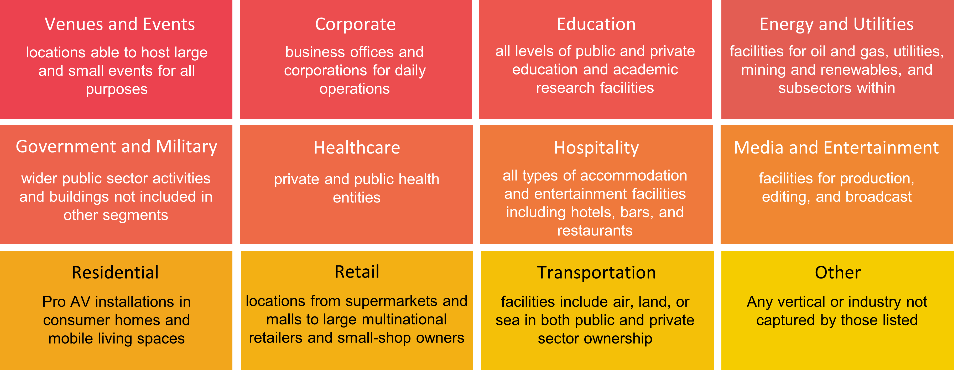
The 12 verticals covered by IOTA.
Each of these markets contribute to the growth in pro AV in their own way.

Slide 31
Buyer profiles are shifting.
Recession resistant markets, like Government & Energy are growing the fastest.
2025 Revenue
CAGR (‘25-’30)
$72.5B
$55.8B
$42.8B
$30.3B
$25.5B
$22.9B
3.1%
4.1%
4.6%
3.7%
4.9%
4.5%
Corporate
Media &
Entertainment
Venues &
Events
Education
Government &
Military
Retail
$11.9B
$11.9B
$8.9B
$17.7B
$16.2B
$15.7B
3.4%
4.0%
4.9%
3.4%
4.4%
2.0%
Others
Transportation
Residential
Hospitality
Energy &
Utility
Healthcare
Source: AVIXA 2025 IOTA forecast for pro AV revenues.

Slide 32
Slower progress yields $84B Corporate market in 2030.
Media & Events remain strong, Transportation and Energy segments continue to grow.
Prior forecasts pegged the Corporate market as the first segment to achieve $90B in 2029. But the impact of economic and other dynamics on Pro AV have set growth back. Nevertheless, the market is still dominant, fueled by Conferencing and Collaboration for hybrid offices, as well as expanding Content Capture and Production for Broadcast AV, and Security, Surveillance and Safety.
Buyer profiles are also shifting with higher growth rates coming from Media & Entertainment and Venues & Events.
Reductions in government spending for Education and lower enrollments in higher education are causing slower growth from the segment.
Energy & Utilities and Transportation have increased in scale, surpassing Hospitality and Residential, respectively. Utility control rooms and Transportation hub overhauls along with digital signage and security and surveillance are driving AV investment.
Corporate
Media & Entertainment
Venues & Events
Education
Government & Military
Retail
Others
Transportation
Residential
Energy & Utilities
Hospitality
2025
2030
Healthcare
Source: AVIXA 2025 IOTA forecast for Pro AV revenues.

Slide 33
Half of leading verticals still hardware & services.
Video Displays growing in share of Corporate for Conferencing & Collaboration and Digital Signage.
Corporate
Media & Entertainment
Venues & Events
2025 Market Size: $72.5B
2025 Market Size: $55.8B
2025 Market Size: $42.8B
Overall, except for Video Displays expanding in the corporate market, the shares of product types in each vertical remained consistent for 2024 and 2025.
Source: AVIXA 2025 IOTA forecast for Pro AV revenues.

Slide 34
Control & Collaboration expanding beyond Corporate.
As the Corporate market becomes crowded, Government, Healthcare & Education offer new opportunities across Services, Content Management, and Collaboration.
Government & Military
Healthcare
Education
2025 Market Size: $25.5B
2025 Market Size: $8.9B
2025 Market Size: $30.3B
Capture and Production also continues to show up in these verticals, though with smaller share in Healthcare and Education as budgets tighten. Managed Services may be a good cost saving opportunity for budget constrained segments, with low Pro AV staff expertise, such as smaller medical facilities and Community College and K-12 school systems.
Source: AVIXA 2025 IOTA forecast for Pro AV revenues.

Slide 35
Spending shifts show less video in Hospitality & Retail.
Transportation consistent in most segments, except for growing Capture & Production spend.
Hospitality
Retail
Transportation
2025 Market Size: $11.9B
2025 Market Size: $22.9B
2025 Market Size: $16.2B
Three very different verticals all rely on Services and Content Management Hardware but use cases and Pro AV maturity differ greatly. For example, Retail has long been deploying Digital Signage and now appears to be more focused on Audio and Content Management Hardware, while Hospitality is still expanding in terms of basic Pro AV adoption.
Source: AVIXA 2025 IOTA forecast for Pro AV revenues.

Slide 36
Utilities add hardware while Residential features Audio.
With investments in alternative energy, expansion of facilities is driving more utility Pro AV support.
Energy & Utilities
Residential
2025 Market Size: $11.9B
2025 Market Size: $15.7B
The Residential segment represents the overlap of Pro AV equipment and Services in home and mobile environments, including home offices, security and media and entertainment products and services.
Source: AVIXA 2025 IOTA forecast for Pro AV revenues.

Slide 37
Section IV.
Solution Bundles
The solution perspective replicates the way many end user organizations view the market.

Slide 38
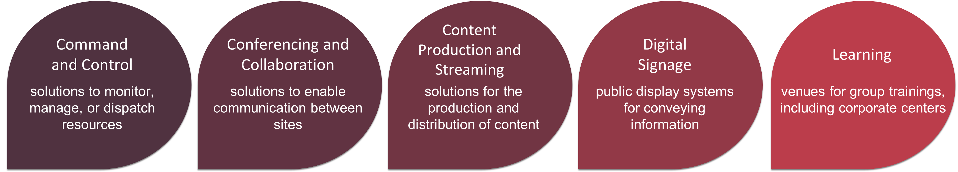
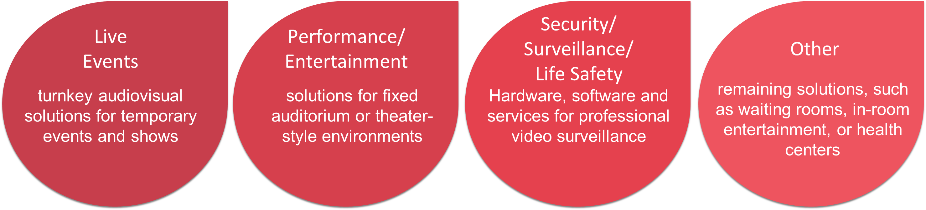
IOTA Pro AV solution types.
Each solution represents a specific bundling of products and services to solve business needs.
Broadcast AV
solutions for the production and distribution of content

Slide 39
Broadcast AV surpasses Digital Signage.
While Conferencing & Collaboration still leads, momentum for the overlap of Pro AV into entertainment and other content creation and delivery use cases is driving growth.
2025 Revenue
CAGR (‘25-’30)
$60.9B
$44.2B
$42B
$41.6B
3.0%
3.7%
3.6%
2.4%
Conferencing &
Collaboration
Digital Signage
Learning
Broadcast AV
$13.7B
$38.4B
$36.9B
$36B
$18.5B
$16.8B
6.5%
3.9%
4.6%
3.6%
4.5%
3.9%
Security, Surveillance
& Life Safety
Performance & Entertainment
Live Events
Command
& Control
Others
Source: AVIXA 2025 IOTA forecast for pro AV revenues.

Slide 40
Learning scales back, Broadcast AV & Security move up.
Solutions are diffused in 2025, with Conferencing and Collaboration comprising 18% of the market, Broadcast AV, Digital Signage, and Learning at 13%, and Security at 12%.
Conferencing and Collaboration
Redefined offices, conference rooms, and collaborative spaces will continue to be the largest industry driver as the market remakes the commercial space.
More content from more sources will be the norm as Broadcast AV tools become ubiquitous.
Digital signage will take its place as a must-have vehicle for information, entertainment, and advertising.
Performance and Entertainment and Live Events will continue to expand but at a slower pace than in previous years.
Broadcast AV
Digital Signage
Learning
Security/Surveillance/Life Safety
Performance/ Entertainment
Live Events
Command and Control
Others
2025
2030
Source: AVIXA 2025 IOTA forecast for Pro AV revenues.

Slide 41
Cloud & other services are a mainstay of Conferencing.
Capture and Production Equipment, Video and Content Management Hardware round out solutions.
Broadcast AV
Conferencing & Collaboration
Learning
2025 Market Size: $44.2B
2025 Market Size: $60.9B
2025 Market Size: $41.6B
The shares of product types in each vertical remained consistent for 2024 and 2025.
Source: AVIXA 2025 IOTA forecast for Pro AV revenues.

Slide 42
Content Hardware is key in Experience Solutions.
Live Events lean into Services and Audio, while Environmental leads Performance segment.
Live Events
Performance & Entertainment
Digital Signage
2025 Market Size: $36B
2025 Market Size: $36.9B
2025 Market Size: $42B
Digital Signage remains consistent driving Video Displays, Content Management Hardware, Services, and Software.
Source: AVIXA 2025 IOTA forecast for Pro AV revenues.

Slide 43
Controls driven by Security and Hardware.
Security’s high growth rate drives Controls, Hardware, Cameras, and Services.
Security, Surveillance and Life Safety
Command and Control
2025 Market Size: $38.4B
2025 Market Size: $18.5B
Command and Control is still hardware-oriented but IP-based solutions are slowing reducing the number of units needed per site.
Source: AVIXA 2025 IOTA forecast for Pro AV revenues.

Slide 44
Section V.
Product Trends
Products and Services trends, as well as Distribution Tiers show the underlying revenue drivers for Pro AV solutions.

Slide 45
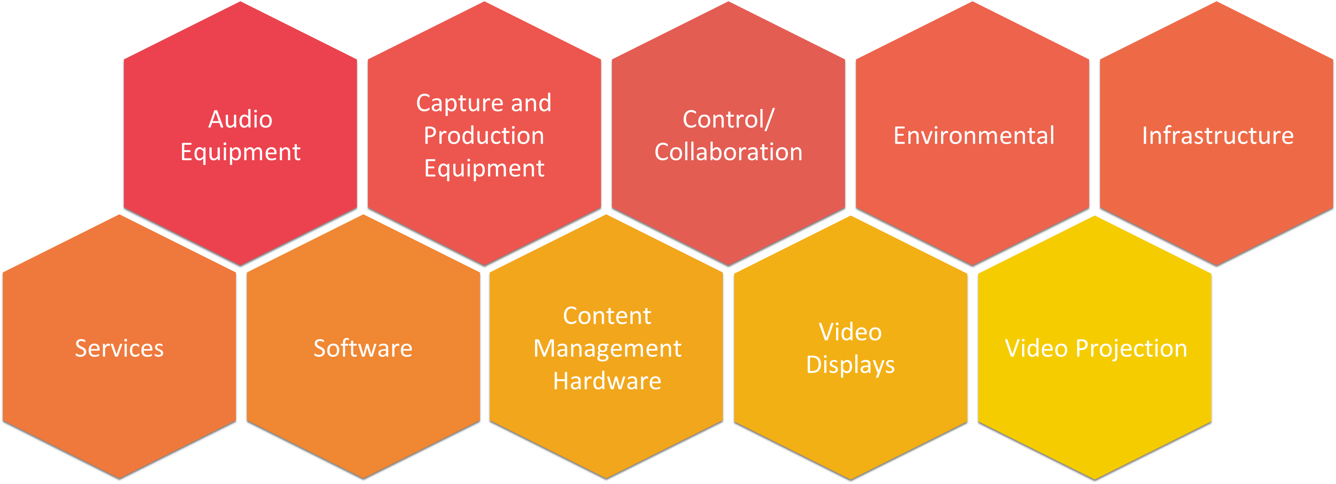
IOTA forecasts 35 products across 10 segments.
Each product represents a specific offering as a building block for solution capabilities.

Slide 46
All segments slowed but Services & Displays remain high-scale, above average growth.​
Content Management Hardware is slowing the most as Cloud Services and Software evolve.
2025 Revenue
CAGR (‘25-’30)
$97.5B
$76.6B
$33.4B
$32.7B
2.1%
5.7%
5.5%
4.3%
Content
Management Hardware
Capture & Production Equipment
Services
Video Displays
$12.9B
7.8%
$20.3B
$18.9B
$16.8B
$14.2B
3.3%
4.5%
-1.3%
3.3%
5.0%
$6.8B
Audio Equipment
Control &
Collaboration
Video
Projection
Infrastructure
Environmental
Stand Alone Software

Slide 47
Hardware volume & Services remain primary.
Product sectors appear in three tiers: Content Hardware/Services; Video Displays/Capture; and everything else.
Content Management Hardware
Led by Media Servers, Content Management Hardware will see below average growth at scale. The market is moving video workflows to cloud-based functionality, but there’s still strong demand for on-premise hardware.
The demand for Services continues to expand, encompassing integration, installation and cloud, as well as a healthy managed services and maintenance market, growing at 10% year over year.
With the dynamics of market saturation in LED displays and new use cases in transportation and public spaces, Video Displays are likely to hold position as the third largest product segment.
Capture & Production Equipment is expanding to encompass virtual production and new use cases in corporate, suggesting a solid trajectory.
Control & Collaboration and Audio Equipment continue steady growth as new verticals and use cases emerge.
Services
Video Displays
Capture & Production Equipment
Audio Equipment
Control/ Collaboration
Video Projection
Infrastructure
Environmental
Standalone Software
2025
2030
Source: AVIXA 2025 IOTA forecast for Pro AV revenues.

Slide 48
Product share remains consistent across segments.
Media Servers, Cloud Services and Flat Panel Displays lead markets.
Content Management Hardware
Services
Video Displays
2025 Market Size: $97.5B
2025 Market Size: $76.6B
2025 Market Size: $33.4B
LED Displays, Storage, and Managed Services are growing.
Source: AVIXA 2025 IOTA forecast for Pro AV revenues.

Slide 49
Video drives Camera market, Audio is balanced.
Control Systems stable and growing, outdistancing Collaboration Systems.
Capture & Production Equipment
Audio Equipment
Control & Collaboration
2025 Market Size: $32.7B
2025 Market Size: $20.3B
2025 Market Size: $18.9B
Results are consistent with prior forecasts.
Source: AVIXA 2025 IOTA forecast for Pro AV revenues.

Slide 50
Networking gear leads infrastructure, growing with AVoIP.
Video Projection still strong in pockets but overall facing declining volume.
Infrastructure
Video Projection
2025 Market Size: $14.2B
2025 Market Size: $16.8B
Video Projection deceleration accelerated in recent years.
Source: AVIXA 2025 IOTA forecast for Pro AV revenues.

Slide 51
Section VI.
Questions about the content?
Looking for access to the data?
Needing further analysis of core segments?
Interested in subscribing to the full library of AVIXA reports?
Please email us at marketresearch@avixa.org

Slide 52
Section VII.
Appendix: Definitions
The following slides provide the definitions of all the geographic, solutions, product and services, and vertical market segments mentioned throughout this report and available within the IOTA data.

Slide 53
Product Segment Definitions
Segment | Product/Services | Detailed Descriptions
Audio Equipment | Audioconferencing Systems (Hardware/Software) | Audioconferencing systems includes speaker phones, conferencing systems, echo cancellers, system interface units and expansion cards, room and group systems, portable systems, and integrated routing switches
 | Headphones, Headsets & Ear sets | Headphones, headsets, and ear sets used in entertainment, production, monitoring, enterprise telephony, and other applications. Includes call center headsets and in-ear monitors.
 | Microphones (Wired and Wireless) | Wired and wireless microphones used in production, entertainment, and professional applications. Includes handheld, tabletop, and chippable or worn form factors.
 | Speakers | Speakers utilized in professional, live entertainment, institutional, and production applications. Includes installed, portable, and amplified or PA. Inclusive of more recent speaker iterations with integrated technology (i.e., DSP).
 | Other Audio Equipment | Others audio equipment includes cinema audio processor, dedicated digital signal processors (DSPs), amplifiers, assistive listening/sound-field systems, audio mixers/consoles, audio production equipment hardware/software, audio receivers/tuners, intercoms/paging systems, language interpretation systems, telephony & VoIP systems and sound masking/speech privacy systems.
Capture and Production Equipment | Cameras (Conferencing/Surveillance) | Cameras for conference room and surveillance markets includes indoor and outdoor cameras such as PTZ, wide angle, dual-tracking, electronically tracking, dome, night vision, and omni-directional zoom, etc. This category also includes USB conference cameras. Residential market and products are not included here.
 | Cameras (Video Production/Recording) | Digital video cameras for broadcast, live events, cinema and television content production and recording including film cameras, digital cinematography, high-end camcorders, ENG news cameras, specialist miniature, and point-of-view cameras (including cameras with built-in robotics), super so-so systems, and system cameras including CCU and camera control. Prosumer camcorders are also included but not consumer grade.
 | Videoconferencing Systems (Hardware/Software) | Videoconferencing systems includes both hardware and integrated software for telepresence end points, desktop system end points, multipurpose room system end points, videophones, all infrastructure including multipoint control units, bridging devices required for video conferences between three or more end points, gatekeepers, gateways, firewalls, and scheduling and management software. This category does not include software-based endpoint solutions.
 | Other Capture & Production Equipment | Other capture and production equipment includes document cameras, scalers, switchers and video processors, as well as broadcast grade digital convertors and prosumer-grade equipment sold for professional usage. Residential products are not included here.

Slide 54
Product Segment Definitions (continued)
Segment | Product/Services | Detailed Descriptions
Control/ Collaboration | Collaboration Systems (Hardware/ Software) | Systems for in-person or online collaboration, including wireless presentation systems. Both hardware and software are included due to common bundling of both.
 | Control Systems | Control systems include keypads, control panels, touch panel controls, remote controls used in both AV applications and applied integrated systems for energy control, building management, and lighting control. Also includes integrated physical access control include keypads, serial controllers, IP-enabled controllers, and edge-based controllers. Controllers for both commercial and residential segments are included. Fire and intruder control panels are also included.
Environmental | Lighting Fixtures (including installed and portable) | Lighting fixture includes connected ballasts and wireless adapters, connected switches, environmental and light level sensors, occupancy sensors, keypads and HMI screens, and RF luminaires. Lighting fixtures at consumer residential homes are not included but smart home integrated fixtures such as connected LEDs are.
 | Other Environmental | Other environmental includes acoustic materials, kiosks, rigging and staging, and shades and drapes as well as networked and controlled motorized window dressings.
Infrastructure | Mounts, Stands & Lifts | Mounts, stands, and lifts includes mounts for flat-panel display and video projector, security and swivel mounts, brackets, display lifts, and projector lifts. Stationary and mobile vertical racks, cabinets, and kits are also included. Differentiated from furniture in that mounting systems are used to support equipment and provide functionality such as lifting, lowering, or simply locking equipment in place.
 | Other Infrastructure | All cable types, cable management systems, connectors and adapters, and cable assemblies used for pro AV and AV/IT installations. Fiber optic transmission equipment for audio, video, and data applications is included. Consoles and furniture, power distribution, supplies & cooling systems, and test, measurement and monitoring equipment.
 | Plates, Panels & Wall Boxes | Plates, panels, and wall boxes for various input and output connectors, converters for pro AV use and when integrated into overlapping applications such as smart home.
 | Signal Routing & Switching (Hardware/Software) | Signal routing and switching includes signal switchers, transmitters and matrix switchers (routers) that transmit and replicate control information and IP-based AV signals outside of specialist applications (such as broadcast).

Slide 55
Product Segment Definitions (continued)
Segment | Product/Services | Detailed Descriptions
Video Displays | Flat-Panel Displays, TVs, and Monitors | Flat-panel displays, TVs and monitors includes all direct-view flat-panel displays such as LCD, OLED, and PDP that are sold through professional distributors, system integrators, and pro AV dealers and are used for digital signage and professional applications. Interactive flat-panel displays with touch overlays sold for pro AV applications are also included in this category. Flat-panel TVs used for home cinema and home theaters requiring custom installation and design are included in this category. Monitors include medical, broadcast, and professional graphics specialty displays. These monitors include clinical review, diagnostic, surgical displays, Grade 1 master monitor, picture monitor, reference monitor, picture viewer, and wave viewer. Generic desktop computer monitors are excluded.
 | LED Video Displays | LED video displays use arrays of either SMD or lamp-based LEDs (light emitting diodes) to create tiles of direct-view displays that can then be configured to form a larger custom-sized display.
Video Projection | Projectors (DPL, LCOS, Laser, etc.) | Projectors (DPL, LCOS, laser) include both portable and installed digital video-capable projectors used for conference room, classrooms, large venues, rental staging, and cinema. Ultra-portable projector and personal pico-projectors are not included as these do not require installation. Front projectors used for home cinema and home theaters requiring custom installation and design are included in this category.
 | Projection Screens | Projection screens include motorized wall and ceiling screens, folding and staging screens, fixed wall screens, tripod and portable screens for AV, HDTV, multi-aspect ratio, video, widescreen, and letterbox format for front and rear-projection displays. Projector screens for home cinema and home theaters are included.
 | Projector Accessories (Bulbs, Lenses) | Projector accessories include bulbs, lenses, and 3D systems. Not included are editors, splicers, rewinders, and maintenance supplies. Projector accessories for commercial and CEDIA products are included.

Slide 56
Product Segment Definitions (continued)
Segment | Product/Services | Detailed Descriptions
Content Management Hardware | AV Servers | AV servers are purpose-built, pro AV hardware-specified equipment that is primarily used in the media and entertainment industry. AV integrator and resellers are selling more enterprise-used specialist servers in order to run the software that used to run on purpose-built pro AV devices.
 | I/O Cards | I/O cards include all other input-output cards that are sold separately and not integrated into or part of equipment mentioned previously, including for rack-based equipment and in desktop or laptop computers (e.g. Firewire, PCMCIA, USB).
 | Media Players | Media players include purpose-built hardware players for applications such as digital signage to play video content on screens. Media players run on a variety of operating systems including Windows, Linux, Android, and iOS and are capable of performing many functions and include features such as upscaling, streaming, interactive, live feeds, beacons, and geo-fencing.
 | Media Servers | A media server is a networked physical device that provides share computed functionality, typically containing a central processing unit (CPU), random access memory (RAM), storage, physical network interface, power supply, and management. It allows video and audio data to be ingested, analyzed, accessed, encoded, processed, and outputted automatically or manually from a central location, or to run special applications that allow the user to access the media from a remote location via the internet. The media server contains physical arrangements that allow for CPU, RAM, and physical network interfaces within the server enclosure blade, open compute, rack, and tower. It includes both pro-AV software, specified equipment, and generic IT enterprise-built equipment that are primarily used for AV.
 | Media Storage | Media storage is a networked physical device that stores, shares, and archives images, audio, and video data in any media content-related industry. It typically contains a basic central processing unit (CPU), a primary storage device, such as random access memory (RAM), and a secondary storage device, like a solid-state drive (SSD) or hybrid hard drive (HDD). Secondary storage can be removable, internal, or external. Media storage offers media data processing and storing functions automatically or manually from a central location or run special applications that allow the user to access the media from a remote location via the internet. It includes both purpose-built, pro-AV-specific configured equipment, and generic IT enterprise-built equipment that is primarily used for AV.

Slide 57
Product Segment Definitions (continued)
Segment | Product/Services | Detailed Descriptions
Services | AV Design | AV design services include all revenue generated by systems integrators, dealers, design-build contractors, distributors, and independent design consultants for system design or planning.
 | AV Installation/Integration | AV installation and integration services include all revenue generated in system build and installation, as well as specific revenue for system integration into existing workflows or technical plants such as integrating AV products into an existing IT networks.
 | Managed Services & Maintenance | Revenues from managed services in pro AV such as cloud services, and for maintenance contracts, extended warranties and life-cycle support, and embedded staff on the customer’s premises, as well as training revenues.
 | Cloud Services | Revenues from cloud services used for the management and distribution of AV content for collaboration or presentation purposes. This includes licensing of collaboration services like Zoom or Teams that flows through the pro AV channel but excludes strict data storage services used for system back-ups.
 | Rental & Staging | Rental and staging includes all service revenue associated with AV products and temporary provision for staged events. Does not include leasing or other long-term direct finance purchases as well as support service revenue.
Standalone Software | Standalone Software | Standalone software includes all software that is not integrated or packaged with other products for AV asset management, design, show control, collaboration, content creation, scheduling, content management, and room management for many solutions such as digital signage, collaboration, cinema, live events, and command and control. Video management software for surveillance and access control software are also included in this category.

Slide 58
Solutions Bundle Definitions
Solutions | Definitions
Command and Control | Command and control solutions include technology and services used in control rooms across various industries to monitor, manage, or dispatch required resources. Examples include operations center or room, dispatch center, emergency communications center, emergency operations center, network operations center, and/or communications center, among others.
Conferencing and Collaboration | Conferencing and Collaboration solution includes a combination hardware, software technologies and services that enable communication between two or more sites. These solutions may be sold in the form of bundles or separate components and often include a cloud-based aspect.
Broadcast AV | Solutions catering to the ‘audio/video capture’ and ‘audio/video production’ of content destined to be disseminated over video networks, theatre exhibition, or streaming services using a transactional, subscriber or ad funded business model. This includes hardware such as Cameras, encoders, video processors, scalers and switchers, managed services & maintenance and software.
Digital Signage | Digital signage solutions use display, media players, servers, software, and managed services to display content in out-of-home (OOH),and public environments, and by multiple individuals simultaneously to convey information, advertising, or other forms of messaging.
Learning | Classroom solutions include audio visual hardware and software products and services that assist teaching in K-12, higher secondary education facilities, and corporate learning.
Live Events | Live events includes hardware, software, and services to provide turnkey live event audio visual solutions for events and shows or temporary facilities.
Performance/Entertainment | Theatre solutions include permanent installations of audio and video equipment in both residential and commercial settings. Examples include cinema, home theatre, and theatre installations in museums, houses of worship, entertainment venues, and so on. Rental and staging equipment for temporary facilities are excluded from this category and covered under Live Events.
Security/Surveillance/Life Safety | Includes the following equipment types for professional video surveillance: analog security cameras, DVRs, NVRs, network security cameras, video encoders, video management software (VMS), CS-mount lenses, camera housings, CCTV, controllers and keyboards, and motorized camera positioning mounts.
Other Solutions | Specialty medical displays such as clinical review, diagnostic, surgical displays, and professional graphics displays. It also includes other solutions not captured above.

Slide 59
Vertical Market Definitions
Industry | Definitions
Corporate and Finance | The Corporate industry refers to all business and company pro AV use for daily operations either in offices or as part of the business operations of those corporations. Includes corporate conferencing facilities, but not specialist conference halls. It includes finance service centers and banks.
Education | Education includes all levels of education and academic research across the world both in public and private sectors.
Energy and Utilities | The energy and utilities vertical comprises oil and gas, utilities, mining, and renewables segments with most of their subsectors.
Government and Military | Government and military vertical includes the majority of wider public sector activities and buildings apart from those covered in other segments such as education, healthcare, and transportation. All armed forces-related activities are also included. State-owned public spaces are also included where they are not venues or event locations.
Healthcare | The healthcare vertical includes all locations where private and public health entities use any pro AV equipment.
Hospitality | The hospitality vertical includes all types of accommodation and entertainment facilities including hotels, bars, and restaurants.
Media and Entertainment | The media and entertainment vertical includes all production, editing, and broadcast pro-AV equipment and services across film, games, music, radio, and TV. Digital signage installations in the media and entertainment vertical are not included here.
Residential | The residential vertical includes all pro AV installations in homes and privately-owned locations, including high-end smart home and installed home theater.
Retail | The retail vertical includes all possible retail locations from supermarkets and malls to large multinational retailers and small-shop owners.
Transportation | The transportation vertical refers to all infrastructure, sites, and buildings related to public transportation systems by air, land, or sea in both public and private sector ownership. This includes airports, train stations, metro systems, and ports.
Venues and Events | This includes all locations able to host larger or smaller events for purposes such as athletic events, sports stadiums, museums, amusement parks, houses of worship, concerts, cinemas, or other entertainment venues and specialist conference halls.

Slide 60
Geographic Segments
Region | Sub-Region and Countries
Asia-Pacific | Australasia: Australia and Rest of Australasia (New Zealand, Papua New Guinea, and the islands of Micronesia and the South Pacific)
 | China: People’s Republic of China, Hong Kong and Taiwan
 | East Asia: Japan, South Korea, and the rest of Southeast Asia (Brunei, Cambodia, Indonesia, Laos, Malaysia, Myanmar, Philippines, Singapore, Thailand, and Vietnam)
 | Indian Subcontinent: India and the rest of the Indian subcontinent (Afghanistan, Bangladesh, Bhutan, India, Maldives, Nepal, Pakistan, and Sri Lanka)
Europe | Central Europe: Albania, Bosnia and Herzegovina, Bulgaria, Croatia, Cyprus, Czech Republic, Greece, Hungary, Kosovo, Macedonia, Montenegro, Poland, Romania, Serbia, Slovakia, Slovenia, and Turkey
 | Eastern Europe: Russia and the rest of Eastern Europe (Armenia, Azerbaijan, Belarus, Estonia, Georgia, Kazakhstan, Kyrgyzstan, Latvia, Lithuania, Moldova, Mongolia, Russia, Tajikistan, Turkmenistan, Ukraine, and Uzbekistan)
 | Scandinavia: Denmark, Finland, Greenland, Iceland, Norway, Sweden
 | DACH: Germany and the rest of DACH (Austria and Switzerland)
 | Western Europe: UK, France, Italy, Spain, Portugal, and the rest of Western Europe (Belgium, Ireland, Liechtenstein, Luxembourg, Malta, and the Netherlands)
Latin America | Central America and the Caribbean: Mexico and the rest of Central America and the Caribbean (Belize, Costa Rica, El Salvador, Guatemala, Honduras, Nicaragua, Panama, and the countries of the Caribbean)
 | South America: Brazil and the rest of South America (Argentina, Bolivia, Chile, Colombia, Ecuador, Falkland Islands, French Guiana, Guyana, Paraguay, Peru, Surinam, Uruguay, and Venezuela)
Middle East and Africa | Middle East and North Africa: Algeria, Bahrain, Egypt, Iran, Iraq, Israel, Jordan, Kuwait, Lebanon, Libya, Morocco, Oman, Palestine, Qatar, Saudi Arabia, Sudan, Syria, Tunisia, United Arab Emirates, and Yemen
 | Sub-Saharan Africa: Angola, Benin, Botswana, Burkina Faso, Burundi, Cameroon, Cape Verde, Central African Republic, Chad, Comoros, Democratic Republic of the Congo, Djibouti, Equatorial Guinea, Eritrea, Ethiopia, Gabon, Gambia, Ghana, Guinea, Guinea-Bissau, Ivory Coast, Kenya, Lesotho, Liberia, Madagascar, Malawi, Mali, Mauritania, Mauritius, Mozambique, Namibia, Niger, Nigeria, Republic of the Congo, Rwanda, Senegal, Seychelles, Sierra Leone, Somalia, South Africa, South Sudan, Sudan, Swaziland, São Tomé and Príncipe, Tanzania, Togo, Uganda, Zambia, and Zimbabwe
North America | Canada and the United States

