Slide 1


National Health Insurance affirmative
Resolved: The United States federal government should establish national health insurance in the United States.
A look at possible affirmative cases, provided by Rich Edwards, Baylor University

Slide 2
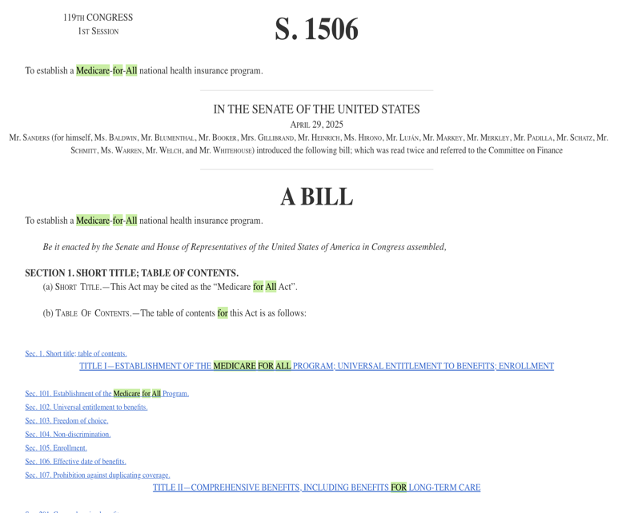
Medicare for all
Harm: Among developed nations, the U.S. spends the most on healthcare and yet is near the bottom in health outcomes.
Inherency: Too much health care spending is wasted in administrative costs associated with private health insurance companies.
Solvency: Medicare for All would save money because Medicare’s administrative expense is much less than for private health insurance.
https://www.congress.gov/bill/119th-congress/senate-bill/1506/text?s=2&r=2&hl=Medicare+for+all

Slide 3
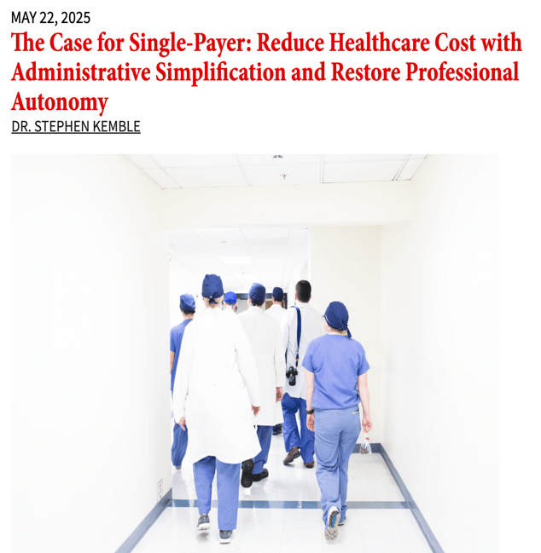
single-payer
Harm: When people become ill or unemployed, they lose their health insurance at the time they most need it.
Inherency: At present, health insurance is tied to employment, excluding the self-employed and those working for non-participating businesses
Solvency: Removing the burden of employee health insurance from private businesses and school districts promotes economic competitiveness and efficiency. Employees are able to move from job-to-job without concerns about losing their health insurance.
https://www.counterpunch.org/2025/05/22/365176/

Slide 4
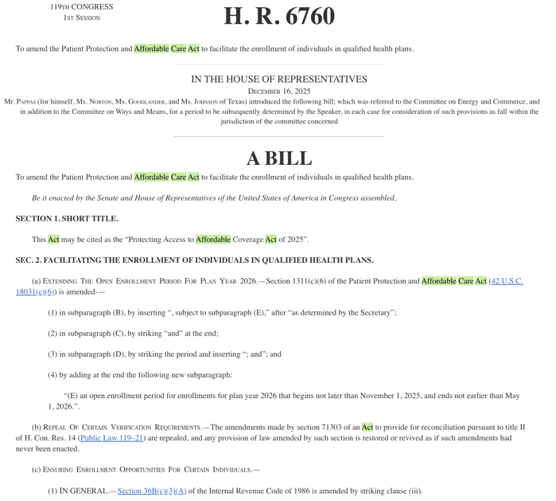
repairing the Affordable care Act
Harm: The ACA was designed to provide universal health insurance coverage, but millions remain uncovered. Without insurance, people delay essential healthcare, leading to disease and death.
Inherency: Current State refusal to expand Medicaid and congressional efforts to limit ACA subsidies have left many uncovered by health insurance
Solvency: Proper support for the ACA provides universal health insurance coverage, saving lives and preventing/curing disease.
https://www.congress.gov/bill/119th-congress/house-bill/6760/text?s=1&r=12&hl=affordable+care+act

Slide 5
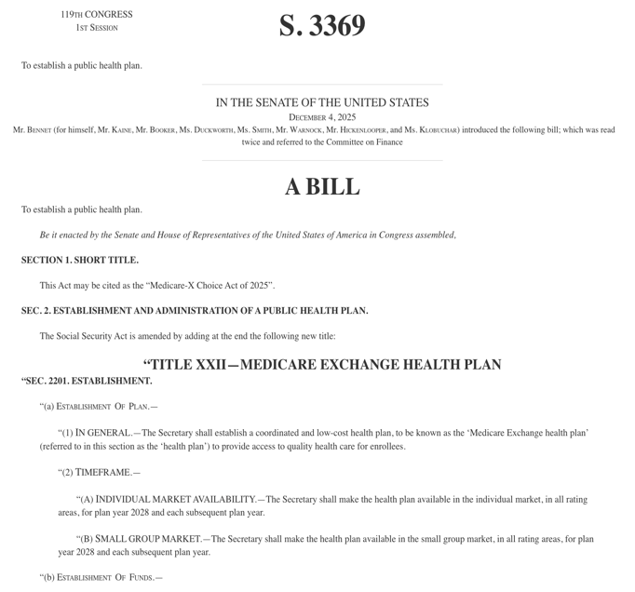
The Public Option
Harm: Many Americans are uncovered by health insurance because they have no option within their financial means. This results in avoidance of necessary preventive and curative healthcare, leading to increased disease and death.
Inherency: Concentration in the health insurance marketplace, together with hospital consolidation is driving up the cost of health insurance.
Solvency: The Medicare-X Choice Act will provide a reliable, accessible alternative to private insurance companies, which can help drive down premiums and increase plan availability in underserved or rural markets.
https://www.congress.gov/bill/119th-congress/senate-bill/3369/text

Slide 6
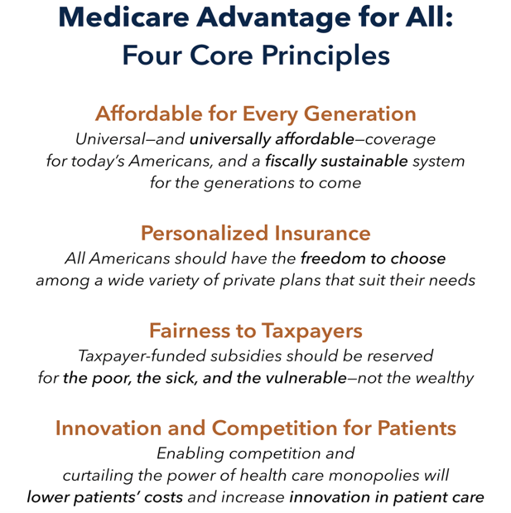
medicare advantage for all
Harm: Too many Americans are uncovered by health insurance and many health insurance plans fail to cover essential health services. In addition, healthcare costs are out-of-control, undermining the strength of the U.S. economy.
Inherency: The current patchwork system of health insurance leaves many Americans with no affordable coverage options.
Solvency: The adoption of Medicare Advantage for All would affordably provide health insurance to all Americans while also ensuring comprehensive coverage of healthcare services.
https://freopp.org/whitepapers/affordable-health-care-for-every-generation/

Slide 7
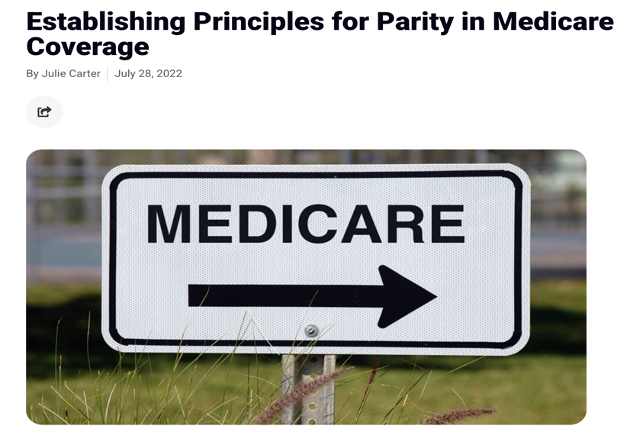
Mental health parity in Medicare
Harm: Elderly Americans have the same need for mental healthcare as younger Americans, but their Medicare coverage is inadequate.
Inherency: Mental health parity is required by law for private health insurers, but Medicare is not required to follow parity rules. Mental health coverage is denied after 190-days.
Solvency: Applying mental health parity requirements to Medicare coverage will best meet the needs of elderly Americans.
https://www.medicarerights.org/medicare-watch/2022/07/28/establishing-principles-for-parity-in-medicare-coverage

Slide 8
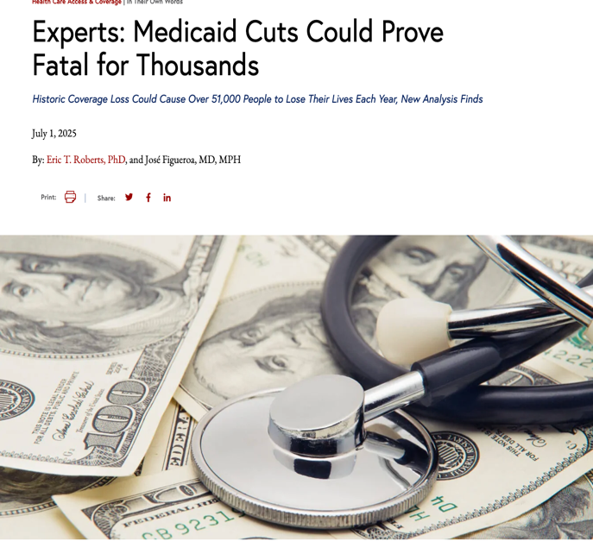
Restore the cuts to Medicaid
Harm: Losing access to Medicaid will prove fatal for thousands of Americans; for many others lost access means avoidance of essential preventive services. In addition, the rural hospitals and Community Health Centers that depend upon Medicaid are marginalized.
Inherency: The One Big Beautiful Bill Act (OBBBA) enacts the largest Medicaid cuts in U.S. history, slashing nearly $1 trillion over a decade and putting up to 10 million people at risk of losing coverage.
Solvency: Restoring Medicaid cuts will save lives and restore the viability of rural hospitals.
https://ldi.upenn.edu/our-work/research-updates/experts-medicaid-cuts-could-prove-fatal-for-thousands/

Slide 9
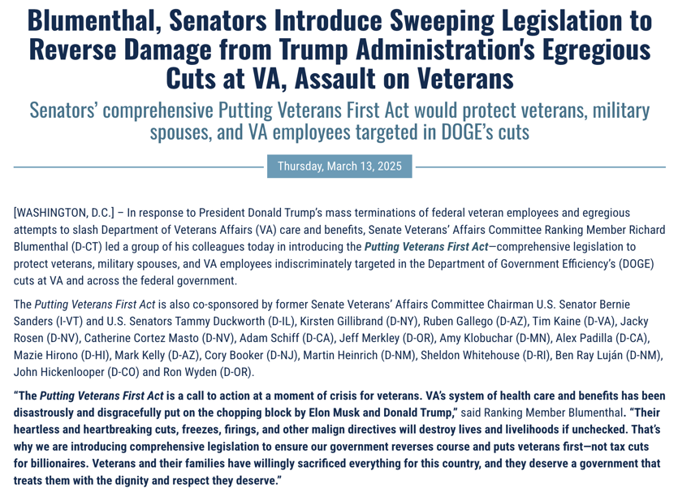
veterans health administration
Harm: America has made a promise to veterans to provide health coverage in exchange for their service. That promise is currently not being kept.
Inherency: DOGE cuts and changes in work rules have reduced essential medical staffing at the VA, negatively impacting health coverage for veterans.
Solvency: Investing The Putting Veterans First Act would restore the quality of VA healthcare by reversing the DOGE cuts.
https://www.veterans.senate.gov/2025/3/blumenthal-senators-introduce-sweeping-legislation-to-reverse-damage-from-trump-administration-s-egregious-cuts-at-va-assault-on-veterans

Slide 10
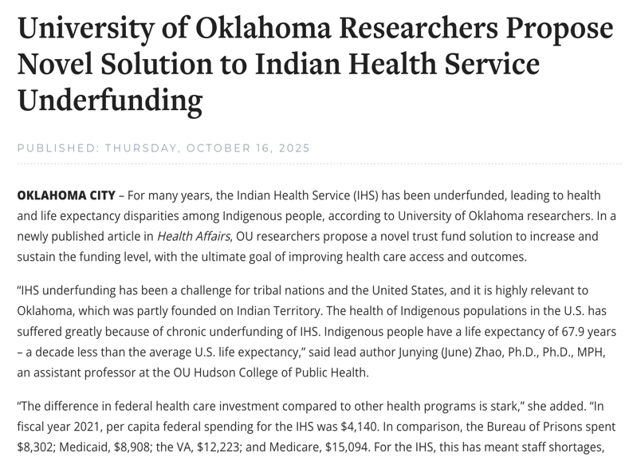
fully funding healthcare in indigenous communities
Harm: The U.S. currently fails to meet its treaty obligations to provide quality healthcare in indigenous communities. As a result, health outcomes in indigenous communities are poor.
Inherency: Funding for the Indian Health Service (IHS) is currently discretionary, resulting in appropriations that meet only a small part of what is needed.
Solvency: Establishing mandatory, entitlement-based funding will meet healthcare needs in indigenous communities.
https://inside.ouhsc.edu/news/article/university-of-oklahoma-researchers-propose-novel-solution-to-indian-health-service-underfunding

Slide 11

Singapore plan
Harm: Healthcare in America costs too much and delivers too little.
Inherency: The incentives in the current system are skewed by the lack of involvement of consumers who do not know prices for healthcare services.
Solvency: Flynn: “The benefits would be enormous. We would free up enough money each year to fix Social Security, balance the budget, and still have trillions left over to spend on other important priorities like education and national defense. The drastically lower healthcare costs would also slash production costs and make domestic manufacturers competitive on international markets again.” (p. 5)
Available at Amazon and other online booksellers

Slide 12
National Health insurance: Affirmative

