Slide 1


Arctic: Affirmative
Resolved: The United States federal government should significantly increase its exploration and/or development of the Arctic.
A look at possible affirmative cases, provided by Rich Edwards, Baylor University

Slide 2
increase domain awareness in the arctic
Harm: The United States lacks sufficient domain awareness in the Arctic, leaving critical gaps in its ability to monitor environmental changes, maritime activity, and potential military threats.
Inherency: Existing efforts are underfunded and poorly coordinated.
Solvency: Passage of the Watcher’s Act (H.R. 2000) will provide greater investment and integration to close monitoring gaps.

Slide 3
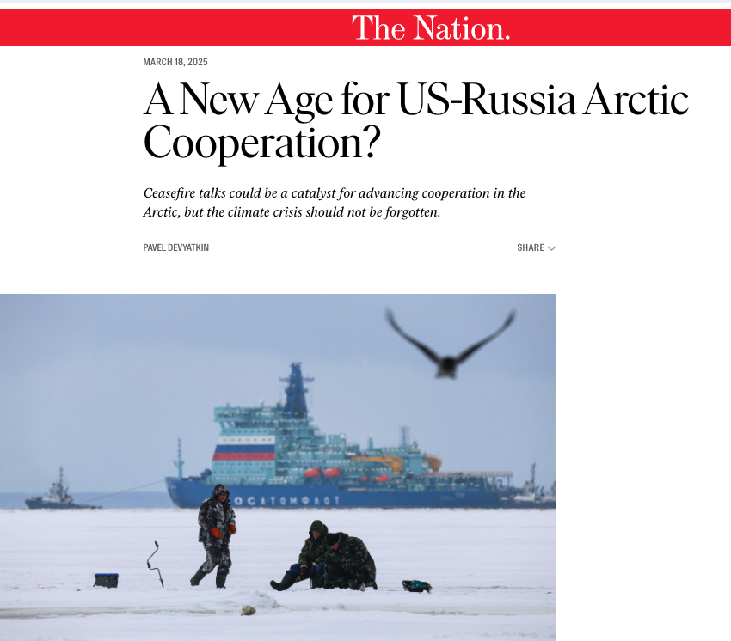
restore research cooperation with russia in the arctic
Harm: Arctic research is severely hindered without Russian participation, limiting global understanding of climate and environmental threats.
Inherency: U.S.–Russia scientific collaboration halted after the 2022 invasion of Ukraine.
Solvency: Restoring cooperation will enable shared data, improve climate models, and support peaceful engagement.
https://www.thenation.com/article/world/russia-putin-trump-climate-diplomacy-war/

Slide 4

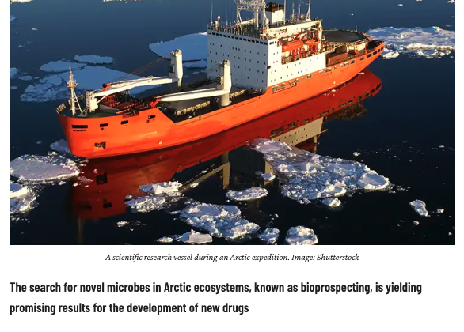
solving antimicrobial resistance with arctic resources
Harm: Antimicrobial resistance (AMR) is a growing global health crisis that renders existing antibiotics ineffective, with the World Health Organization warning that, if left unaddressed, AMR could cause 10 million deaths annually by 2050—surpassing cancer as a leading cause of death and threatening to collapse modern medical systems.
Inherency: Current research overlooks the Arctic’s untapped microbial resources.
Solvency: Arctic bioprospecting can uncover novel compounds to develop life-saving antibiotics.
https://geographical.co.uk/science-environment/bioprospecting-search-for-new-antibiotics-in-the-arctic

Slide 5
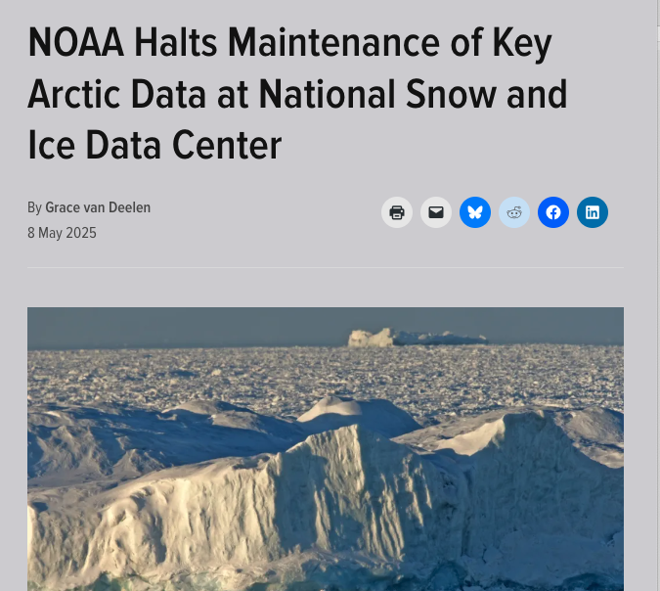
Climate Assessment: Restore funding to the NOAA
Harm: Critical Arctic climate and ecosystem data is being lost due to reduced NOAA research capacity. Databases that have been built over decades are at risk of being lost.
Inherency: The Trump administration’s funding cuts have significantly weakened NOAA’s ability to monitor and study the Arctic.
Solvency: Restoring federal funding enables NOAA to resume essential Arctic research, improving climate forecasting and environmental protection.
https://eos.org/research-and-developments/noaa-halts-maintenance-of-key-arctic-data-at-national-snow-and-ice-data-center

Slide 6
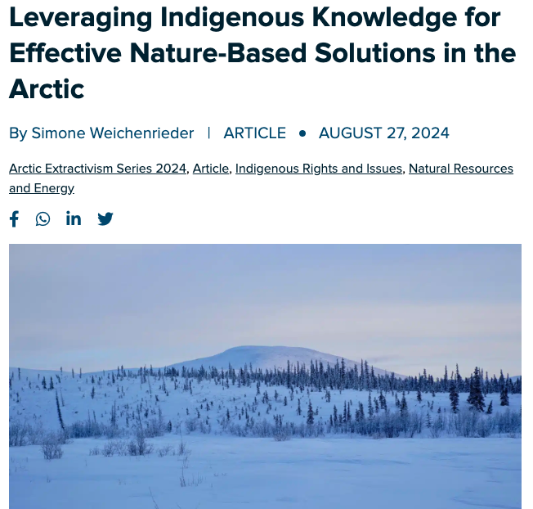
Indigenous studies: applying nature-based solutions in the arctic
Harm: The U.S. lacks effective protection of biodiversity in the Arctic because it overlooks the traditional ecological knowledge of Indigenous Peoples.
Inherency: Current federal research and climate initiatives do not prioritize or adequately include Indigenous perspectives or practices.
Solvency: Federally funded studies of Indigenous communities can discover nature-based solutions tailored to Arctic ecosystems.
https://www.thearcticinstitute.org/leveraging-indigenous-knowledge-effective-nature-based-solutions-arctic/

Slide 7
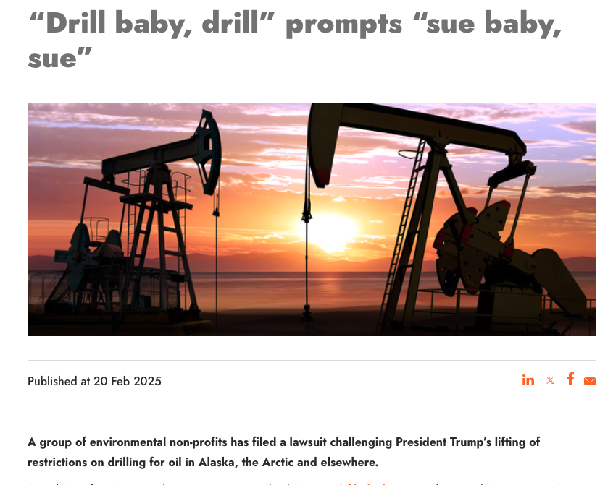
Oil & gas drilling in the arctic
Harm: The U.S. patent system should be improved by taking action against the patent trolls that currently undermine U.S. innovation and leadership in technology.
Inherency: The absence of congressional authorization and court challenges prevent full development of domestic Arctic oil and gas resources.
Solvency: Expanding Arctic drilling would boost energy independence, create jobs, and strengthen geopolitical leverage.
https://iclg.com/news/22298-drill-baby-drill-prompts-sue-baby-sue

Slide 8
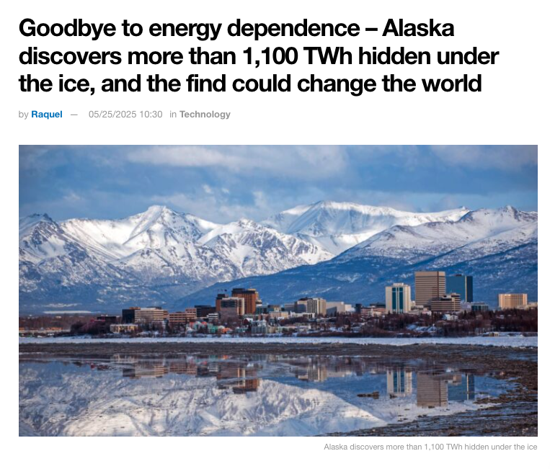
renewable energy promotion in the arctic
Harm: Arctic communities rely on expensive, polluting diesel power, harming health and the environment.
Inherency: Federal support for renewable energy in the Arctic is limited and inconsistent.
Solvency: Investing in Arctic renewable energy projects can provide clean, reliable power and reduce carbon emissions.
https://eladelantado.com/news/alaska-hydrokinetic-energy-ice-discovery/

Slide 9
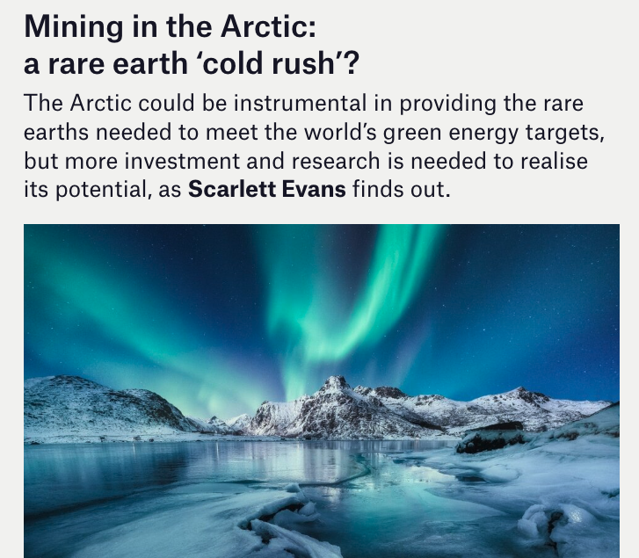
mineral resources from the arctic
Harm: U.S. industries depend on foreign rare earth supplies, especially from China, creating a critical vulnerability.
Inherency: Current U.S. mining efforts in the Arctic are minimal due to regulatory, logistical, and investment barriers.
Solvency: Expanding REE mining in the Arctic can reduce dependence on China and secure supply chains for advanced technologies.
https://mine.nridigital.com/mine_feb25/arctic-mining-rare-earths

Slide 10
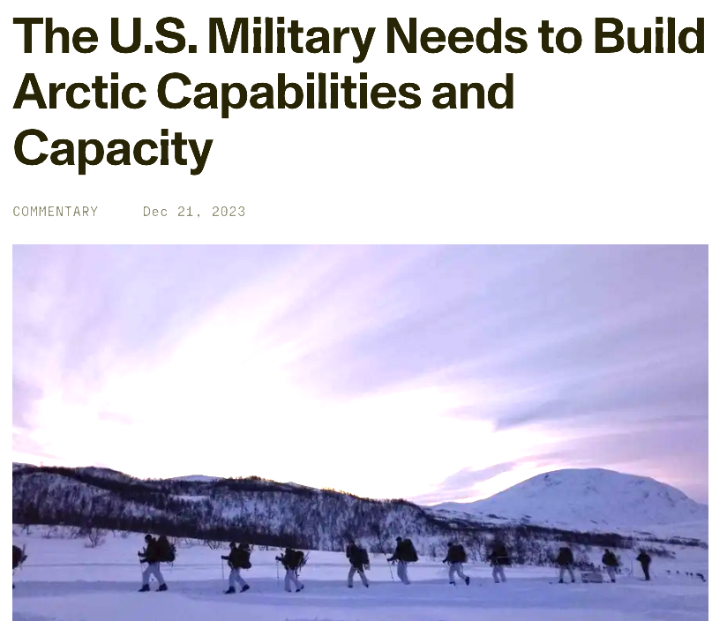
Military infrastructure expansion
Harm: Russia and China are rapidly expanding their Arctic military presence, threatening U.S. security and strategic interests.
Inherency: The U.S. lacks sufficient Arctic military infrastructure and capabilities to deter adversaries.
Solvency: Expanding military development in the Arctic will enhance deterrence, protect U.S. interests, and maintain regional stability.
https://www.rand.org/pubs/commentary/2023/12/the-us-military-needs-to-build-arctic-capabilities.html

Slide 11
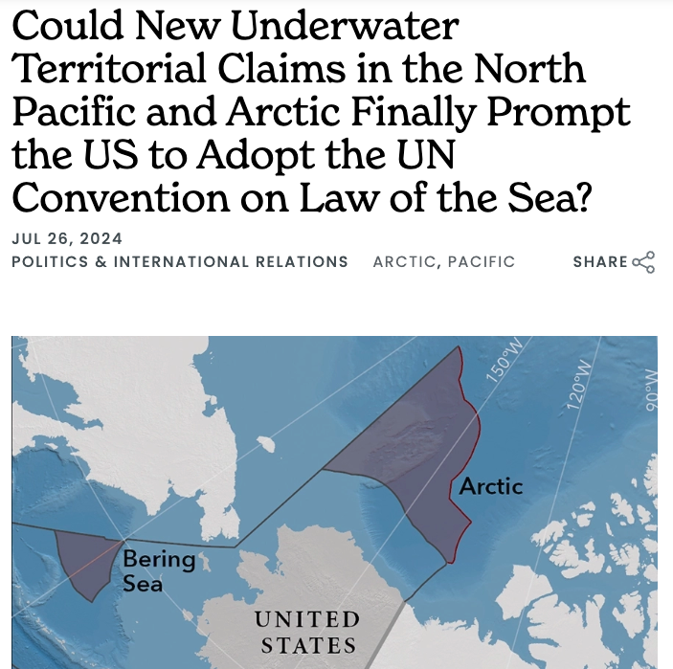
UN convention on the law of the sea (UNCLOS)
Harm: The U.S. cannot fully claim or develop Arctic resources without recognized legal rights under international law.
Inherency: The U.S. has not ratified UNCLOS, limiting its ability to secure extended continental shelf claims.
Solvency: Ratifying UNCLOS would legitimize U.S. Arctic claims and increase lawful resource development in contested areas.
https://www.eastwestcenter.org/news/web-article/could-new-underwater-territorial-claims-north-pacific-and-arctic-finally-prompt-us

Slide 12
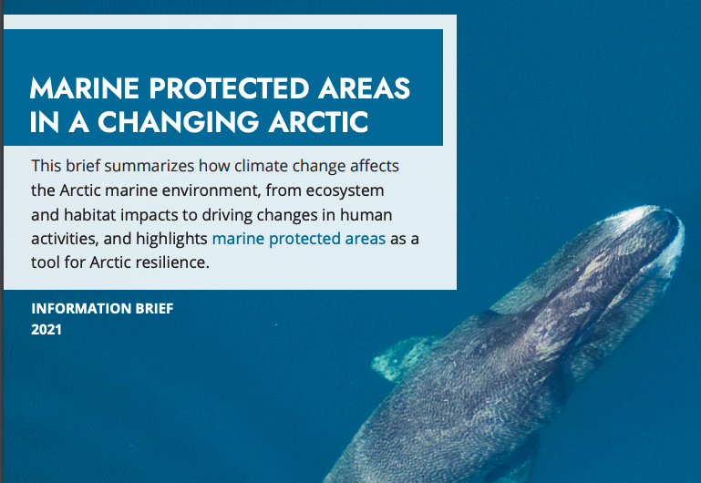
marine protected areas in the arctic
Harm: Arctic fish stocks are increasingly threatened by overfishing as melting ice opens new waters to exploitation.
Inherency: The U.S. lacks sufficient marine protected areas in the Arctic to safeguard vulnerable ecosystems and fish populations.
Solvency: Establishing Arctic MPAs can restrict harmful fishing practices, preserve biodiversity, and promote long-term sustainability.
https://oaarchive.arctic-council.org/server/api/core/bitstreams/ef51fb7b-2304-420a-b585-f0f1873542fd/content

Slide 13
ARCTIC: Affirmative

