Slide 1
2027 NFHS Softball
Living Lineup
Updated 1/05/2026

Slide 2

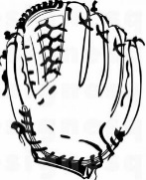

Background to living lineup
Adds action to lineup management discussion
Physical movement helps kinesthetic learners understand the concept better
Also adds a visual aspect to the movement of positions
Suggested “Props” for the presentation
  Laminated number sheets for each person in the lineup(shown on next slide)
  Laminated pieces that represent batting and fielding for the DP/FLEX with Velcro to allow them to be moved
  Laminated pieces for the other players to show their job with Velcro to allow them to be moved
  Chairs for eligible substitutes and players that have left the game in the positions needed
    Sitting down means they are not currently in the game
  Laminated pieces for those that have left the game a second time and no longer have eligibility
Notes:
There have been a number of discussions about the pace of play for NFHS Softball. Rule proposals have been submitted for various ways to enforce the timing between innings and various options to change the current rules providing different penalties if violated. After reviewing these proposals and comparing them with the current rules governing these items the NFHS Softball rules committee decided to reject the rule proposals and provide information by creating POE’s for these items. Starting with a reminder of the time between innings when it starts and highlighting that maintaining good game flow is an important aspect of the game. The next POE focused on umpires game management and how to enforce these items without being overly aggressive. This year the focus is on coaches roles in management of game flow as well as highlighting the existing timing aspects within the current rules.

Slide 3
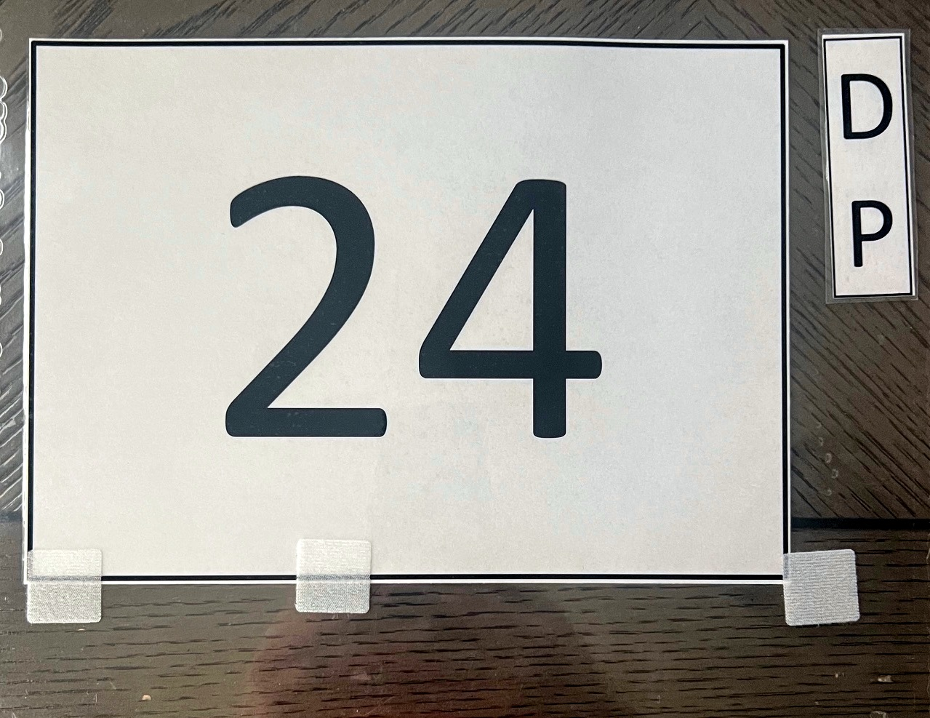
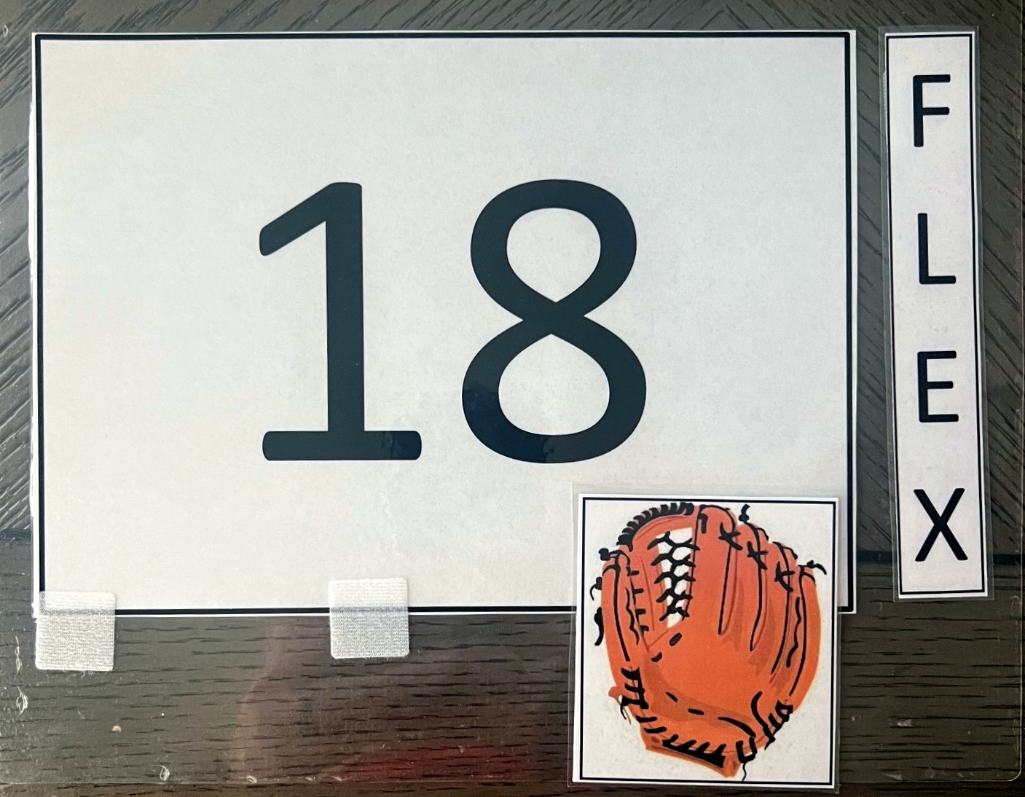

Close up of number sheets and movement

Slide 4
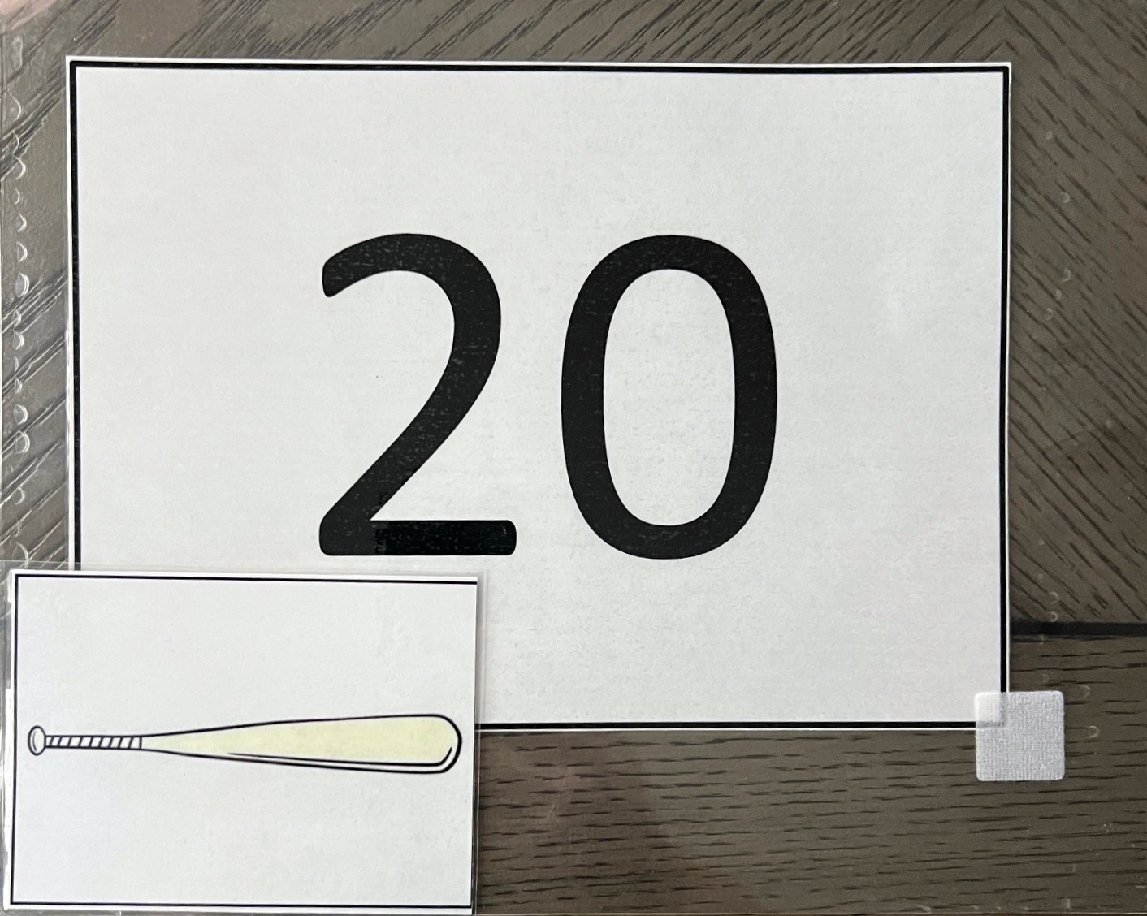
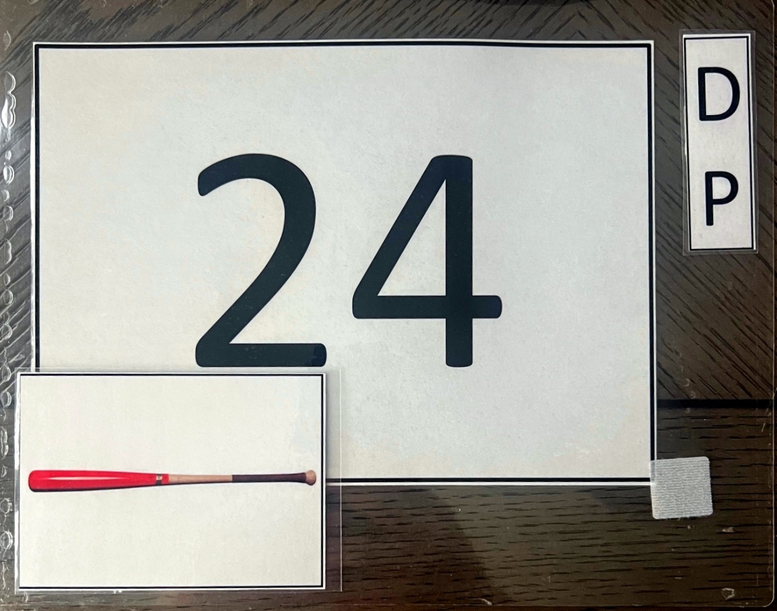
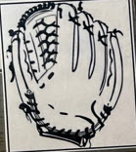
Movement for DP playing defense

Slide 5
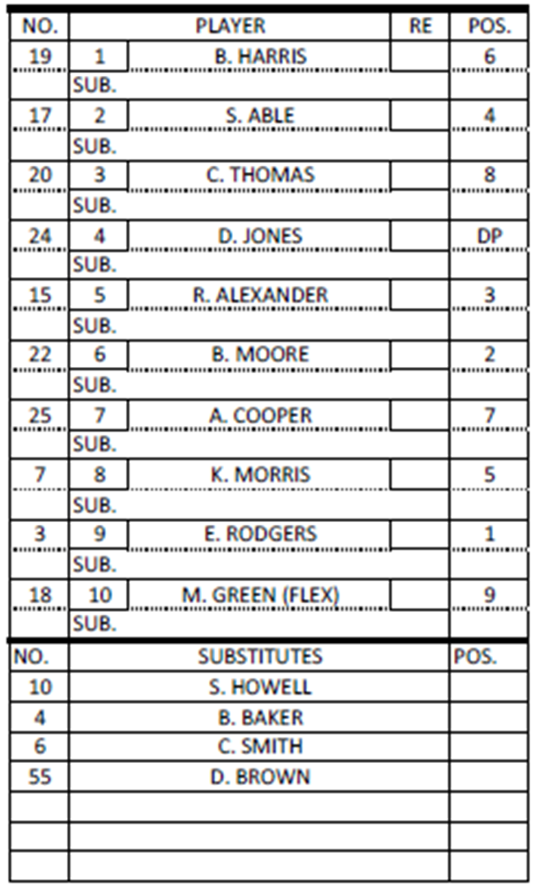
Arrangement for living lineup
*
*
Ask for 14 volunteers
  Need minimum of 4
Give each volunteer a number and place them in order shown in the lineup card
  * indicate the required spots
    If you have limited volunteers tape the remaining numbers to empty chairs to show the positions
  If you have enough volunteers have the 4 substitutes sit in chairs
  Have a chair behind spot 4 and spot 10 in the lineup
*
*

Slide 6

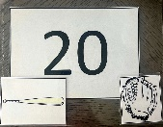
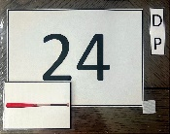
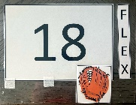
Arrangement for Living Lineup
B1
B2
B3
B4
B5
B6
B7
B8
B9
10
4
55
10
6
19
17
15
22
25
7
3

Slide 7

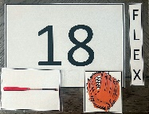

Movement for Example 1
FLEX playing offense for dp
B1
B2
B3
B4
B5
B6
B7
B8
B9
10
4
55
10
6
19
17
15
22
25
7
3
FLEX is playing offense in the 4th position (DP’s spot) in the lineup
DP has no job so they have left the game (take a seat)
FLEX playing offense for DP (taking their bat)

Slide 8
DP/FLEX RULE
SAMPLE EXERCISES

Slide 9
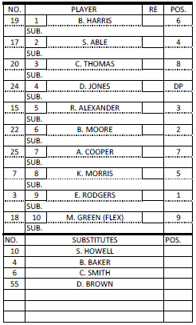

SAMPLE LINEUP CARD
All samples will use this lineup card and progress through a series of substitutions

Slide 10
Sample exercise #1
Jones (DP) bats and gets on base safely
The offensive coach asks for time to make a change
“Green will run for Jones"

Slide 11
SAMPLE EXERCISE #1
Green (FLEX) running for Jones (DP)
Notes:
This slide contains several “layers” of the lineup card that can only be seen when the slide show is being viewed.

Slide 12
Sample exercise #1
Note –
Jones has left the game (no longer playing offense), they still have one reentry. Green is now playing offense and defense.

Slide 13
Sample exercise #2
Two innings later, Green singles to left
The offensive coach asks for time to make a change
"Smith is running for Green and Green will still be playing right field”

Slide 14
Sample exercise #2
Note –
This substitution is critical for the umpire to ensure they understand what the coach is requesting
Coach says “Smith is running for Green” at this point there are two options:
  Smith is substituting for Green and is the new FLEX playing offense in the DP’s position in the lineup. Change is made and recorded in the 10th position
  Smith is substituting for Jones and is the new DP, Green is going back to playing defense only. Change is made and recorded in the 4th position.
By actively listening and understanding the second part of the coach's statement “Green will still be playing right field” we know the coach wants option 2.

Slide 15
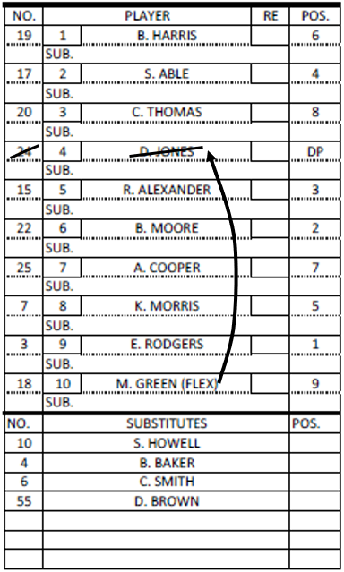
SAMPLE EXERCISE #2
Smith (sub) running for Green (FLEX) is recorded as a sub for Jones and becomes the new DP
Green remains in the game playing right field only
6
Smith
DP
Notes:
This slide contains several “layers” of the lineup card that can only be seen when the slide show is being viewed.

Slide 16
Sample exercise #2
Note –
Since Green will continue to play defense, Smith enters the game for the first time as the new DP
Since Green (FLEX) is still playing defense they have NOT left the game (never quit using their mitt)

Slide 17
Sample exercise #3
In the 4th inning, the offensive coach asks for time to make another change
“Jones to reenter and bat for Smith”

Slide 18
SAMPLE EXERCISE #3
6
Smith
DP
Jones (starting DP) reenters for Smith
Notes:
This slide contains several “layers” of the lineup card that can only be seen when the slide show is being viewed.

Slide 19
Sample exercise #3
Note –
Jones has used their one reentry
Smith has left the game and has a reentry remaining
This is no different than a substitution / reentry anywhere else in the lineup

Slide 20
Sample exercise #4
In the next half inning, the defensive coach asks for time to make another change
“Jones will play defense in center field for Thomas”

Slide 21
SAMPLE EXERCISE #4
8
6
Smith
DP
Jones (DP) to play defense in center field for Thomas
Notes:
This slide contains several “layers” of the lineup card that can only be seen when the slide show is being viewed.

Slide 22
Sample exercise #4
Note –
Jones the DP is now playing offense (using their bat) and defense (using Thomas’ mitt)
Thomas still bats in the 3rd position in the lineup is playing offense only (still using their bat) and has NOT left the game

Slide 23
Sample exercise #5
In the next inning, the defensive coach asks for time to make another change
“Thomas is going back to playing center field, Jones will play defense in right field for Green”

Slide 24
SAMPLE EXERCISE #5
8
9
8
Thomas goes back to center field
Jones (DP) to play defense in right field for Green (FLEX)
6
Smith
DP
Notes:
This slide contains several “layers” of the lineup card that can only be seen when the slide show is being viewed.

Slide 25
Sample exercise #5
Note –
Jones (DP) is still playing offense and defense (now using the FLEX’s mitt)
Green (FLEX) has left the game (still has a reentry) since they are not playing defense (no longer using their mitt)

Slide 26
NFHS.org Phone # 317-822-5735 Email: Ssearcy@nfhs.org

