Slide 1
2025-26 NFHS Softball
Substituting, Lineup Management, Illegal Substitutes, Coaching and Conferences, Courtesy Runners
Updated 1/05/2026

Slide 2
Rule 3-1-3
Players, Positions
The team's lineup card shall include first initial and last name, jersey number, position and batting order of each starting player and shall include each eligible substitute. Lineups become official after they have been exchanged, verified and then accepted by the plate umpire during the pregame conference.
PENALTY: After the lineup card has been submitted to and verified by the umpire and a change is subsequently made to a player/substitute name or number, or if a player/substitute is added to the lineup card, the umpire shall issue a team warning to the head coach of the team involved. Any further changes made to a player/substitute name or number results in the head coach being restricted to the dugout/bench area for the remainder of the game.

Slide 3

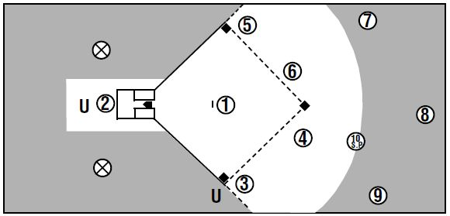
Fielder’s Positions

Slide 4
Rule 3-2-1
Substituting
A player who is not listed as an eligible substitute on the lineup card shall not be prohibited from playing.
PENALTY: After the lineup card has been submitted to and verified by the umpire and a change is subsequently made to a player/substitute name or number, or if a player/substitute is added to the lineup card, the umpire shall issue a team warning to the head coach of the team involved. Any further changes made to a player/substitute name or number results in the head coach being restricted to the dugout/bench area for the remainder of the game. (3-1-3)

Slide 5
Rule 3-2-2
Substituting
A substitute may replace any player when the ball is dead or time has been called. The substitute or coach shall report to the plate umpire at the time of the change by stating name and shirt number of the:
a. player entering the game for the first time.
b. player re-entering.
c. FLEX who is batting for the DP.
d. DP who is playing defense for the FLEX.
e. player being replaced in the batting order and the position to be occupied in the field if the player is not a courtesy runner.
NOTE: A pitcher may be removed as a pitcher and return as a pitcher only once per inning provided the return does not violate either the substitution or charged conference rule.

Slide 6
Rule 3-2-3
Substituting
The plate umpire shall record all substitutions on the lineup card and then announce immediately any change(s) to the opposing team’s head coach. Projected substitutions are not permitted. If there is no announcement of substitutions, a substitute has entered the game when:
a. a runner takes the place of a runner who has replaced.
b. a pitcher takes a position on the pitcher's plate.
c. a fielder reaches the position usually occupied by the fielder who has been replaced.
d. a batter takes a positon in the batter's box.
e. and, in each of the above situations, when the ball is declared live by the plate umpire.

Slide 7
Projected Substitution (2-57-4) Discussion
Projected Substitute – A projected substitute is the act of entering a substitute without first removing a player from that position in the lineup.
If you can make the requested change on your lineup card at the moment it is requested it is not a projected substitute.
If you can NOT make the requested change on your lineup card at the moment it is requested this IS a projected substitute.
  At the start of the inning a coach tells the plate umpire I want #10 to bat for #1, #12 for #2 and #13 for #3. These are the first three batters in this half inning. Can all three of these substitutions be accepted at once?
    YES! It is a good practice to remind the coach that once reported all three of these players have entered the game

Slide 8
Projected Substitution Examples
At the start of the inning a coach tells the plate umpire “I want #10 to bat for #1, #12 for #2 and #13 for #3.” These are the first three batters in this half inning. Can all three of these substitutions be accepted at once?
  YES! All three of these replacements can be changed on the lineup card when requested. #12 is the first batter but the other two substitutions can also occur at the time requested. It is a good practice to remind the coach that once reported all three of these players have entered the game in case something strange happens and they don’t bat, they are still officially in the game.
Coach tells the plate umpire “I want #10 to bat for #1 but #1 will return to play 3B when we go to defense.” Can you accept both of these changes?
  NO! You can accept #10 for #1. But you cannot accept #1 returning on defense, #10 still has to bat so they have to remain in the game until the team returns on defense. The reentry of #1 cannot be recorded on the lineup when announced so this is a projected substitution and cannot be accepted.

Slide 9
Rule 3-2-4, 3-2-5
Substituting
A substitute or courtesy runner shall not enter the contest unreported. (3-5-7, Penalty 8-10-7)
Any player, starter or substitute may be withdrawn from the game and re-entered once, provided such player occupies the same batting position whenever in the lineup. A starter and any substitute for a starter may not be in the game at the same time. A violation results in illegal substitution.

Slide 10
Recording Changes on Lineup Card

Slide 11
Recording changes on lineup card
Although there are many ways to record changes in the lineup during a game, the following slides will show the most popular way to record those changes.
If an umpire were to decide to use a different method, it is critical that they document all changes in a manner that allows them to know what changes were made to ensure a proper ruling if a question of player legality is raised.

Slide 12

Recording a Sub
Baker
4
Baker is going to bat for Able.
Mark out Baker since they are no longer an available substitute.
Mark out Able since they have left the game.
Write Baker’s name and number in the correct position.

Slide 13
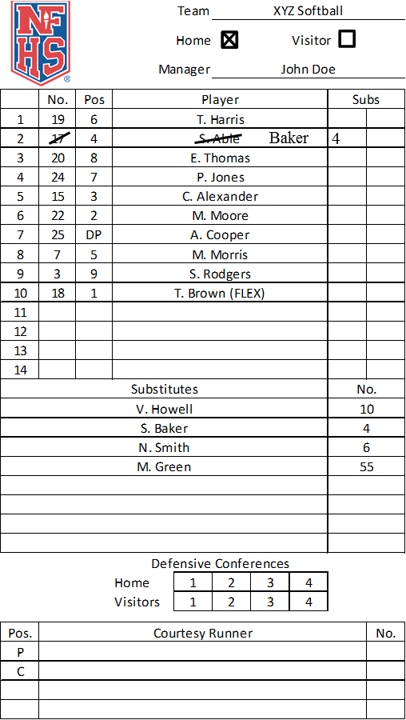
Re-entering a Player
Able is going to play defense for Baker.
Mark out Baker since they are leaving the game.
Circle Able to show they have re-entered the game.

Slide 14
Additional Substitution Items

Slide 15
Rule 3-2-8
If a team is playing with 9 (F.P.), 10 (S.P. or F. P. if DP/FLEX is used), or 11 (S.P. if an EP is used) and there are no available substitutes when a runner advancing on an awarded base or after reaching base is unable to continue:
  The previous batter not on base is allowed to replace that player as a temporary runner until the runner is put out, scores or the half-inning ends.
  When the player who could not continue is scheduled to bat, an out shall be called.
  When the half-inning ends and the team assumes a defensive position. (4-3-1g)
  Once a team has gone short-handed and another eligible player becomes available, that player may fill the empty space in the lineup.

Slide 16
Rule 3-2-9
Any player who exhibits signs, symptoms, or behaviors consistent with a concussion (such as loss of consciousness, headache, dizziness, confusion, or balance problems) shall be immediately removed from the game and shall not return to play until cleared by an appropriate health-care professional.
See NFHS Suggested Guidelines for Management of Concussion in Appendix B.

Slide 17
Rule 3-2-10
A coach or athlete who is bleeding, has an open wound, has any amount of blood on the uniform, or has blood on their person, shall be directed to leave the game until the bleeding is stopped, the wound is covered, the uniform and/or body is appropriately cleaned, and/or the uniform is changed before returning to competition. If medical care or treatment can be administered in a reasonable amount of time, the individual does not have to leave the game. The length of time that is considered reasonable is umpire judgment. The re-entry rule would apply to players taken out of the game for this rule.
See Communicable Disease Procedures, Appendix D.

Slide 18
ILLEGAL / UNREPORTED SUBSTITUTES

Slide 19
Rule 3-3-1
Illegal offensive or defensive players may be discovered by the umpire or either team anytime after the ball becomes live and an illegal substitute has taken a position as:
  a runner the illegal substitute has replaced or as a batter in the batter's box;
  a pitcher on the pitcher's plate, or as a fielder reaching a position
  usually occupied by the fielder being replaced; or
  a courtesy runner if that player has violated the courtesy runner
  rule.
PENALTY: (Art.1) Restricted to the dugout/bench area for the remainder of the game. (Art. 1a, c) The player is also called out.

Slide 20
Rule 3-3-2
Illegal offensive players may be discovered:
  a. when in the batter's box, the ball is live and/or before the batter- runner reaches first base, or is put out and before a pitch is delivered to the next batter of either team;
  when the illegal batter-runner or runner advances, scores or causes a play to be made that allows another runner(s) to advance or score, and the infraction is detected before the next pitch by either team;
  c. when an illegal batter-runner or runner advances, scores or causes a play to be made that allows another runner(s) to advance or score, and the infraction is detected after the next pitch by either team;

Slide 21
Rule 3-3-2
  d. in a game-ending play prior to all infielders and/or umpires leaving the diamond.
  PENALTY: The illegal substitute is restricted to the bench/dugout for the remainder of the game. (Art. 2a, b) The player is called out. (Art. 2c, d) If still on base, the player is called out. (Art. 2a) The proper batter is considered to have lost the turn at bat. The next proper batter shall bat. (Art. 2b, d) Play is nullified. Outs made on play stand. Runners not put out return to base(s) occupied
  at the time of the pitch. (Art. 2c) Play stands.
  NOTE: The penalty for illegal substitution takes precedence over the batting-out-of-order penalty.

Slide 22
Rule 3-3-3
Illegal defensive player is discovered before the next pitch to either team when:
    a. involved in a play with batted ball;
    b. a non-batted ball is handled or touched by an illegal
    substitute that leads to a runner being put out;
    c. a non-batted ball is handled or touched by an illegal
    substitute that alters the play, but no runner is put out
    (i.e., on an overthrow on a stealing runner, the illegal
    substitute retrieves ball and prevents runner from
    advancing farther).

Slide 23
Rule 3-3-3 penalties
1. The illegal player/substitute shall be restricted to the dugout/bench for the remainder of the game. (Art. 3a, b) Team on offense has option of taking the play or accepting the penalty (out is nullified, runners return to base occupied at time of pitch.) (Art. 3c) Umpire may award bases based on judgment and the circumstances concerning the play. (Art. 3a) The batter is allowed to bat again with the same count. (Art. 3b, c) The pitch is canceled if it is a strike or stands if it is a ball.
2. After another pitch, all play stands but the illegal player/substitute is still restricted to the dugout/bench for the remainder of the game.
3. Any time a non-batted ball is handled or touched by an illegal substitute and does not lead to a runner being put out or alter a play, the play stands and the illegal substitute is restricted to the dugout/bench.

Slide 24
Unreported vs illegal substitute
Unreported substitute (2-57-2)
  An unreported substitute is a substitute who has a legal right to participate in the game but has not reported to the umpire prior to participation (3-2-4, 3-5-7). All substitutions must be reported to the umpire. NOTE: A courtesy runner is not a substitute, but must be reported to the umpire. (8-10-7)
  See 3-5-7 PENALTY
Illegal Substitute (2-57-3)
  An illegal substitute is a player who enters or re-enters the game without eligibility to do so (illegal re-entry); a player who re-enters the game in the wrong position in the batting order; (F.P.) the FLEX who enters the game as a batter or runner in a different position in the batting order than the DP; or a player who violates the courtesy runner rule.
  See 3-3 PENALTY

Slide 25
Unreported vs illegal substitute Examples
Unreported substitute
  Eligible Sub S1 replaces R1 at 1B without being reported
  Eligible Sub S2 comes to bat in place of B3 without being reported
  Eligible Sub that was a courtesy runner for F1 earlier in the game replaces F1 on 2B without being reported
  All actions would be legal if they would have been reported
Illegal Substitute
  B3 reenters the game a second time to bat
  B4 reenters the game a second time as F8
  S1 enters the game to bat for B3, B3 returns on defense. The next inning S1 courtesy runs for F2
  S1 courtesy runs for F1 in the 1st inning then courtesy runs for F2 in the 2nd inning
  The DP is batting 4th in the lineup, the FLEX enters on offense for B6
  All of these actions are illegal even if reported

Slide 26
COACHING

Slide 27
Rule 3-4-3
Any time a coach is in live-ball area to confer with players or an umpire, or to occupy a coach's box, the coach shall be attired in school uniform or jersey/coaching shirt with slacks, shorts or other leg coverings in school colors or colors of khaki, black, white or gray. Cut-offs or any type of jeans are prohibited. Jackets are not considered part of the coach's uniform.
PENALTY: A coach not dressed in appropriate attire shall not be permitted in the field of play following the pregame conference for the duration of the game or until the situation has been remedied.

Slide 28
Rule 3-4-4, 3-4-5
A coach shall not physically assist a runner during playing action.
PENALTY: (Art. 4) The runner is out and the ball is in play. (8-7-5)
Offensive team personnel, other than the base coach, shall not be near a base to which a runner is advancing or returning; nor shall anyone fail to vacate any area (including a coach's box) needed by a fielder in an attempt to put out a batter or runner. (8-7-16)
PENALTY: (Art. 5) The ball is dead. The runner closest to home is out and all runners not out must return to the last base touched at the time of the interference.

Slide 29
BENCH AND FIELD CONDUCT

Slide 30
Rule 3-5-6
Only the batter, runner(s), on-deck batter, coaches in the coach’s box, bat/ball shaggers or one of the nine players on defense (S.P. 10) are permitted to be outside the designated dugout/bench or designated warm-up areas. (3-4-7)
NOTE: Bench personnel are permitted to engage in throwing and running activities during the one minute designated for the pitcher to throw five warm-up pitches at the beginning of each half inning.

Slide 31
Rule 3-5-17
Team personnel shall not intentionally remove any lines of the batter’s box or on the field of play.
PENALTY: A strike shall be called on the batter if a member of the offense intentionally removes the line and a ball awarded to the batter if a member of the defense intentionally erases a line. A team warning shall be issued, with the next offense resulting in a strike/ball, the offender and the head coach being restricted to the dugout.

Slide 32
CHARGED CONFERENCES

Slide 33
Rule 3-6-1
Each team, when on defense, may be granted not more than three charged conferences without penalty during a seven-inning game to permit coaches or their representatives to confer with a defensive player or players. In any extra-inning game, each team shall be permitted one charged conference without penalty each inning while on defense. The number of charged conferences permitted is not cumulative. A request for time for a conference may be made by a coach, player, substitute or bench personnel. Time granted for an obviously incapacitated player shall not constitute a charged conference. A conference is not charged when the pitcher is removed as pitcher. This defensive team charged conference rule coverage is effective when the ball first becomes live at the start of each half-inning.
NOTE: If the incoming pitcher has already pitched in the game, the pitcher will receive five warmup pitches, unless returning to pitch in the same half-inning. When a pitcher is removed by rule and the incoming pitcher has not pitched in the game, the umpire is authorized to permit additional warm-up pitches.
PENALTY: After three charged conferences in a seven-inning game, or for any charged conference in excess of one in each extra inning, the pitcher shall be removed as pitcher for the duration of the game.

Slide 34
Rule 3-6-2
Each team, when on offense, may be granted not more than one charged conference per inning to permit the coach or any of that team's personnel to confer with base runners, the batter, the on-deck batter or other offensive team personnel. The umpire shall deny any subsequent offensive team requests for charged conferences. This offensive team charged conference rule coverage is effective when the ball first becomes live at the start of each half inning. Time granted for an obviously incapacitated player shall not constitute a charged conference.

Slide 35
Rule 3-6-3
When either team has a charged conference, the other team may also have a conference which is not charged, provided the non-charged conference concludes when the opposing team's charged conference concludes, thus not delaying the game.

Slide 36
COURTESY RUNNER

Slide 37
Rule 8-10-1, 8-10-2
The team at bat may use a courtesy runner for the pitcher and/or the catcher at any time. Neither the pitcher nor the catcher will be required to leave the game under such circumstances. The same courtesy runner may not run for both the pitcher and the catcher any time during the game.
2. In the top of the first inning only, the pitcher and catcher are identified as those
players listed on the lineup as the pitcher and catcher; both must face at least the
first batter on defense (one pitch). Thereafter, the pitcher and catcher are identified
as the last players who physically played that position on defense. The pitcher or
catcher must bat and reach base legally (or earn their way on base) in order to be
eligible for a courtesy runner.
EXCEPTION: When an injury or disqualification occurs in the top of the first inning to the pitcher/catcher identified on the lineup card and the pitcher/catcher is unable to face the first batter in the bottom of the first inning, the player who ran for the pitcher/catcher is retroactively a substitute for the pitcher/catcher, no longer a courtesy runner. All substitution rules apply and the pitcher/catcher has left the game.

Slide 38
Rule 8-10-3, 8-10-4
Players who are currently in the game or have participated in the game in any other playing capacity are ineligible to serve as courtesy runners.
A player may not be a substitute for any player in the half inning that the player ran as a courtesy runner.
EXCEPTION: When an injury or disqualification occurs and no substitutes are available, the courtesy runner must be used as a substitute, and take the place of the injured player. Should the courtesy runner be on base, and is entered as a substitute, the pitcher or catcher for whom the courtesy runner is running, must run in the pitcher’s/catcher’s place.

Slide 39
Rule 8-10-5, 8-10-6
5. The courtesy runner is not permitted to run as a courtesy runner for the Designated Player (DP), if the DP is only batting, and not playing defense, for the pitcher or the catcher.
6. Once the courtesy runner is designated for that half-inning, the pitcher or catcher for whom is running may not return to run while that courtesy runner is on base. A courtesy runner shall not run for a courtesy runner. When a legal substitute replaces a courtesy runner, the player for whom the courtesy runner was running has left the game.
EXCEPTIONS:
1. Should an injury or disqualification occur to any other offensive player, and no substitutes are available, the courtesy runner must take the place of the player. In this case, the courtesy runner enters as a substitute and the pitcher or catcher for whom the courtesy runner is running, must run in the pitcher’s/catcher’s place.
2. When the courtesy runner is injured or disqualified, the player for whom the courtesy runner is running (pitcher or catcher) may return to run the bases or a legal substitute may be entered.

Slide 40
Rule 8-10-7 and Penalties
Penalty: (Art. 1 through 6) Illegal substitute. (3-3)
CR must be reported to plate umpire.
Penalty: (Art. 7) Unreported substitute as in 3-2-4 and 3-5-7 PENALTY.

Slide 41
CR scenario #1
In the top of the third inning B8, the DP, singles to left field, Coach A asks for time and wants the FLEX (the pitcher) to run for DP. Is this legal? Yes, the DP has left the game and has 1 re-entry.
After two pitches to B9, Coach A asks for time and wants to enter #12, an unused sub, as a CR for the pitcher. Is this legal? No, the pitcher must have earned their way on base to be eligible for a CR. The FLEX was substituted for after the DP was on base so they did not earn their way on base.

Slide 42
CR scenario #2
In the top of the first inning B2, the catcher singles to left field, Coach A asks for time and enters #8 an unused sub as a courtesy runner. Is this legal? Yes
In the top of the 8th inning B3 is due up to bat and B2, the catcher, is to be placed on 2B to start the inning; Coach A wants to use #8 for the catcher as a CR. Is this legal? Yes, the catcher earned their way on base by their position in the lineup and the tiebreaker rule placing them on base.

Slide 43
NFHS.org Phone # 317-822-5735 Email: Ssearcy@nfhs.org

