Slide 1


national Health Insurance: negative responses
Resolved: The United States federal government should establish national health insurance in the United States.
A look at negative responses, provided by Rich Edwards, Baylor University

Slide 2

Negative toolbox
Topicality
Disadvantages
Case
Counterplans
Kritiks
A brief look at Disadvantages and Case Arguments will be provided here; see other NFHS slide series for Topicality and Counterplans.

Slide 3
What are the elements of a disadvantage?
Uniqueness: Explain (with evidence) why the disadvantage is not happening in the present system.
Link: Explain (with evidence and/or by citing claims made in the Affirmative case) why the adoption of the plan will cause the disadvantage.
Impact: Establish (with evidence) why the disadvantage would cause great harm.

Slide 4
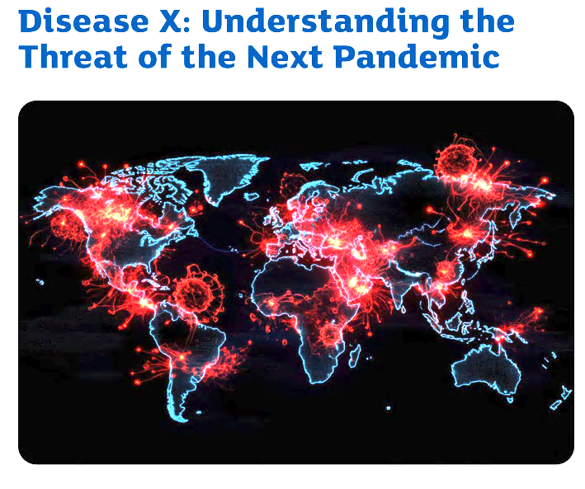
Disadvantage: disease pandemics
Uniqueness: At present, pharmaceutical company prices and profits support new drug development.
Link: The restricts pharmaceutical company prices and profits; since the U.S. is the world’s medicine chest, the loss of drug research will have a worldwide impact.
Impact: A Without the infrastructure for new drug development, the next pandemic will cause massive disease and death.
https://cosciencehub.copangroup.com/what-will-be-the-next-pandemic-be-prepared-for-disease-x/

Slide 5
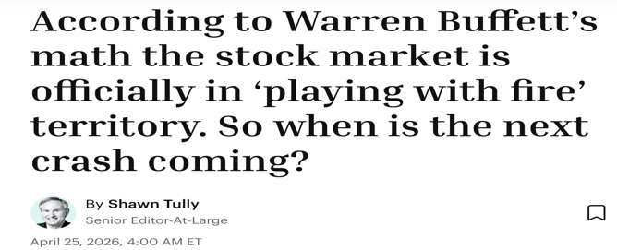

Disadvantage: Tax increase shock
Uniqueness: At present, coverage is funded through employment-based health insurance.
Link: The plan shifts all payment to the federal government, resulting in a massive tax increase.
Impact: A massive tax increase will shock investor confidence and cause a deep recession or depression, triggering global conflict.
https://fortune.com/2026/04/25/everyone-knows-a-stock-market-crash-is-coming-but-when/

Slide 6
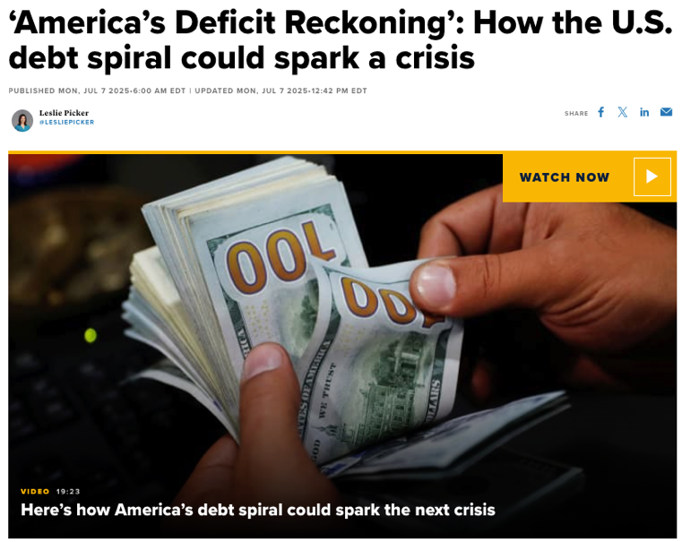
Disadvantage: Deficit Disaster
Uniqueness: At present, the U.S. Treasury is managing to finance the deficit, but barely.
Link: The plan will massively increase health care spending – by trillions of dollars according to many projections. As other countries lose confidence in U.S. Treasuries, interest rates have to increase to compensate, creating never-ending cycle.
Impact: Increased difficulty in financing the deficit snowballs to worldwide financial disaster.
https://www.cnbc.com/2025/07/07/how-the-us-deficit-could-spark-a-crisis-.html

Slide 7


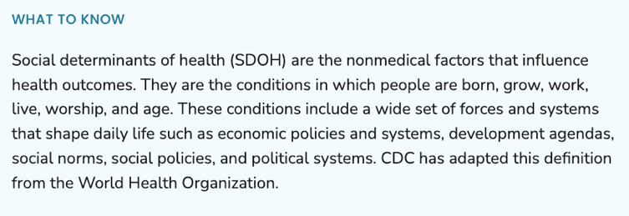
Disadvantage: Spending Trade-offs
Uniqueness: At present, the Trump administration has prioritized military projects by cutting healthcare spending.
Link: The plan will force the Trump administration to re-direct funding toward healthcare, creating spending tradeoffs with other social welfare programs.
Impact: Reduced spending on social welfare programs will have a more negative impact on health outcomes than the current cuts to healthcare.
https://www.cdc.gov/about/priorities/why-is-addressing-sdoh-important.html

Slide 8
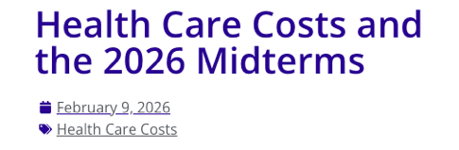
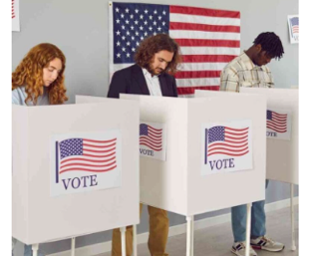
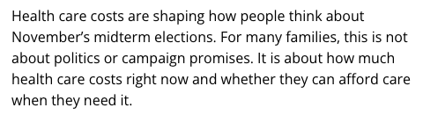
Disadvantage: Midterm Politics
Uniqueness: At present, MAGA candidates are disadvantaged in Midterm elections because of cuts to the ACA and Medicaid.
Link: The plan provides healthcare coverage for Americans, removing one of the key advantages to Democrats in the Midterms. Healthcare is a prominent electoral issue.
Impact: The MAGA victory in the Midterms will complete the destruction of Constitutional norms in voting rights, press freedom, religious freedom, and protection of minorities
https://asclepiusinitiative.org/health-care-costs-and-the-2026-midterms/

Slide 9

Disadvantage: IATROGENESIS
Uniqueness: At present, healthcare consumers have “skin-in-the-game,” meaning that people seek care only when clearly needed. Preventive screening is not a point of emphasis at present.
Link: The Medicare-for-All or single-payer provides free access to healthcare, leading to the medicalization of everyday life.
Impact: Unnecessary medical procedures kill – 3rd leading cause of death in the U.S.: Hospital-acquired infections; Adverse drug reactions; Medical errors; Surgical complications.

Slide 10
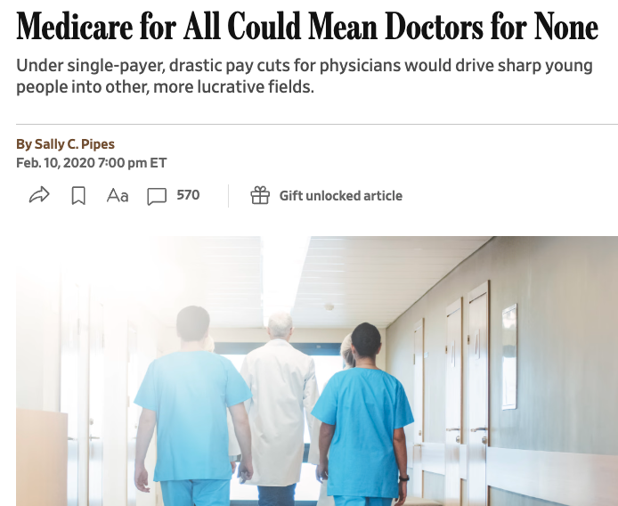
Disadvantage: Provider shortage
Uniqueness: At present, providers tolerate the losses incurred at Medicaid and Medicare reimbursement rates with private health insurance picking up the difference.
Link: Medicaid/Medicare reimbursement rates will close hospitals and incentivize provider retirement.
Impact: The combination of increased demand and decreased supply will produce long wait times; delayed healthcare will increase disease and death.
https://www.wsj.com/articles/medicare-for-all-could-mean-doctors-for-none-11581379209

Slide 11
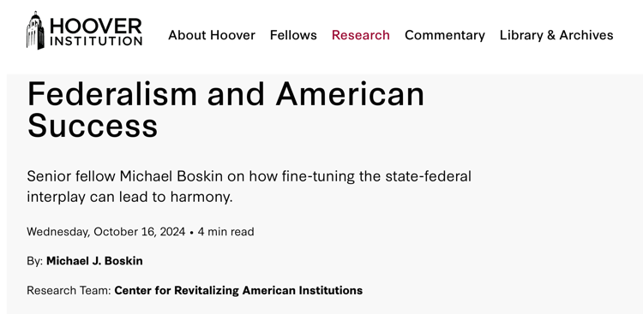

Disadvantage: FEDERALISM
Political Polarization Impact – federalization increases national political conflict.
Single Point of Failure Impact – centralized systems become less adaptable and resilient.
Uniqueness: At present, the Affordable Care Act operates through state-based marketplaces.
Link: The plan shifts all payment to the federal government, leaving the states behind.
Impact: In addition to violating the 10th Amendment, nationalizing health insurance will decrease responsiveness and increase political polarization. International modeling of a healthy U.S. system of federalism leads to reduced ethnic conflict, preventing war.
https://www.hoover.org/research/federalism-and-american-success

Slide 12

Disadvantage: GROWTH BAD
Uniqueness: The affirmative case claims that U.S. economic growth is currently stagnant because of high spending on healthcare.
Link: The affirmative solvency argument claims that the plan will jump-start U.S. economic growth.
Impact: Increased economic growth will push the world past the brink for climate change, risking human extinction.
https://soapboxie.com/social-issues/Are-Humans-Facing-Near-Term-Human-Extinction-Due-to-Global-Warming

Slide 13

Disadvantage: U.S. Hegemony Bad
Uniqueness: The case claims that the U.S. is currently losing its leadership position on the world stage.
Link: The plan claims to restore and U.S. economic competitiveness and leadership.
Impact: A U.S. return to world leadership and dominance results in unending wars.
https://theweek.com/articles/937094/why-global-hegemony-worst-thing-happen-america

Slide 14
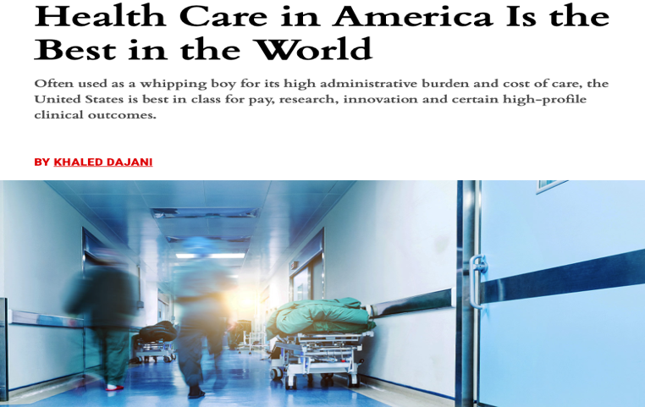
Negative Response to: MEDICARE FOR ALL
Harm: The quality of U.S. healthcare is best in the world and the U.S. level of spending for healthcare is justified.
Inherency: The U.S. maintains a properly functioning safety net including the Emergency Medical Treatment and Labor Act (EMTALA) and Community Health Centers.
Solvency: Medicare-level quality and administration is a step down.
Disadvantages: Disease Pandemics, Federalism, Deficit Disaster, Provider Shortage, Spending Tradeoffs
https://www.fairobserver.com/region/north_america/khaled-dajani-usa-health-care-america-best-world-quality-health-care-system-world-news-34879/

Slide 15
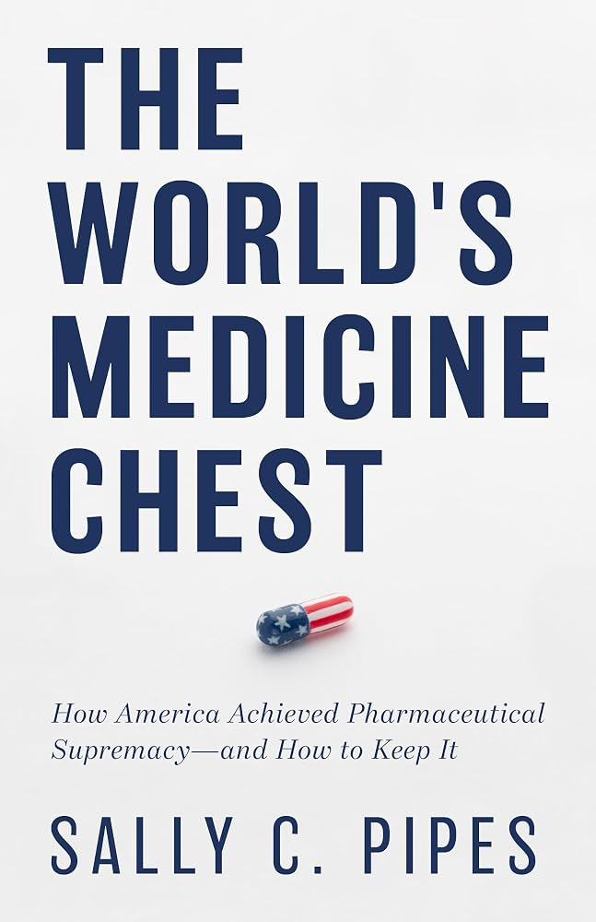
Negative Response to: SINGLE-PAYER
Harm: The claim that the U.S. is losing economic competitiveness because of the employer tie to health care is incorrect. First, U.S. leads the world in economic competitiveness; Second, the employment tie is a strength, not a weakness.
Inherency: The ACA marketplaces provide an alternative for those not offered by employee health coverage.
Solvency: The single-payer plan will worsen quality of care.
Disadvantage: Disease Pandemics, Federalism, Deficit Disaster, Provider Shortage

Slide 16
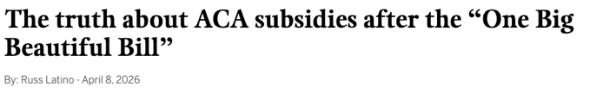
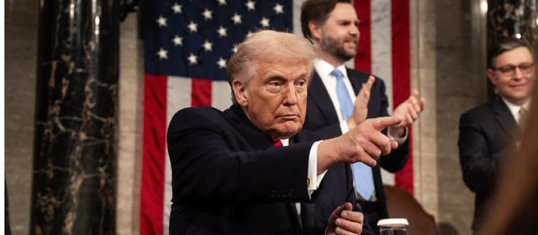
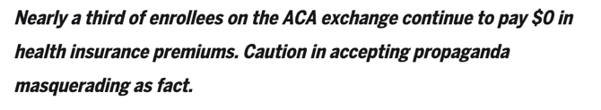
Negative Response to: REPAIRING THE AFFORDABLE CARE ACT
Harm: The COVID-era subsidies were always intended to be temporary; the original ACA subsidies are sufficient. The dropoff in coverage is much less than predicted. Medical bankruptcy is not a serious harm.
Inherency: State-based management of the ACA marketplace is best; safety net programs exist.
Solvency: Medicaid and ACA expansion have no impact on health outcomes.
Disadvantage: Iatrogenesis, Federalism, Deficit Disaster
https://magnoliatribune.com/2026/04/08/the-truth-about-aca-subsidies-after-the-one-big-beautiful-bill/

Slide 17



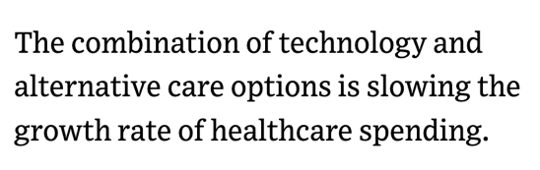
Negative Response to: THE PUBLIC OPTION
Harm: Health insurance company profits are not excessive; growth in healthcare costs has peaked and is now coming down.
Inherency: The ACA marketplaces provide all of the options needed for those seeking healthcare coverage.
Solvency: Health Insurance remains a choice: Many will still choose to be uninsured.
Disadvantage: This If the plan achieves its stated objective of using competition to force all to utilize Medicaid/Medicare level reimbursement rates, hospitals will close, providers will retire and not be replaced: Provider Shortage Disadvantage
https://www.modernhealthcare.com/providers/mh-healthcare-spending-growth-brookings-institute/

Slide 18
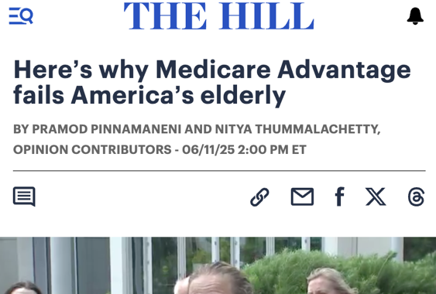
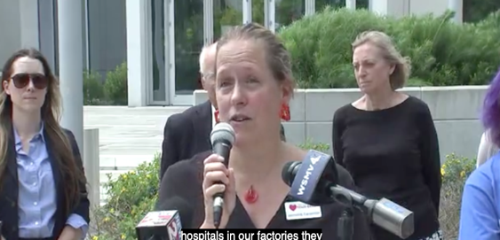
Negative Response to: MEDICARE ADVANTAGE FOR ALL
Harm: Level of care is appropriate at present.
Inherency: ACA is meeting healthcare need.
Solvency: Medicare Advantage doesn’t even work for the elderly Americans who mistakenly choose it: provider options are limited and the requirement of pre-approval unnecessarily delays care.
Disadvantage: Medicare Advantage explodes healthcare costs leading to bloated insurance company profits: Deficit Disaster. Medicare Advantage robs providers by using low reimbursement rates while insurance companies profit: Provider Shortages
https://thehill.com/opinion/healthcare/5342603-medicare-advantage-failing-elderly-patients/

Slide 19
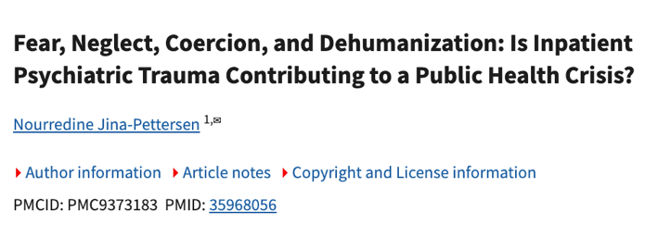
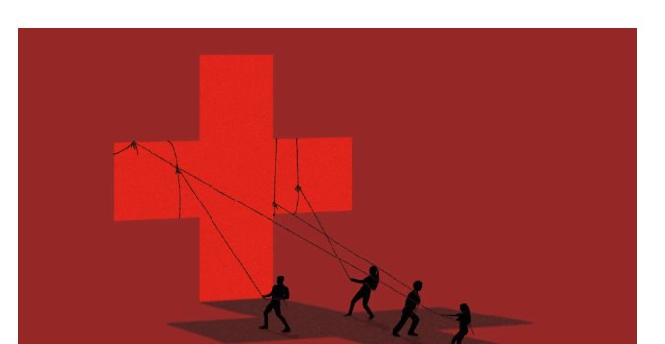
Negative Response to: MENTAL HEALTH PARITY IN MEDICARE
Harm: The 190-day limit applies only to residency in mental hospitals; there is no limit on psychiatric care or community care facilities.
Inherency: Elderly Americans receive appropriate care outside of mental hospitals in community care.
Solvency: Mental hospitals are not the appropriate place for successful treatment of mental health issues.
Disadvantage: Mental hospitals provide inappropriate medicalization of mental health issues: Iatrogenesis.
https://pmc.ncbi.nlm.nih.gov/articles/PMC9373183/

Slide 20

Negative Response to: RESTORE THE CUTS TO MEDICAID
Harm: Medicaid coverage is not helpful: Finding a doctor who will accept Medicaid is nearly impossible so the emergency room becomes the treatment location of choice.
Inherency: ACA coverage is far superior; for persons living at or near poverty, there is no premium. Here is the catch: persons eligible for Medicaid are not eligible for ACA coverage. Not being eligible turns out to be a benefit.
Solvency: Health outcomes are not improved by Medicaid coverage.
Disadvantage: Deficit Disaster; Spending Trade-offs, Midterms
https://www.wsj.com/health/healthcare/medicaid-insurers-doctor-networks-appointments-72f9c11f

Slide 21
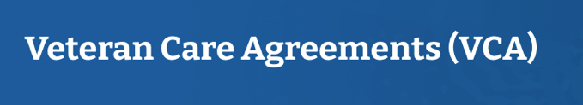
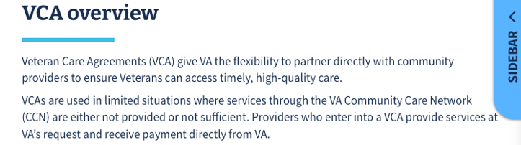

Negative Response to: VETERANS HEALTH ADMINISTRATION
Harm: The extent of the cuts is exaggerated; provider numbers are larger even after the cuts than was the case in 2022.
Inherency: The Veterans Community Care Program is the superior solution; whenever Veterans Health Administration care is unavailable, veterans can choose any provider.
Solvency: Restoring the cuts does not actually change the availability or quality of care.
Disadvantage: Midterms, Spending Trade-offs
https://department.va.gov/vha/community-care/partnerships/veteran-care-agreements/

Slide 22
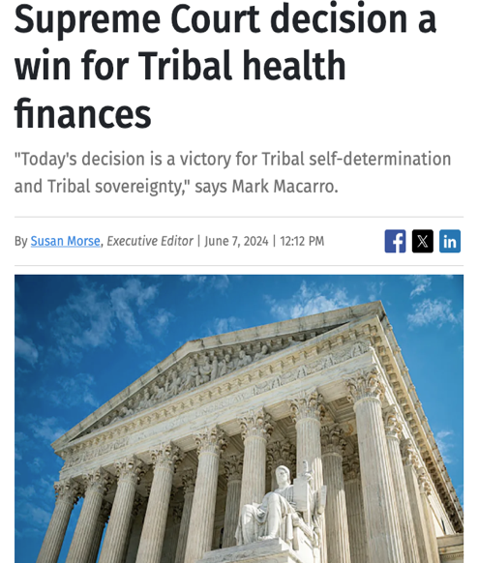
Negative Response to: HEALTHCARE IN INDIGENOUS COMMUNITIES
Harm: The contract services agreements are increasingly becoming the healthcare solution of choice in indigenous communities.
Inherency: The Supreme Court decision in Becerra, Secretary of Health and Human Services, et al. v. San Carlos Apache Tribe (2024) ensures contract services funding.
Solvency: Federal solutions are inappropriate in meeting the unique healthcare needs of indigenous communities.
Disadvantage: This Indigenous history and culture is best preserved when tribal governments design their own healthcare solutions; sovereignty is undermined by federal solutions.
https://www.healthcarefinancenews.com/news/supreme-court-decision-win-tribal-health-finances

Slide 23
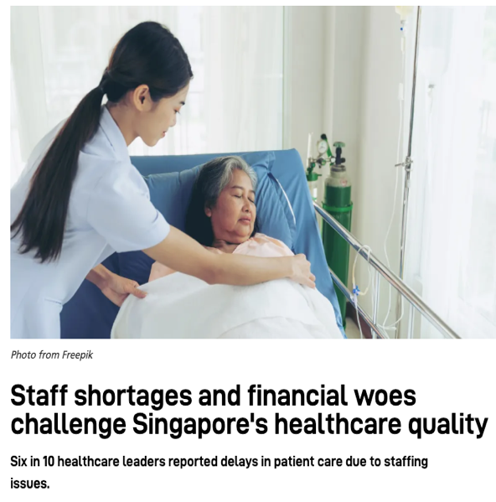
Negative Response to: SINGAPORE PLAN
Harm: The money the U.S. spends on healthcare is not wasted; healthcare is a major sector of the U.S. economy, producing good jobs and financial strength.
Inherency: Individuals seeking high deductible plans paired with health savings accounts can easily find them in the present system.
Solvency: The Singapore success is totally inapplicable in the U.S.: Providers work for the government; Singapore residents are rich; Singapore is smaller than a single large U.S. city.
Disadvantage: Midterms, Disease Pandemics
https://healthcareasiamagazine.com/news/staff-shortages-and-financial-woes-challenge-singapores-healthcare-quality

Slide 24
NATIONAL HEALTH INSURANCE: NEGATIVE

