Slide 1
2025-26 NFHS Softball
Dead Ball and Suspension of Play
Updated 1/05/2026

Slide 2
Rule 5-1-1a, 5-1-1b, 5-1-1c, 5-1-1d
Dead Ball
Ball becomes dead immediately when (see Table 5-1):
a pitch touches a batter or the batter’s clothing (8-1-7,8-1-8, 8-6-4, 8-6-5). NOTE: (F.P.) The ball becomes dead even though the batter strikes at it.
the ball is illegally batted (7-4-8, 7-4-2, 7-4-9, 7-4-10, 8-6-2) or comes in contact with the bat a second time. (7-4-13)
c. the batter enters the batter’s box with an illegal bat or a damaged bat that was previously removed from the game. (7-4-2, 7-4-15)
d. any batted ball, while on or over foul ground, 1. touches any object other than the ground or any person other than a fielder; 2. goes directly from the bat to the catcher’s protector, mask or person without first touching the catcher’s glove or hand; or
3. becomes an uncaught foul. (8-6-1)

Slide 3
Rule 5-1-1e, 5-1-1f
Dead Ball
there is interference by a batter-runner, runner or a retired runner (7-4-4; 8-1-6; 8-2-6, 8-2-7, 8-2-8, 8-2-11, 8-3-6, 8-6-3, 8-7-10, 11, 12, 14,18) or by any person. (3-4-5, 6, 7-4-12, 8-7-16)
f. a fair batted ball, which is on or over fair ground,
1. touches a runner or an umpire before touching any fielder and before passing any fielder other than the pitcher (8-1-6, 8-7-11);
2. touches a runner after passing through or by a fielder and another fielder could have made an out;
3. touches a spectator (7-4-11, 8-2-12, 8-5-10); or
4. goes over, through or wedges in the field fence.

Slide 4
Rule 5-1-1g, 5-1-1h
Dead Ball
a pitch or any other thrown ball;
is touched by a spectator;
is touched by nonparticipating team personnel;
goes into a stand or players’ bench (even if it rebounds to the field);
goes over or through or wedges in the field fence (8-5-3, 8-5-7); or
lodges in an umpire’s equipment, or touches loose equipment. (1-9-3, 2-2-3, 8-5-11, 8-7-15)
the umpire handles a live ball, calls “Time” for inspecting the ball, or for any other reason, including items in 5-2. (4-1-3d, e)

Slide 5
Rule 5-1-1i, NOTES 1,2
Dead Ball
a fielder, after catching a fair or foul batted ball (fly or line drive), leaves the field of play by stepping with one foot or by falling into a designated dead ball area (i.e., bench, dugout, stand/bleacher, etc.). (8-5-8, 8-5-9)
NOTES: If a chalk line or imaginary line is used to determine dead-ball (out-of-play) territory, the line is considered in play.
If the fielder's feet are touching the line or are in live-ball territory, the fielder is considered in the field of play and legally may field, catch or throw the ball without penalty.
If the player's entire foot (no part of the foot is touching in live-ball territory) is beyond the line and touches dead-ball territory at the time the player catches, fields or throws the ball, the player has entered dead-ball territory, the ball is dead, no play is allowed.

Slide 6
Rule 5-1-1i NOTE 3,4
Dead Ball
If a fielder has one foot in play and the other foot in the air, the fielder legally may catch, field or throw the ball unless the fielder’s entire foot contacts the ground in dead-ball territory, at which time the ball becomes dead, no play is allowed, and the penalty is applied.
If a fielder contacts dead-ball territory with any part of the body except the foot, the fielder is considered out of play. No play is allowed, and the penalty is applied. When the fielder completely leaves and then re-establishes position within live ball territory (both feet in live-ball territory), a catch would be allowed.

Slide 7
Rule 5-1-1j, 5-1-1k, 5-1-1l
Dead Ball
any personnel connected with the offensive team requests “Time” or uses any other command or commits an act for the purpose of trying to cause the opposing pitcher to commit an illegal pitch. (6-2-4e)
after each strike or ball, as soon as a pitch touches the ground (S.P. only), or when an intentional base on balls is awarded. (S.P. and F.P.) (7-4-6, 8-1-3)
an infielder intentionally drops a fair fly, fair line drive or fair bunt in flight with at least first base occupied and with less than two outs. (8-2-10)
EXCEPTION: Infield fly rule. (8-2-9)

Slide 8
Rule 5-1-1m, 5-1-1n, 5-1-1o, 5-1-1p, 5-1-1q
Dead Ball
a runner interferes with a fielder attempting to catch a foul fly. (8-7-10b)
the batter-runner steps backward toward home plate to avoid or delay being tagged out. (8-2-5)
an illegal pitch occurs, but no pitch is delivered to the batter. (6-2-2, 6-2-3, 6-2-4)
there is interference by a batter (7-4-3, 7-4-4 Penalty, 7-4-14).
a batter-runner or runner violates the look-back rule. (8-8-2, 8-8-3, 8-8-4)

Slide 9
Rule 5-1-2
Delayed Dead Ball
It is a delayed dead ball when (see Table 5-1):
an illegal pitch is delivered.
a catcher or any fielder obstructs a batter or obstructs the ball through use of detached player equipment. (8-1-4, 8-5-2, 8-5-4)
the umpire interferes (F.P.) with a catcher who is attempting to throw a non-batted ball.
a ball touches an illegal glove/mitt.
anyone who is required to wear a batting helmet deliberately removes the helmet while the ball is live.

Slide 10
Rule 5-1-3 & 5-1-4
Art. 3 The ball becomes dead when time is taken to make an award when a catcher or any fielder illegally obstructs a runner. (8-5-2 PENALTY)
Art. 4 After a dead-ball situation, the ball becomes live when the umpire calls and/or signals "Play Ball."

Slide 11
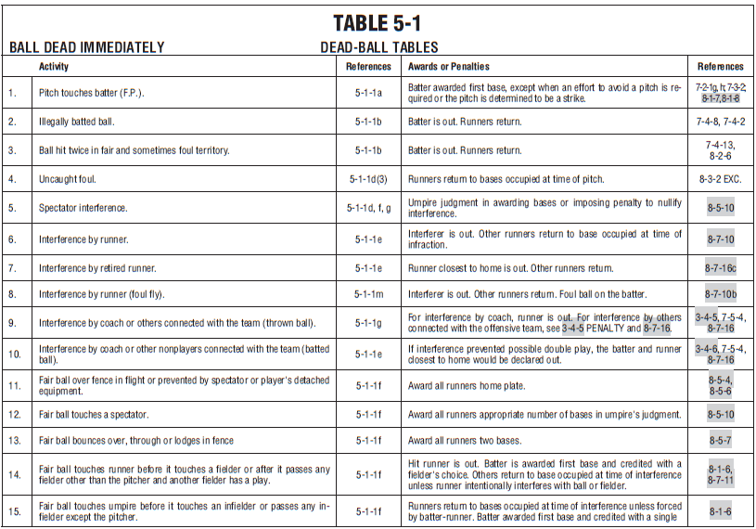
Dead Ball Table

Slide 12
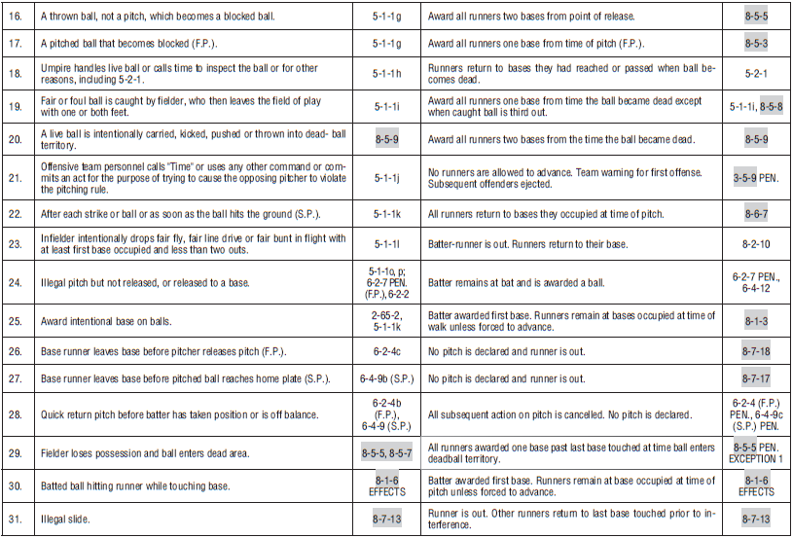
Dead Ball Table

Slide 13
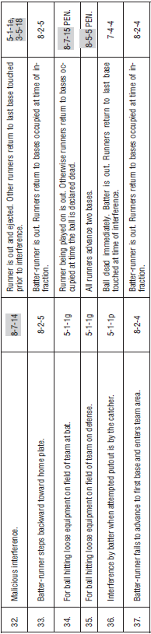
Dead Ball Table

Slide 14
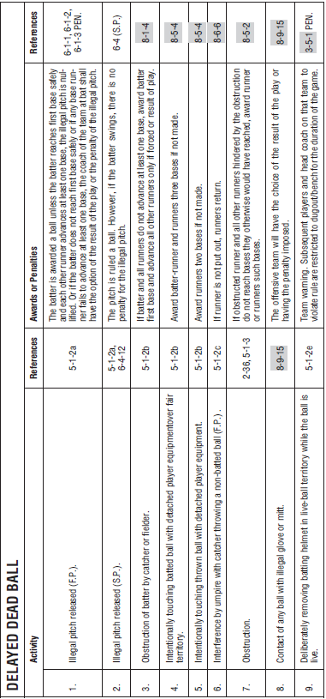
Dead Ball Table (Delayed Dead Ball)

Slide 15
Rule 5-2-1 Suspension of Play
“Time” shall be called by the umpire and play suspended:
as in (5-1-1, 2, 3).
when the umpire considers the weather or ground conditions unfit for play. NOTE: After 30 minutes, the umpire may declare the game ended or, by state association adoption, suspended.
when a player, bench personnel or spectator is ordered from the field of play, or player is ordered to secure protective equipment.
when an umpire or player is incapacitated, unless injury occurs during a live ball, then time shall not be called until no further advance or putout is possible. NOTE: If necessary, the umpire may suspend play immediately if, in the umpire’s judgment, further play may cause injury or jeopardize a participant’s safety. (10-2-3g)

Slide 16
Rule 5-2-1 Suspension of Play
e. when a player or coach is granted time for a substitution,
conference with the pitcher, or for similar cause.
f. when play is suspended for any other cause, including an award of a base after an infraction, inspection of the ball, or the ending of a half-inning.

Slide 17
Rule 5-2-2 Suspension of Play
When the ball becomes dead:
no action by the defense during that time can cause a player to be put out, except a proper dead-ball appeal. (2-1-3b)
b. a runner may not advance, nor return to a base that was not touched or that the runner was not in contact with on a caught fly ball during a live ball if the runner had advanced to or beyond a succeeding base.
c. any runner may advance when awarded a base or bases for an act which occurred before the ball became dead. All awarded bases must be touched. (8-1-6, 8-1-7, 8-1-8, 8-3-11)

Slide 18
NFHS.org Phone # 317-822-5735 Email: Ssearcy@nfhs.org

