Slide 1

National Health insurance:
Topicality Arguments
Resolved: The United States federal government should establish national health insurance in the United States.
A look at negative topicality arguments provided by Rich Edwards, Baylor University

Slide 2
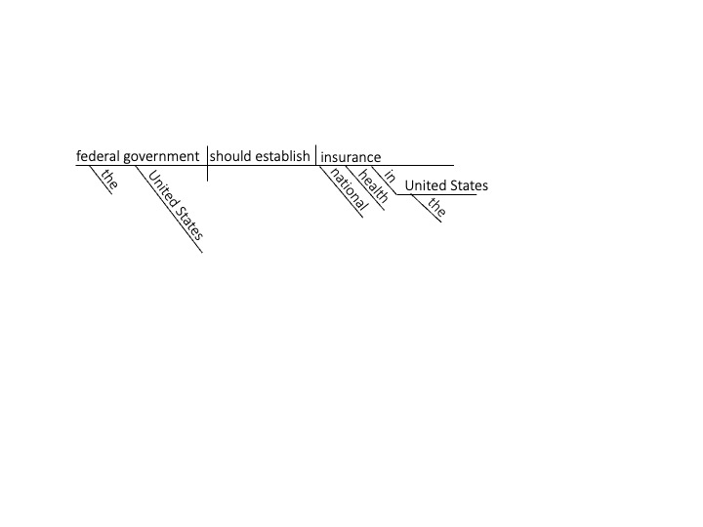
“national health insurance” is universal: coverage must be for all
The term “national health insurance” in the resolution requires that the plan cover all residents of the nation .
Bodenheimer, 2023. Thomas Bodenheimer (Prof., Medicine, U. of California San Francisco), UNDERSTANDING HEALTH POLICY: A CLINICAL APPROACH, p. 201.
National health insurance means the guarantee of health insurance for all the nation's residents—what is commonly referred to as “universal coverage.”

Slide 3
“National health insurance” requires a single-payer
The term “national health insurance” in the resolution requires that the health care system which is established be paid for by the federal government
Cuadrado, 2019. Cristóbal Cuadrado et al. (Prof., Public Health, University of Chile), HEALTH POLICY, “National Health Insurance: A Conceptual Framework From Conflicting Typologies,” July 2019, p. 621.
Based on the previous literature we identified some common characteristics across NHI definitions, namely universal coverage, pooling in a single fund and a purchasing function based on a single-payer financing mechanism.

Slide 4
“national health insurance” means comprehensive coverage
This topicality violation states that the affirmative team must cover medically necessary services in the scope of its coverage, including primary care, inpatient care, outpatient care, emergency care, etc.
Tulchinsky & Varavikova, 2000. Theodore Tulchinsky & Elena Varavikova (School of Public Health, Hadassah-Hebrew University, Israel/Central Research Institute of Public Health, Moscow). THE NEW PUBLIC HEALTH: AN INTRODUCTION TO THE 21ST CENTURY, p. 832.
National Health Insurance: Mandatory health insurance administered or regulated by the state, with universal coverage, comprehensive services, and public administration.

Slide 5
“national health insurance” – the government is not the provider
“National health insurance” is an insurance system which requires that care be provided by private practitioners and not a federal government health system
Shi & Singh, 2022. Leiyu Shi & Douglas Singh (Prof., Health Policy Management, Johns Hopkins U./ Prof., Economics, U. of Indiana), DELIVERING HEALTH CARE IN AMERICA: A SYSTEMS APPROACH, p. 666.
National health insurance (NHI) A tax-supported national health care program in which services are financed by the government but are rendered by private providers (Canada is an example of a country that has NHI).

Slide 6
“insurance” means something other than veterans health administration
VA health care is not an “insurance”-based system; instead the federal government is actually the provider of care; VA doctors and nurses work for the government and VA hospitals are owned by the government.
U.S. Department of Veterans Affairs, 2025. HEALTH CARE BENEFITS OVERVIEW, 2025 Edition. Retrieved May 22, 2026 from https://www.va.gov/HEALTHBENEFITS/resources/publications/10-185_HCBO_2025.pdf All
Veterans applying for VA health care are required to provide information on their health plan coverage, including coverage provided under health plan policies of their spouses, if applicable. The VA health care benefit is NOT considered a health insurance plan.

Slide 7
“insurance” means something other than the indian health service
The Indian Health Service is not an “insurance”-based system; instead the federal government is actually the provider of care; IHS doctors and nurses work for the government and medical facilities are owned by the government.
Indian Health Service, 2026. FREQUENTLY ASKED QUESTIONS, May 9, 2026. Retrieved May 31, 2026 from https://www.ihs.gov/forpatients/faq/
The Indian Health Service is funded each year through appropriations by the U.S. Congress. The Indian Health Service is not an entitlement program, such as Medicare or Medicaid. The Indian Health Service is not an insurance program. The Indian Health Service is not an established benefits package.

Slide 8
“Establish” means to bring into being
This topicality violation states that the term establish in the resolution means to bring into being. Many teams may be tempted to expand or modify an existing policy, like Medicare, Medicaid, or the Affordable Care Act. This violation would say those affirmatives are not topical because they do not establish national health insurance in the United States.
Nichols, 2000. Wendalyn Nichols (Editor). RANDOM HOUSE WEBSTER’S COLLEGE DICTIONARY, p. 451.
Establish: To bring into being on a firm or permanent basis; found; institute.

Slide 9
“Federal government” means the central government
This interpretation argues that the central government of the United States must take the action in the resolution. Many teams may be tempted to use the state governments as either their primary actor for the plan, or as a co-actor, for example by expanding Medicaid.
LONGMAN DICTIONARY OF CONTEMPORARY ENGLISH, 2005, p. 580.
Federal government: Relating to the central government of a country such as the U.S., rather than the government of one of its states.

Slide 10
national health insurance: Topicality Arguments

