Slide 1

WELCOME > RDA ACCESS POINT > COMPLETE STREETS PROJECT > ENOTA PARK > Q&A > WRAP UP
Abi Data collection
In order to meet our promise of a BeltLine for all, we are working to collect demographic and geographic information from our participants. This information is strictly for internal reference and research purposes only to guide us in outreach and public engagement efforts and will not be distributed to other organizations.

Slide 2
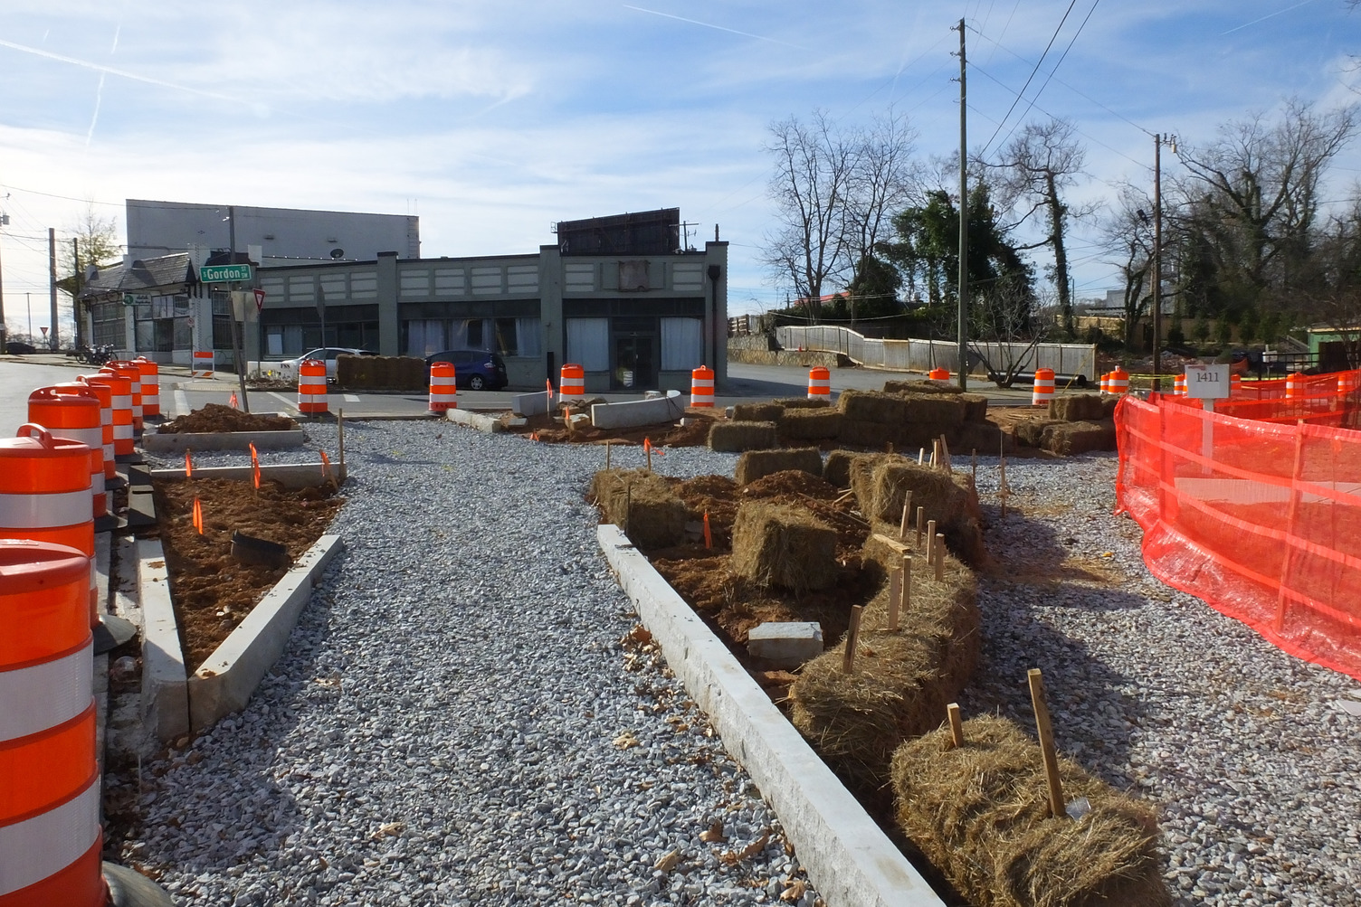



WELCOME > RDA ACCESS POINT > COMPLETE STREETS PROJECT > ENOTA PARK > Q&A > WRAP UP
Abernathy boulevard Projects & Enota Park
Southwest Study Group Meeting
February 1, 2024, at 6:30pm
@atlantabeltline
@atlantabeltline
@atlantabeltline

Slide 3

WELCOME > RDA ACCESS POINT > COMPLETE STREETS PROJECT > ENOTA PARK > Q&A > WRAP UP
Virtual meeting format
Your line is muted, and you won’t be able to share your video or screen during the meeting.
A recording of this meeting, the presentation, a copy of tonight’s Q&A and all other supporting materials will be made available online at www.beltline.org/meetings.
If you are having technical difficulties during the meeting, please email engage@atlbeltline.org.

Slide 4
WELCOME > RDA ACCESS POINT > COMPLETE STREETS PROJECT > ENOTA PARK > Q&A > WRAP UP
Poll Questions
Poll Question #1
What neighborhood do you live in?
Westview
Cascade Avenue/Road
West End
Mozley Park
Oakland City
Bush Mountain
Ashview Heights
BeltLine neighborhood in the City of Atlanta not on this list
City of Atlanta neighborhood not on the Beltline
Neighborhood not in the City of Atlanta

Slide 5
WELCOME > RDA ACCESS POINT > COMPLETE STREETS PROJECT > ENOTA PARK > Q&A > WRAP UP
Poll Questions
Poll Question #2
How long have you lived in your neighborhood?
1-5 years
6-10 years
11 or more years

Slide 6
WELCOME > RDA ACCESS POINT > COMPLETE STREETS PROJECT > ENOTA PARK > Q&A > WRAP UP
Poll Questions
Poll Question #3
What is your relationship to the Atlanta BeltLine?
I use the trail
I am a homeowner in a BeltLine neighborhood
I rent a home in a BeltLine neighborhood
I am a residential landlord in a BeltLine neighborhood
I am a business owner in a BeltLine neighborhood
I am a commercial landlord in a BeltLine neighborhood
I am a developer
I am a real estate broker
I am a community activist/advocate
I am generally interested in the BeltLine project

Slide 7
WELCOME > RDA ACCESS POINT > COMPLETE STREETS PROJECT > ENOTA PARK > Q&A > WRAP UP
Poll Questions
Poll Question #4
What are you most likely to be doing on the trail?
Exercising or other recreation
To run errands
To get to work or school
To engage in leisure activities
I don’t use the trail

Slide 8
WELCOME > RDA ACCESS POINT > COMPLETE STREETS PROJECT > ENOTA PARK > Q&A > WRAP UP
Poll Questions
Poll Question #5
Is tonight your first BeltLine meeting?
Yes
No

Slide 9
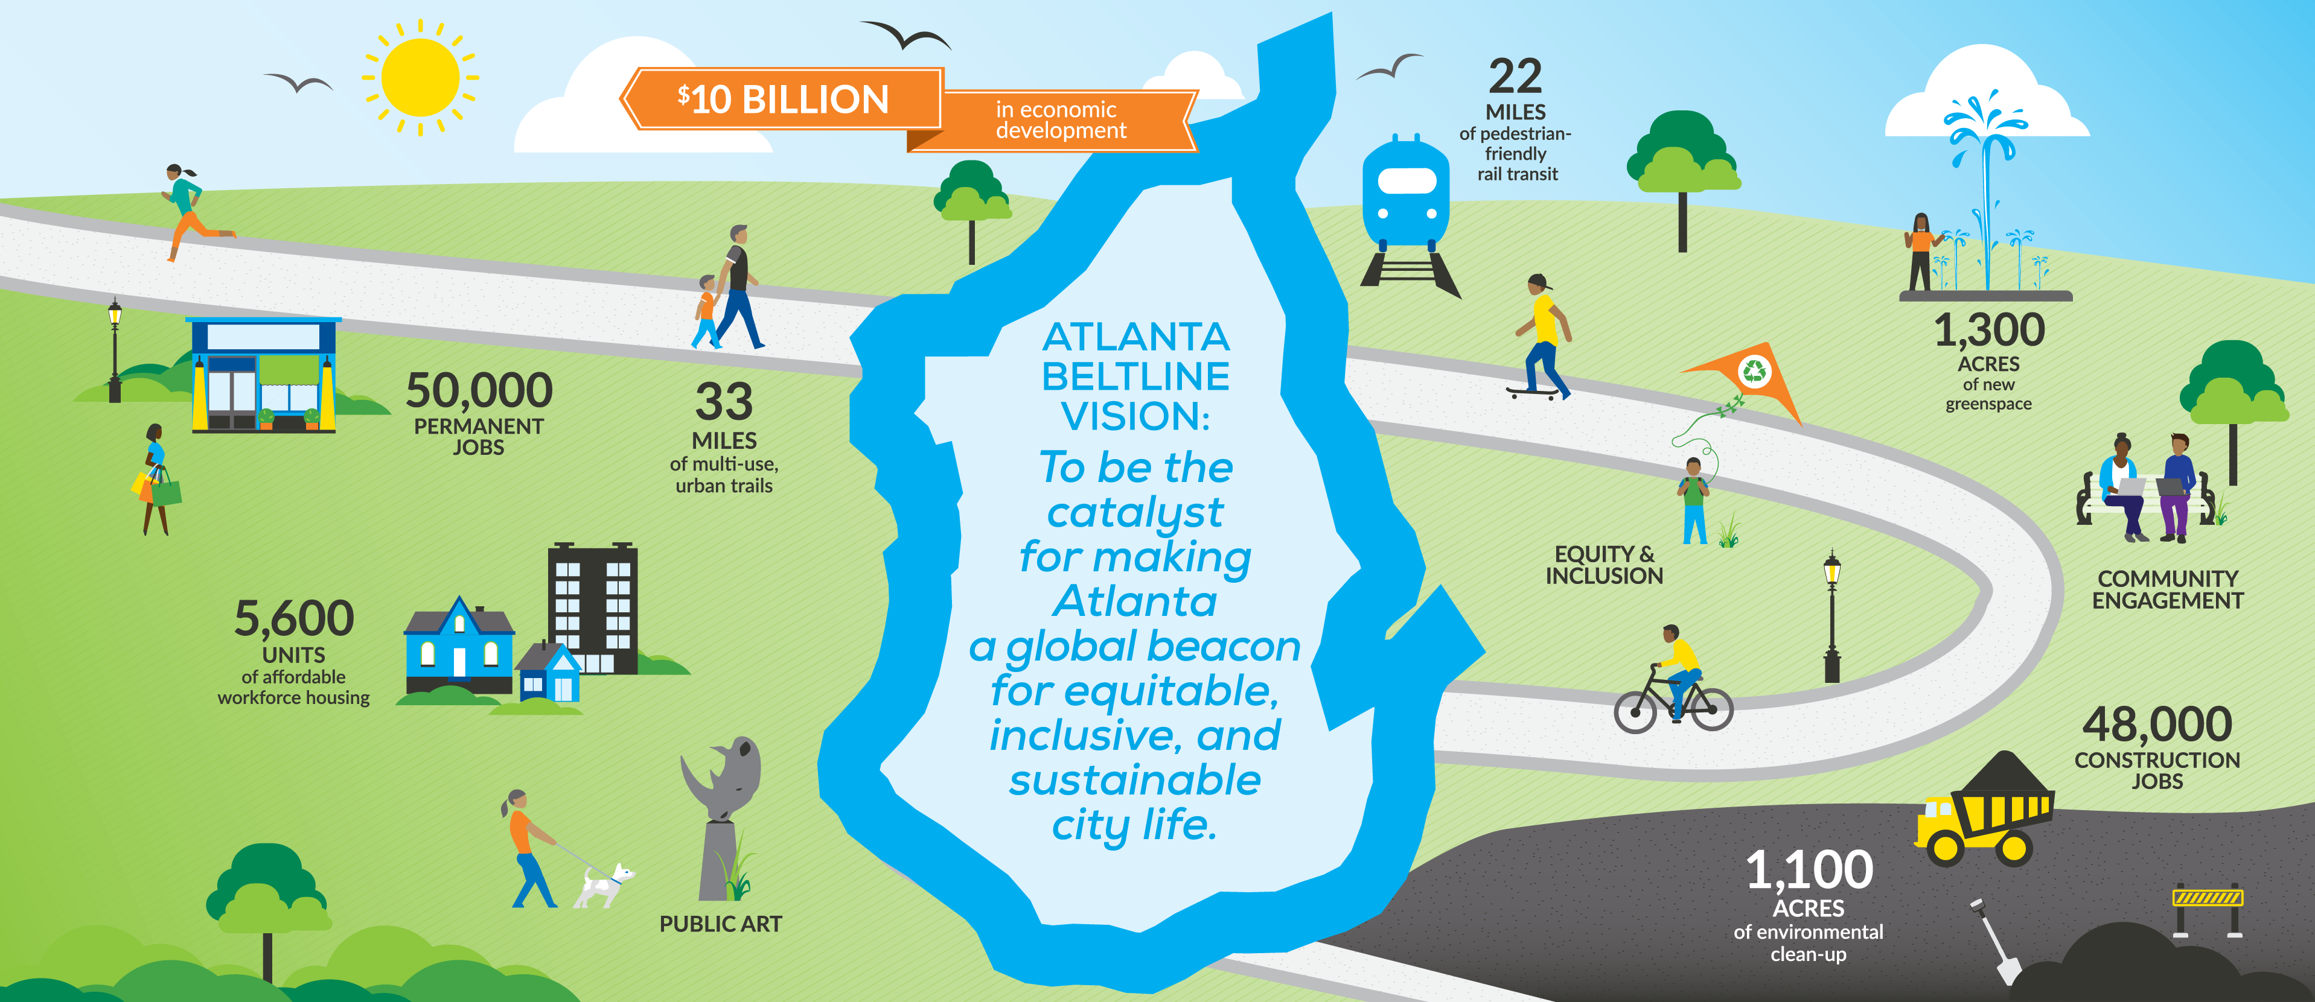
WELCOME > RDA ACCESS POINT > COMPLETE STREETS PROJECT > ENOTA PARK > Q&A > WRAP UP
Atlanta Beltline vision

Slide 10


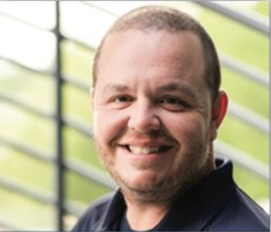
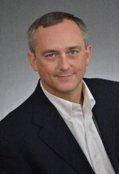

WELCOME > RDA ACCESS POINT > COMPLETE STREETS PROJECT > ENOTA PARK > Q&A > WRAP UP
Ralph David Abernathy Access Point
Contractor
Ralph David Abernathy
Access Point & RDA Complete Street Conversion Project
F.S. Scarbrough, LLC
Allen Eison
Vice President
Randy Cash Superintendent
Office #:
(770) 486-4905
Hannah Coxe
Asst. Project Manager
Randy Cash
Superintendent
Allen Eison Executive
Vice President
Varun Patel
Assistant Superintendent

Slide 11
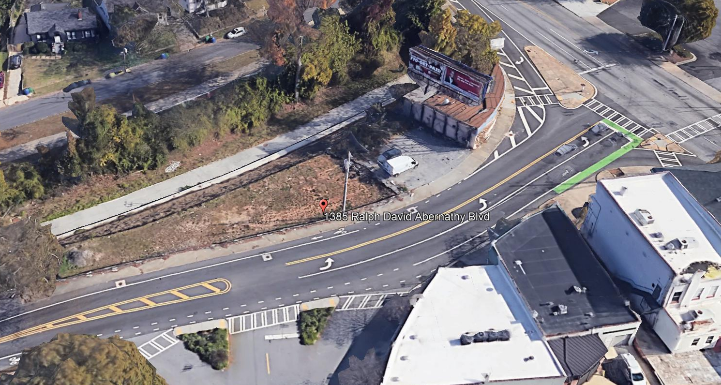
WELCOME > RDA ACCESS POINT > COMPLETE STREETS PROJECT > ENOTA PARK > Q&A > WRAP UP
Ralph David Abernathy Access Point
Location:
1385 RDA and the Westside Trail
MUSE STREET
CASCADE AVENUE
S GORDON STREET
Notes:
ABI purchased the property for the purpose of building an access point for the Westside Trail
2017: ABI & Westview Community collaboration on the Complete Street Vision for Ralph David Abernathy Blvd.
2018: ABI began developing concepts, but had to be put on hold due to staff resourcing challenges
2019: Due to the hiring of new staff, ABI restarted the effort to deliver the project
2021-2023: Working with GDOT to receive encroachment permit
Spring 2023: Advertise for Construction Bidders

Slide 12
WELCOME > RDA ACCESS POINT > COMPLETE STREETS PROJECT > ENOTA PARK > Q&A > WRAP UP
Ralph David Abernathy Access Point
STAIRS
Location:
1385 RDA and the Westside Trail
1114 S. GORDON
CROSS
WALKS
WESTSIDE TRAIL
GREEN
SPACE
RAMP
PLAZA
RALPH DAVID ABERNATHY BLVD SW
1384
RDA
Notes:
This is the final rendering of all feedback. It looked at 3 concepts over the previous meetings and chose to revise Concept C. All Construction Bid documentation was then created by the Volkert team with the goal of obtaining a permit for construction.
Notes: Funded through TAD/ABI and adding .56 Acres of Greenspace

Slide 13
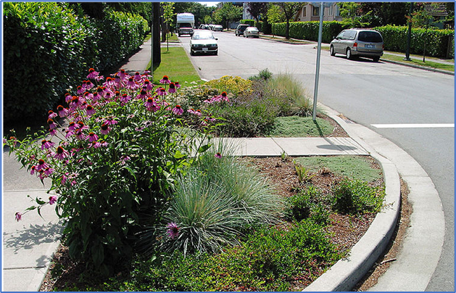
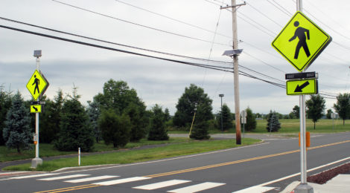
WELCOME > RDA ACCESS POINT > COMPLETE STREETS PROJECT > ENOTA PARK > Q&A > WRAP UP
Ralph David Abernathy Access Point
STAIRS
Gordon Street
Improved Crosswalks with Rapid Flashing Beacons
Inclusion of Greenspace at RDA and Gordon Street
1114 S. GORDON
CROSS
WALKS
GREEN
SPACE
RAMP
RALPH DAVID ABERNATHY BLVD SW
1384
RDA

Slide 14
WELCOME > RDA ACCESS POINT > COMPLETE STREETS PROJECT > ENOTA PARK > Q&A > WRAP UP
Ralph David Abernathy Access Point
SECTION B
Ramp and Stair Sections for Westside BeltLine access
SECTION A

Slide 15
WELCOME > RDA ACCESS POINT > COMPLETE STREETS PROJECT > ENOTA PARK > Q&A > WRAP UP
Ralph David Abernathy Access Point
<<< Ralph David Abernathy Blvd
Plaza and Ramp Section A:
Looking North from the trail
Sidewalk +
Bike Lane
Plaza with Landscaping
ADA-Accessible
Ramp
Westside Trail
Looking North

Slide 16
WELCOME > RDA ACCESS POINT > COMPLETE STREETS PROJECT > ENOTA PARK > Q&A > WRAP UP
Ralph David Abernathy Access Point
Plaza and Stairs Section B:
Looking North from the trail
<<< Ralph David Abernathy Blvd
Proposed Tree
Bike
Lane
Sidewalk
Stairs
Westside Trail
Looking North

Slide 17
WELCOME > RDA ACCESS POINT > COMPLETE STREETS PROJECT > ENOTA PARK > Q&A > WRAP UP
Ralph David Abernathy Access Point
Construction Timeline:
Overall 8–12 month construction schedule expected
Schedule delayed due to weather & existing site conditions
Still anticipating Summer 2024 completion and opening

Slide 18
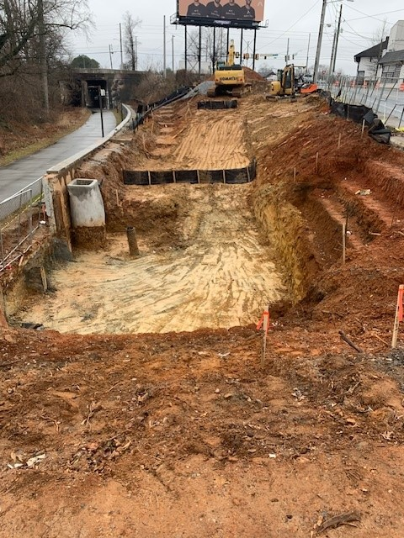
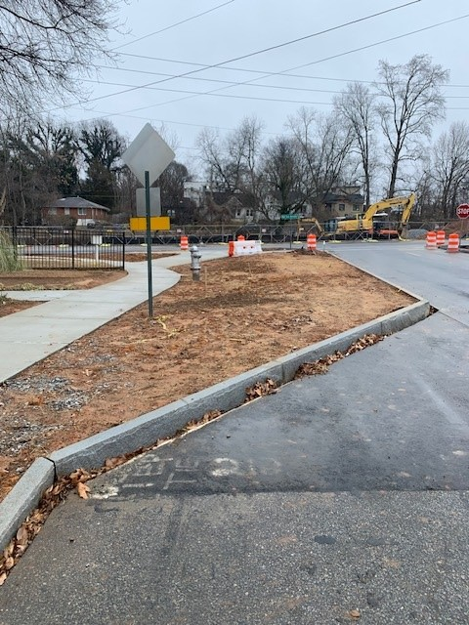
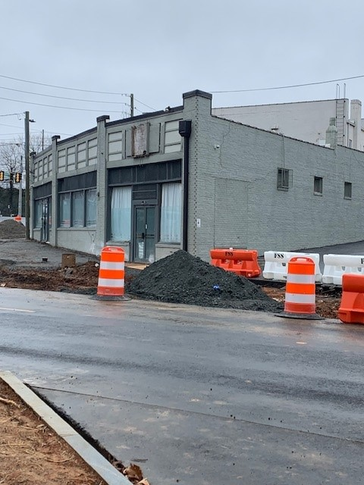
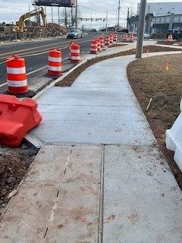
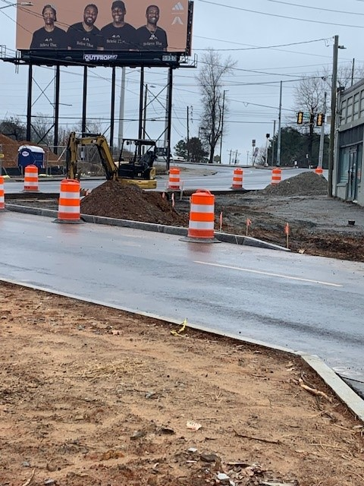
WELCOME > RDA ACCESS POINT > COMPLETE STREETS PROJECT > ENOTA PARK > Q&A > WRAP UP
Ralph David Abernathy Access Point
Work in Progress

Slide 19
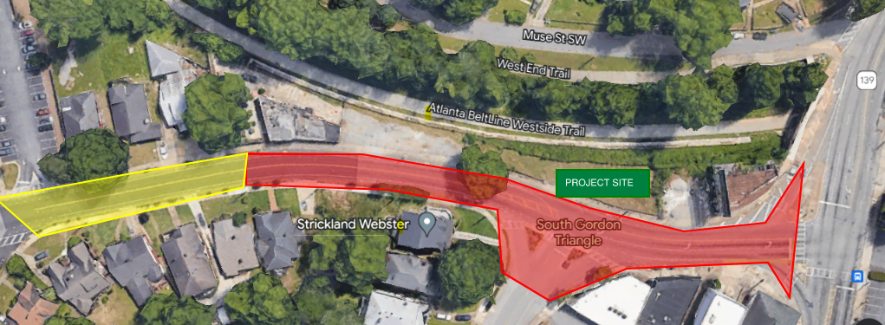
WELCOME > RDA ACCESS POINT > COMPLETE STREETS PROJECT > ENOTA PARK > Q&A > WRAP UP
Ralph David Abernathy Access Point
Traffic and Pedestrian Impacts – Cascade Avenue SW to Stokes Avenue SW (yellow and red areas)
Hours of construction: Monday through Friday 7:00 AM to 5:00 PM (Saturdays as needed)
Expect intermittent traffic delays & increased construction vehicular traffic
Business storefronts to be impacted, coordination by General Contractor will be provided
Sidewalk closures will require increased pedestrian awareness and adherence to barricades and signage to maintain personal safety
Daily disruption (vibration, noise & possible dust) due to construction activities should be expected
Traffic control will be provided by the contractor to maintain vehicle passage

Slide 20
WELCOME > RDA ACCESS POINT > COMPLETE STREETS PROJECT > ENOTA PARK > Q&A > WRAP UP
RDA Complete Street Conversion
Project Scope:
Prioritized safety and comfort
Re-establish a curb face
Widen sidewalks
Pedestrian lighting
Street trees
Parking-protected bike lanes
Mathewson PL SW
LUCILE AVE SW
INMAN ST SW
WILLARD AVE
E ONTARIO ST

Slide 21
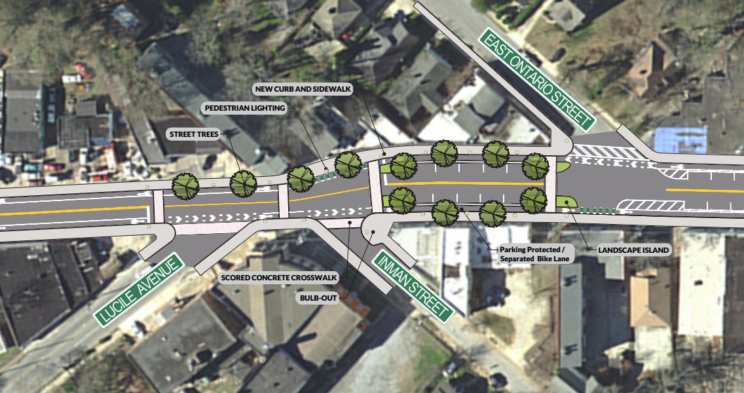
WELCOME > RDA ACCESS POINT > COMPLETE STREETS PROJECT > ENOTA PARK > Q&A > WRAP UP
RDA Complete Street Conversion
Concept Rendering

Slide 22
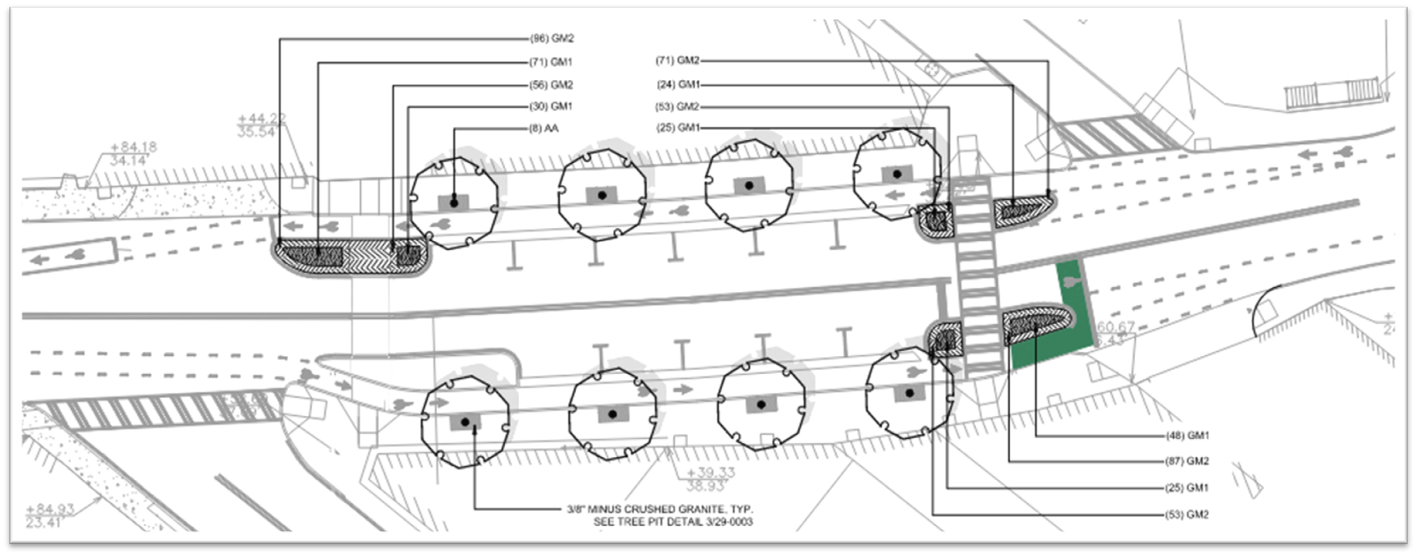
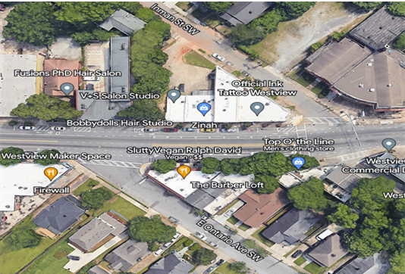
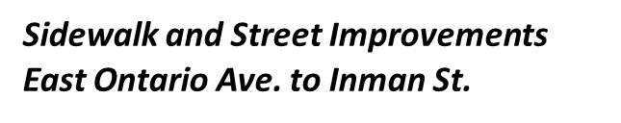
WELCOME > RDA ACCESS POINT > COMPLETE STREETS PROJECT > ENOTA PARK > Q&A > WRAP UP
RDA Complete Street Conversion
8 Street Trees
Bike Lanes
11 Parking Spots

Slide 23
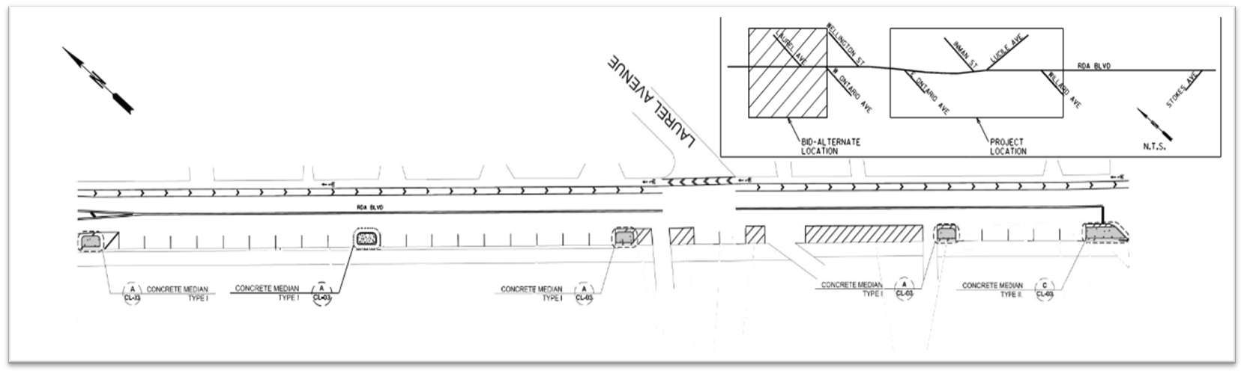
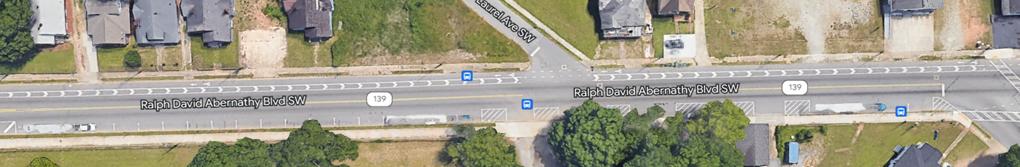
WELCOME > RDA ACCESS POINT > COMPLETE STREETS PROJECT > ENOTA PARK > Q&A > WRAP UP
RDA Complete Streets
Street Parking Improvements near Westview Cemetery
Concrete Median Installation

Slide 24
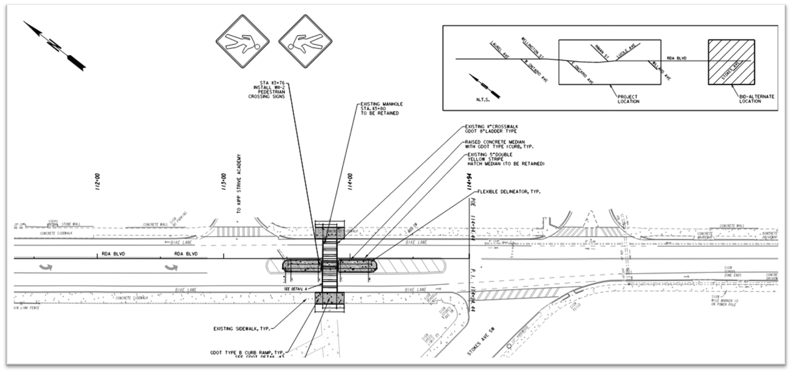
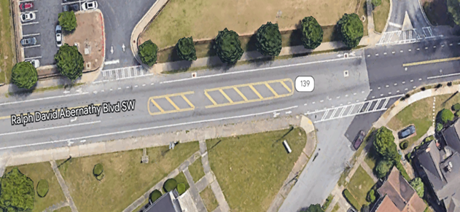
WELCOME > RDA ACCESS POINT > COMPLETE STREETS PROJECT > ENOTA PARK > Q&A > WRAP UP
RDA Complete Streets
Crosswalk Improvements and
Concrete Median Installation at KIPP STRIVE Academy

Slide 25
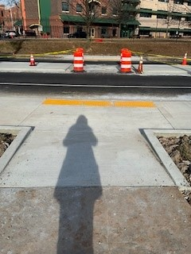
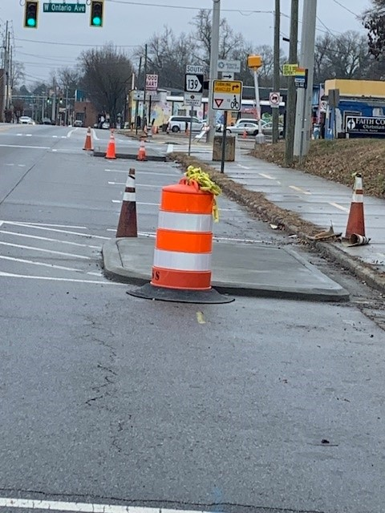
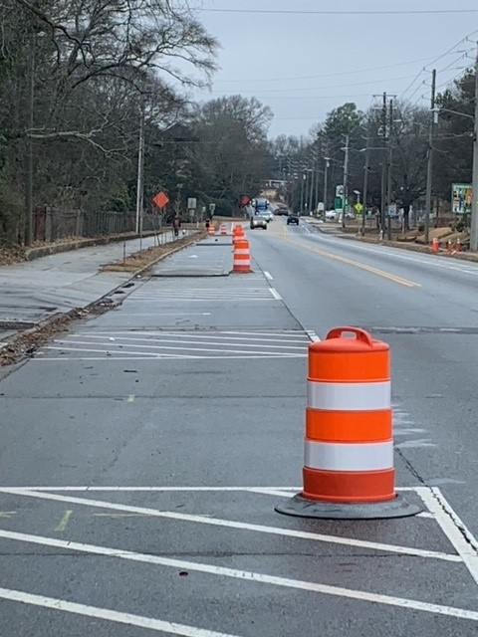
WELCOME > RDA ACCESS POINT > COMPLETE STREETS PROJECT > ENOTA PARK > Q&A > WRAP UP
RDA Complete Street Conversion
Work In Progress
Crosswalk at KIPP Academy
Parking medians from West Ontario to Westside Cemetery

Slide 26
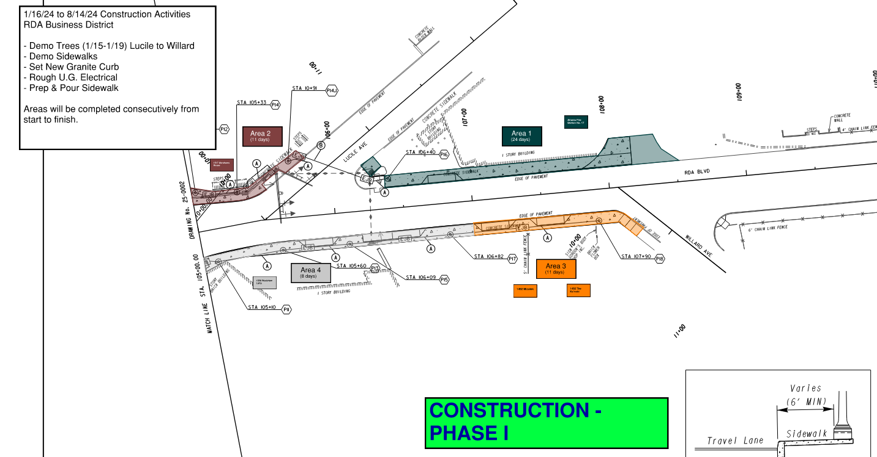
WELCOME > RDA ACCESS POINT > COMPLETE STREETS PROJECT > ENOTA PARK > Q&A > WRAP UP
RDA Complete Street Conversion
Construction Timeline Phase I:
Overall 6–10 month construction schedule expected
Phase I started January 2024

Slide 27
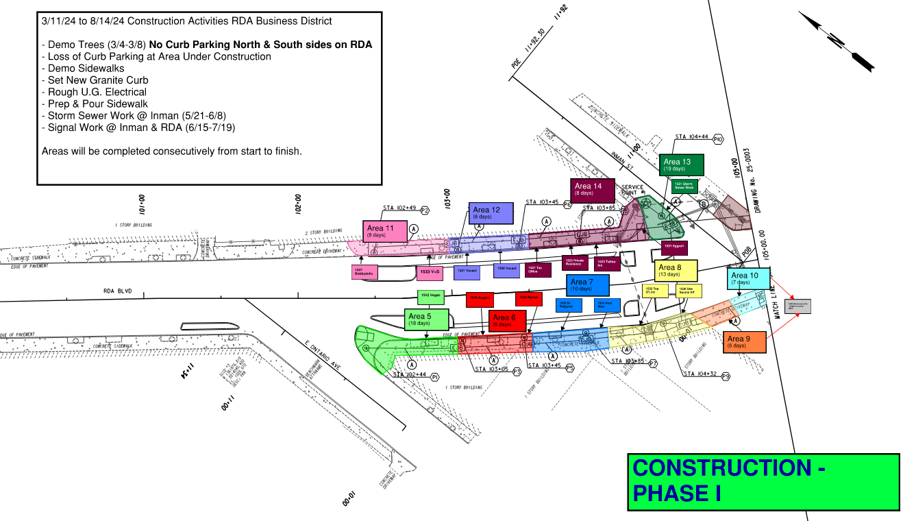
WELCOME > RDA ACCESS POINT > COMPLETE STREETS PROJECT > ENOTA PARK > Q&A > WRAP UP
RDA Complete Street Conversion
Construction Timeline Phase I:
Overall 6–10 month construction schedule expected
Phase I completing late Summer 2024

Slide 28
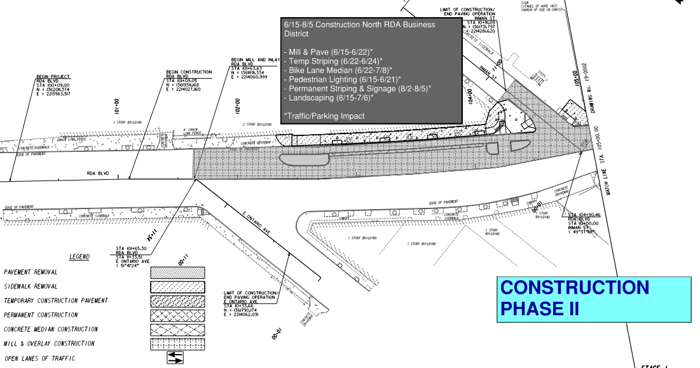
WELCOME > RDA ACCESS POINT > COMPLETE STREETS PROJECT > ENOTA PARK > Q&A > WRAP UP
RDA Complete Street Conversion
Construction Timeline Phase II:
Overall 6–10 month construction schedule expected
Phase II starting Summer 2024

Slide 29
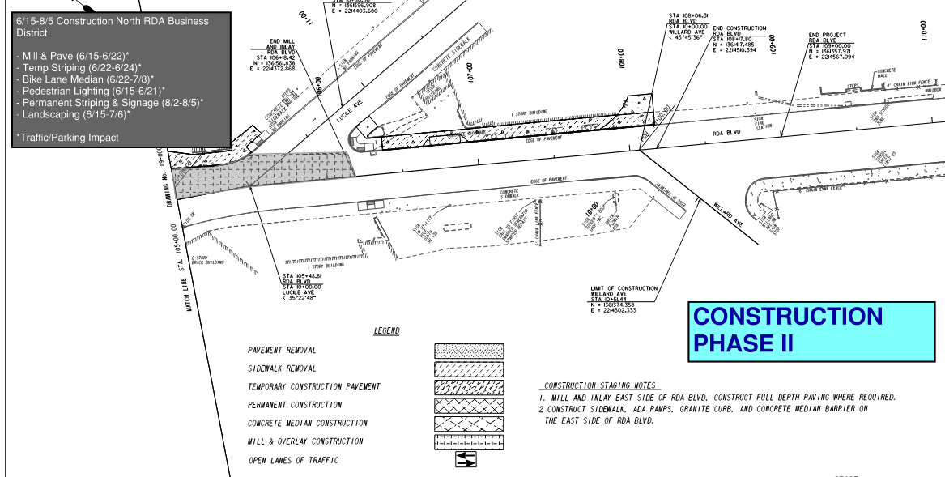
WELCOME > RDA ACCESS POINT > COMPLETE STREETS PROJECT > ENOTA PARK > Q&A > WRAP UP
RDA Complete Street Conversion
Construction Timeline Phase II:
Overall 6–10 month construction schedule expected
Phase II starting Summer 2024

Slide 30
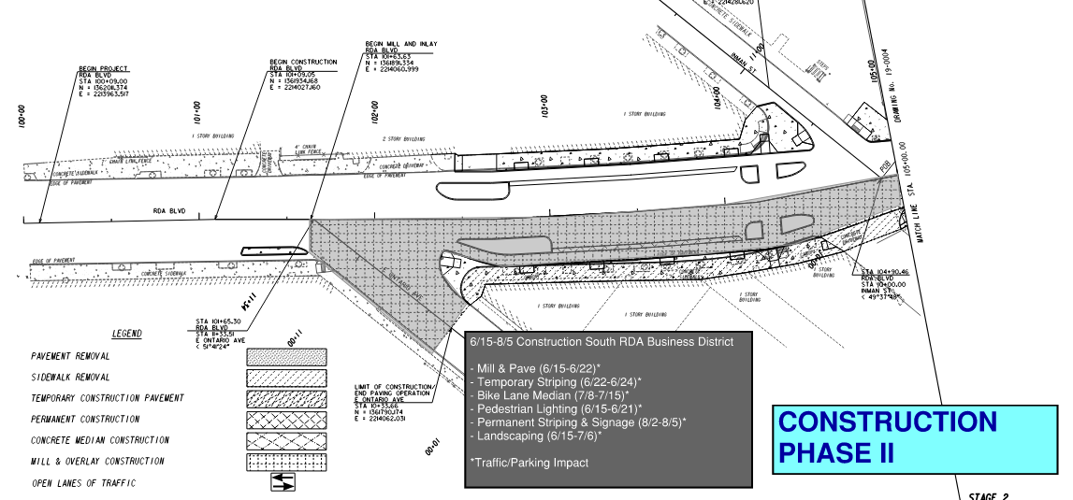
WELCOME > RDA ACCESS POINT > COMPLETE STREETS PROJECT > ENOTA PARK > Q&A > WRAP UP
RDA Complete Street Conversion
Construction Timeline Phase II:
Overall 6–10 month construction schedule expected
Phase II starting Summer 2024

Slide 31
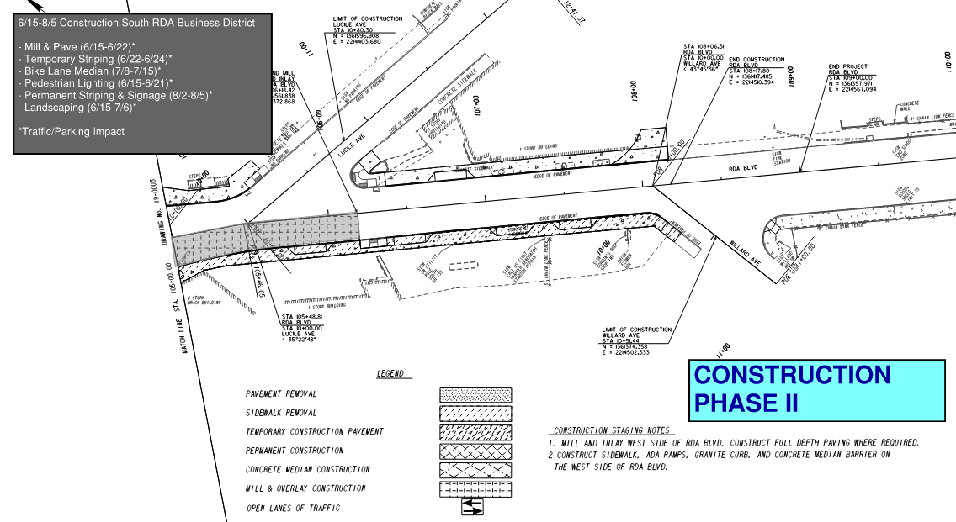
WELCOME > RDA ACCESS POINT > COMPLETE STREETS PROJECT > ENOTA PARK > Q&A > WRAP UP
RDA Complete Street Conversion
Construction Timeline Phase II:
Overall 6–10 month construction schedule expected
Phase II completing late Summer 2024

Slide 32
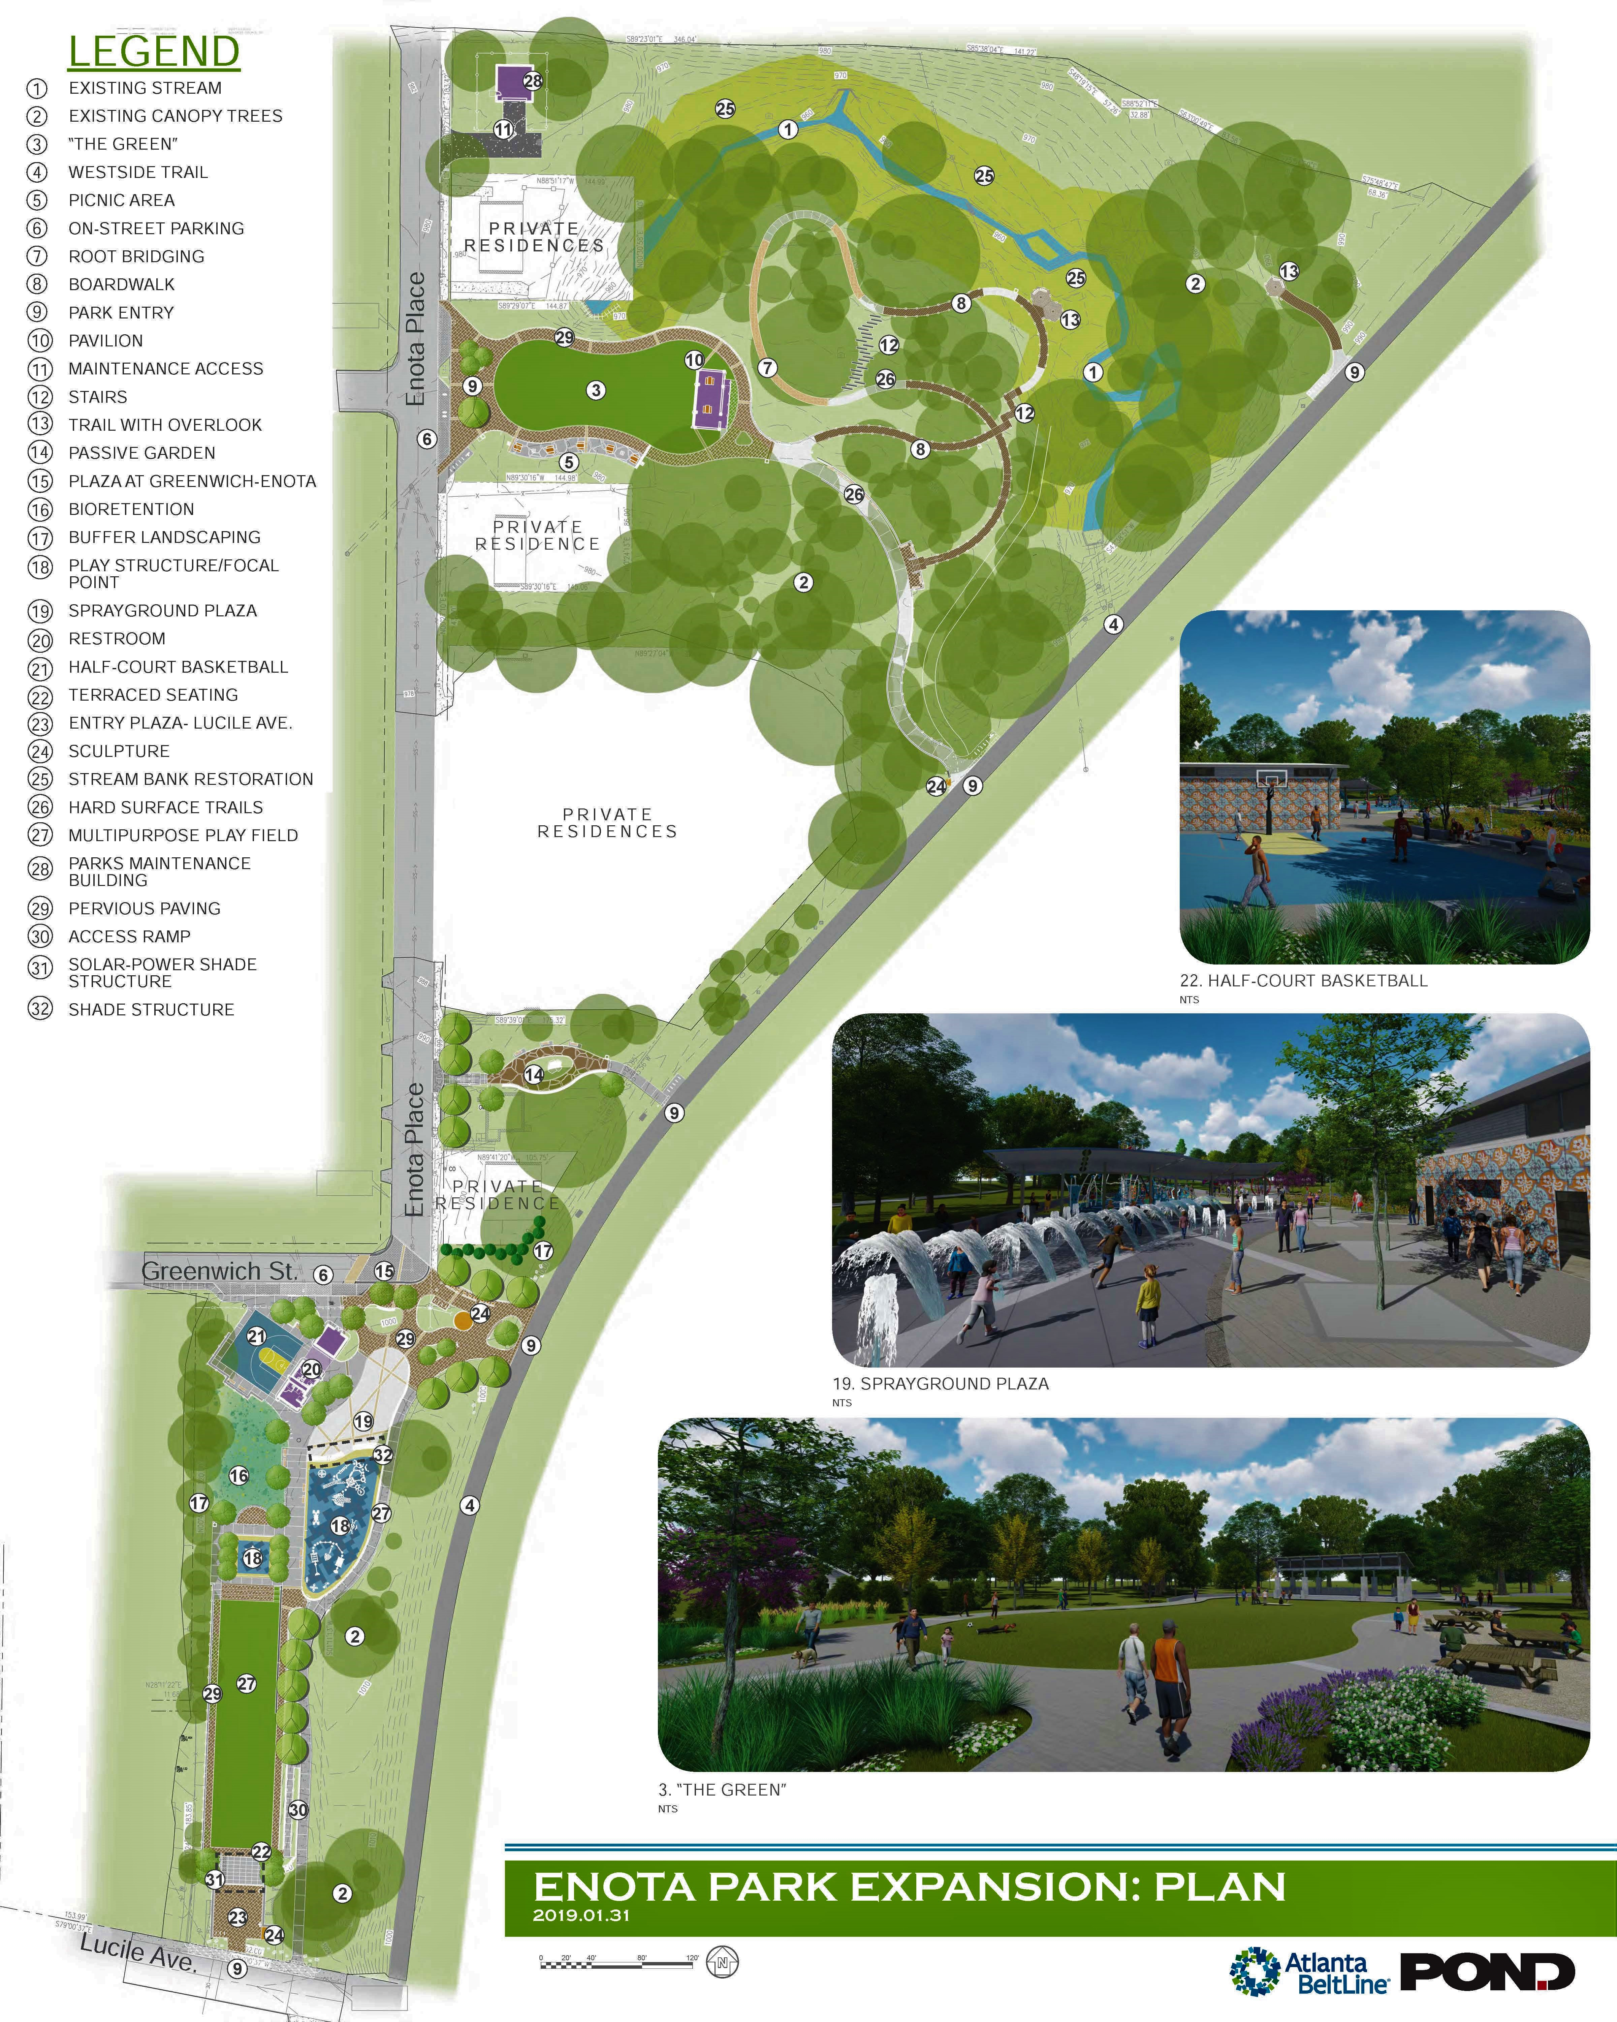
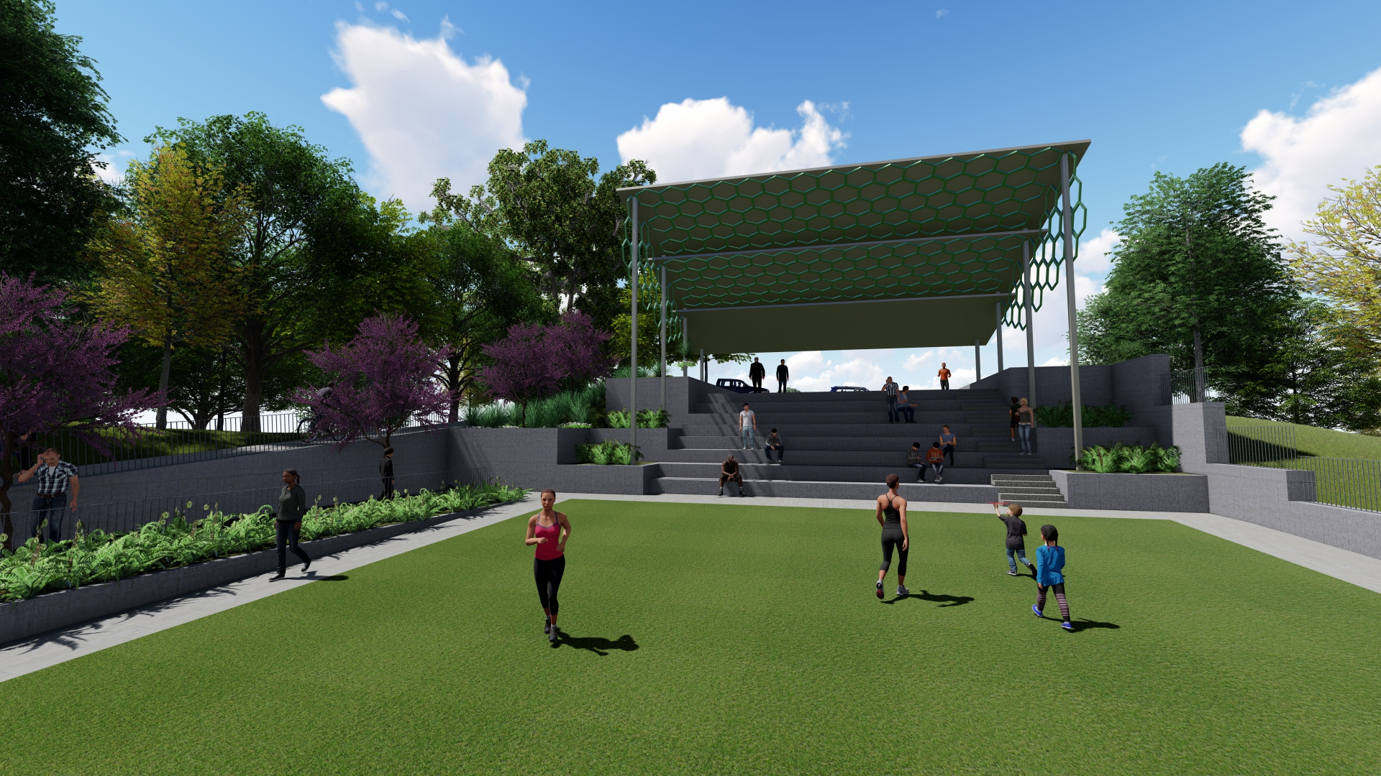
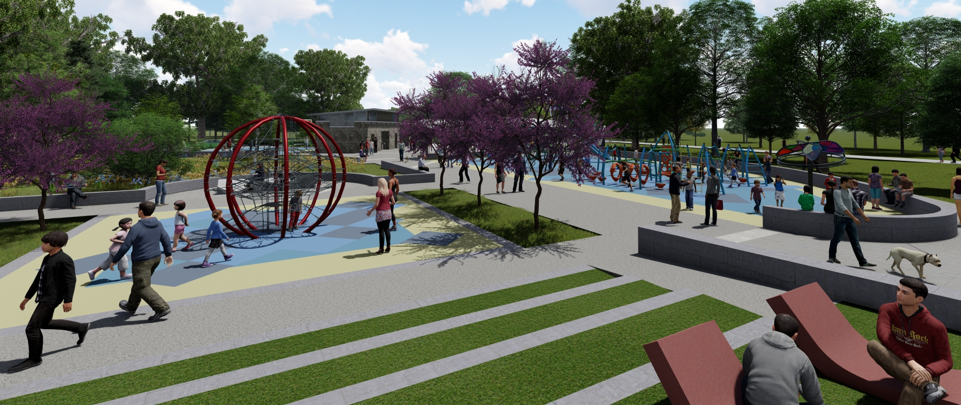
WELCOME > RDA ACCESS POINT > COMPLETE STREETS PROJECT > ENOTA PARK > Q&A > WRAP UP
Enota Park Update
Currently Permitting with City of Atlanta
Procurement for Construction Complete

Slide 33
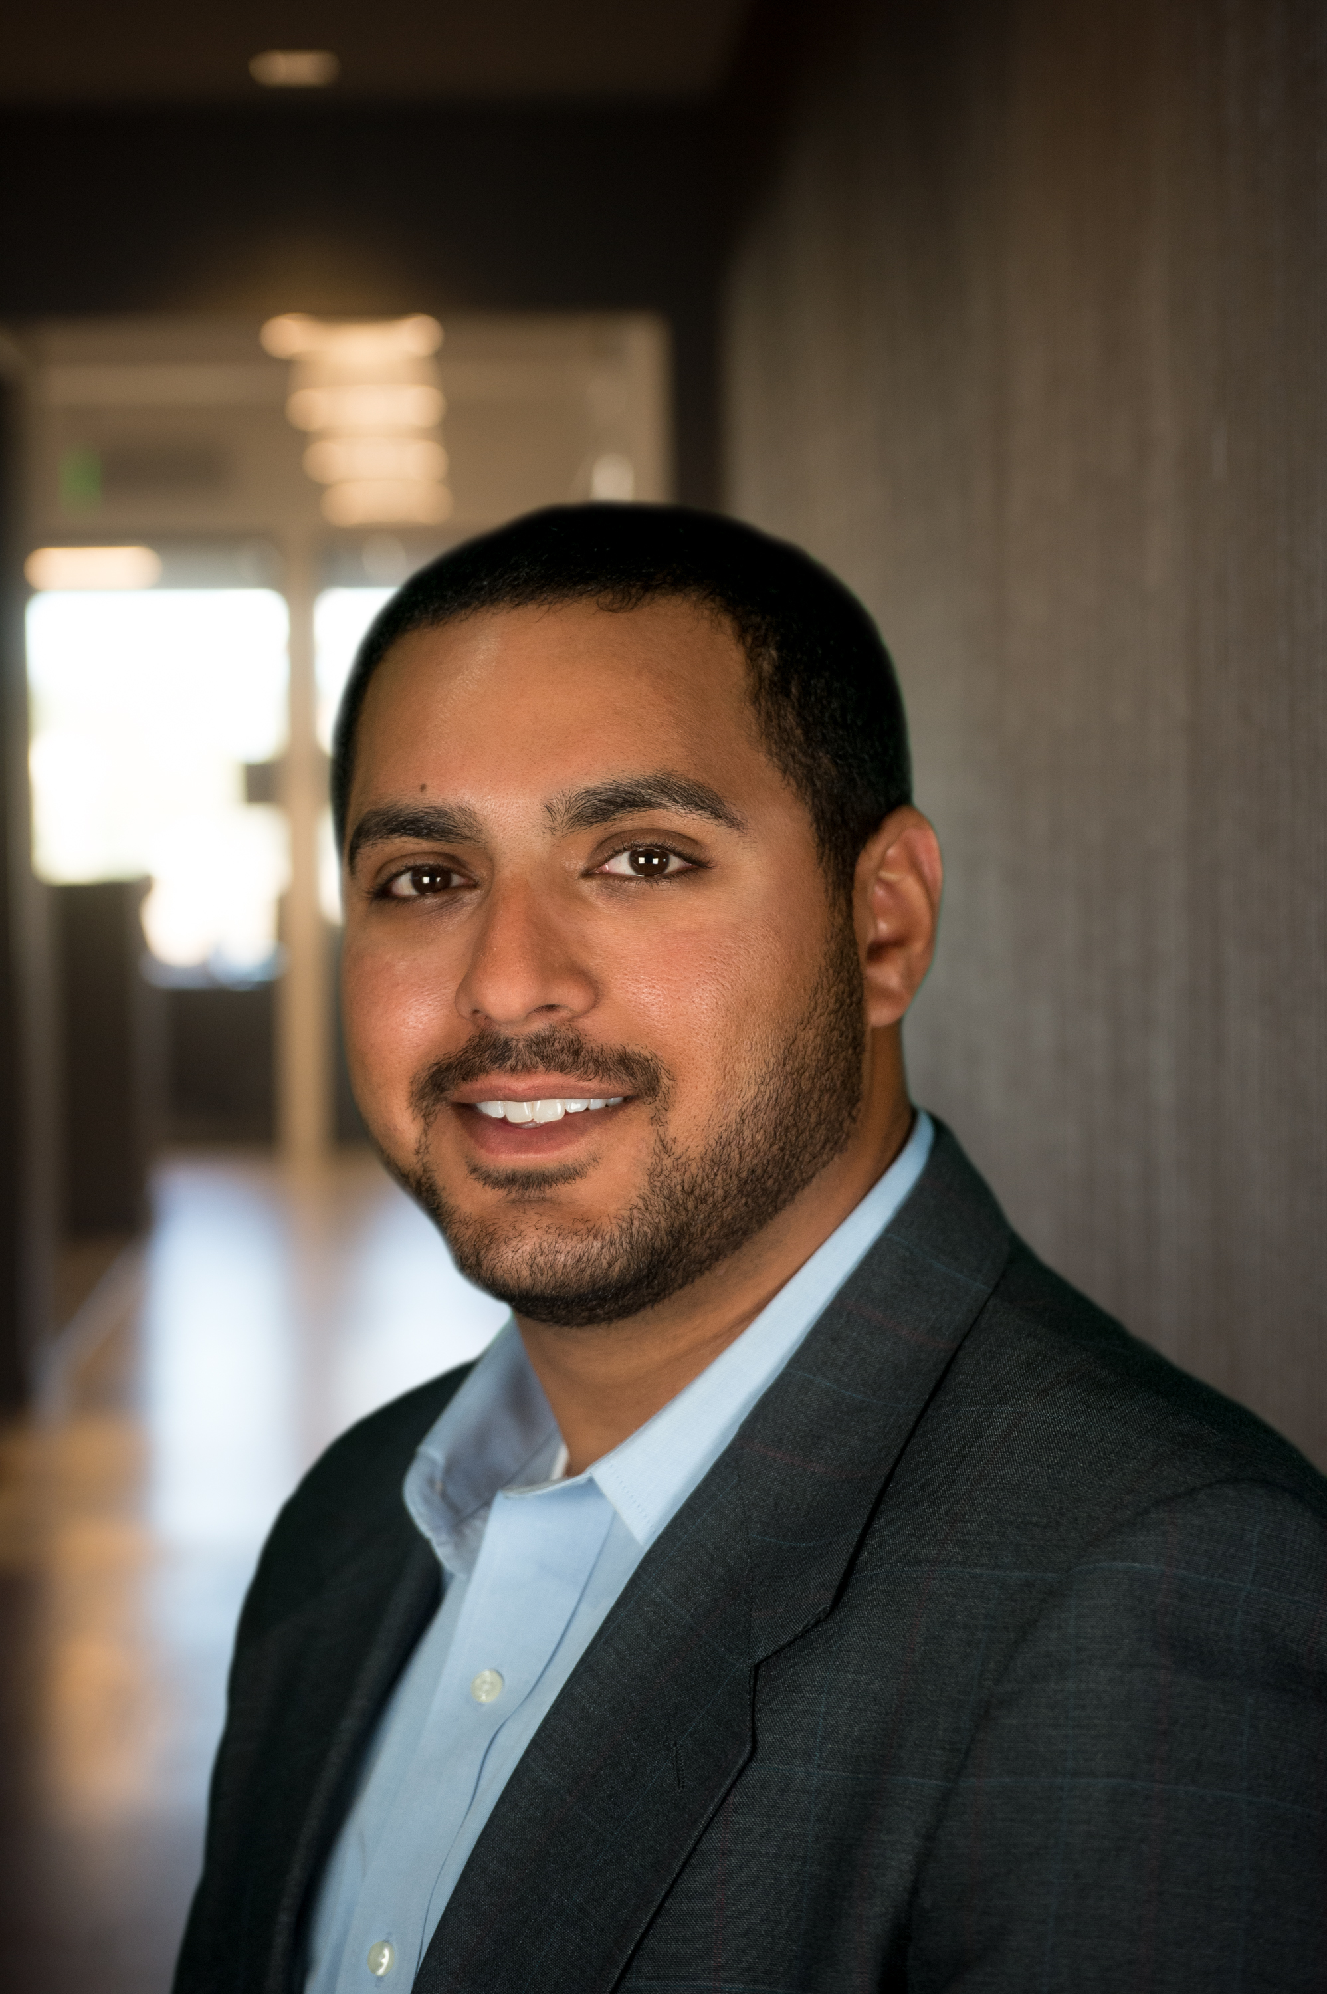
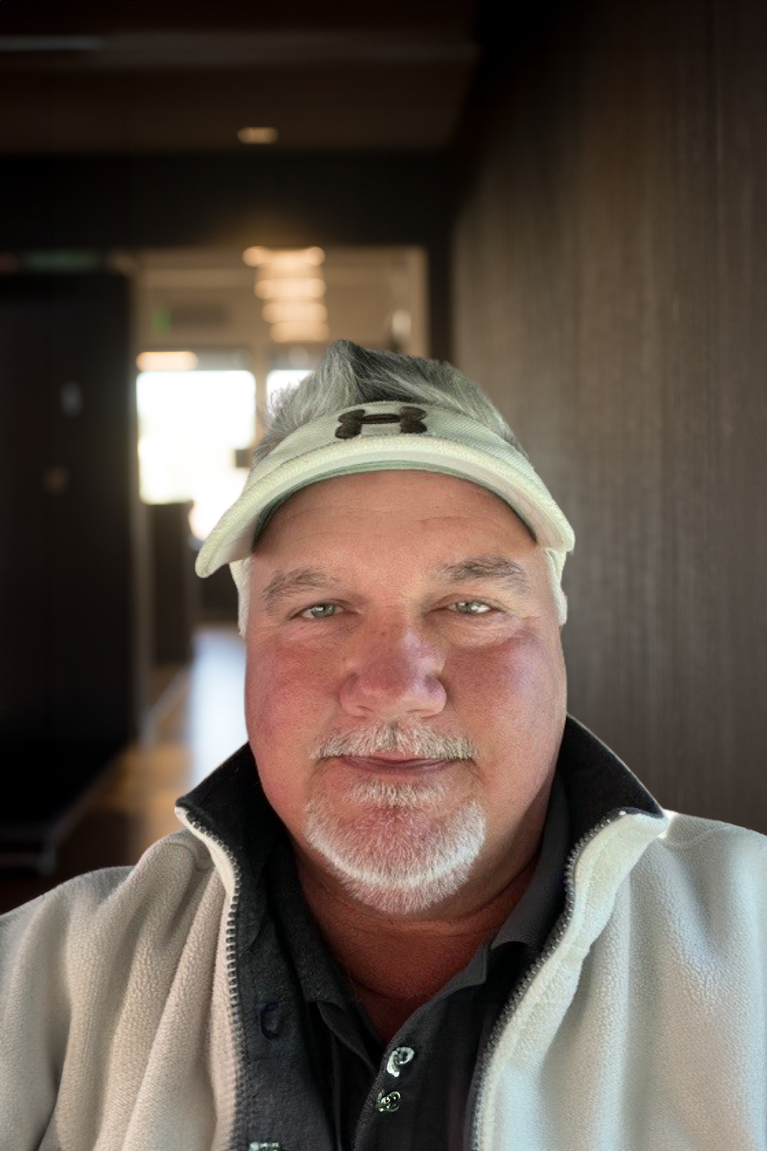

WELCOME > RDA ACCESS POINT > COMPLETE STREETS PROJECT > ENOTA PARK > Q&A > WRAP UP
Enota Park Construction contractor
Enota Park Construction
Reeves Young, LLC
Mo Amircani
Sr. Project Manager
Scott Godfrey Superintendent
Mo Amircani
Sr. Project Manager
Scott Godfrey
Superintendent

Slide 34
WELCOME > RDA ACCESS POINT > COMPLETE STREETS PROJECT > ENOTA PARK > Q&A > WRAP UP
Enota Park Construction
Construction Timeline:
16-month construction schedule anticipated
Construction start and work timeline to be detailed at a later meeting
Construction start and work timeline to be detailed in a later meeting

Slide 35
WELCOME > RDA ACCESS POINT > COMPLETE STREETS PROJECT > ENOTA PARK > Q&A > WRAP UP
Virtual meeting Q&A
Phone Attendees
Press *9 on telephone keypad to “raise your hand” during the Q&A to indicate you want to speak. Facilitator will unmute your mic.
Online Attendees:
Submit a question or comment any time in Q&A box.
The “raise your hand” feature is available to all Zoom participants; however, we are prioritizing phone attendees.
Facebook Live Attendees:
Please feel free to participate in the “Comments Section.” Someone on our staff will make sure I see your questions.

Slide 36
WELCOME > RDA ACCESS POINT > COMPLETE STREETS PROJECT > ENOTA PARK > Q&A > WRAP UP
Poll questions
Poll Question #5
Was the information presented tonight helpful in changing your perception and/or understanding of the BeltLine project?
Yes
No
No opinion

Slide 37
WELCOME > RDA ACCESS POINT > COMPLETE STREETS PROJECT > ENOTA PARK > Q&A > WRAP UP
Poll questions
Poll Question #6
Did you learn something new?
Yes
No
Need more clarity

Slide 38
WELCOME > RDA ACCESS POINT > COMPLETE STREETS PROJECT > ENOTA PARK > Q&A > WRAP UP
Contacts
Jennifer Disotell, Sr. Project Manager, RDA Access Point & Complete Streets Project
jdisotell@atlbeltline.org or 678.458.2028
Meghan Injaychock, Sr. Project Manager, Enota Park
minjaychock@atlbeltline.org or 404.477.3638
Brittany Brewster, Community Engagement Manager, RDA Access, Complete Streets Project & Enota Park bbrewster@atlbeltline.org or 404.477.3645
General Contractor
F.S. Scarbrough, LLC, Contacts: Allen Eison, Project Manager & Randy Cash
Superintendent, Office Phone 770. 486.4905
Fundraising
Rob Brawner, Executive Director, Atlanta BeltLine Partnership, rob@atlblp.org

Slide 39
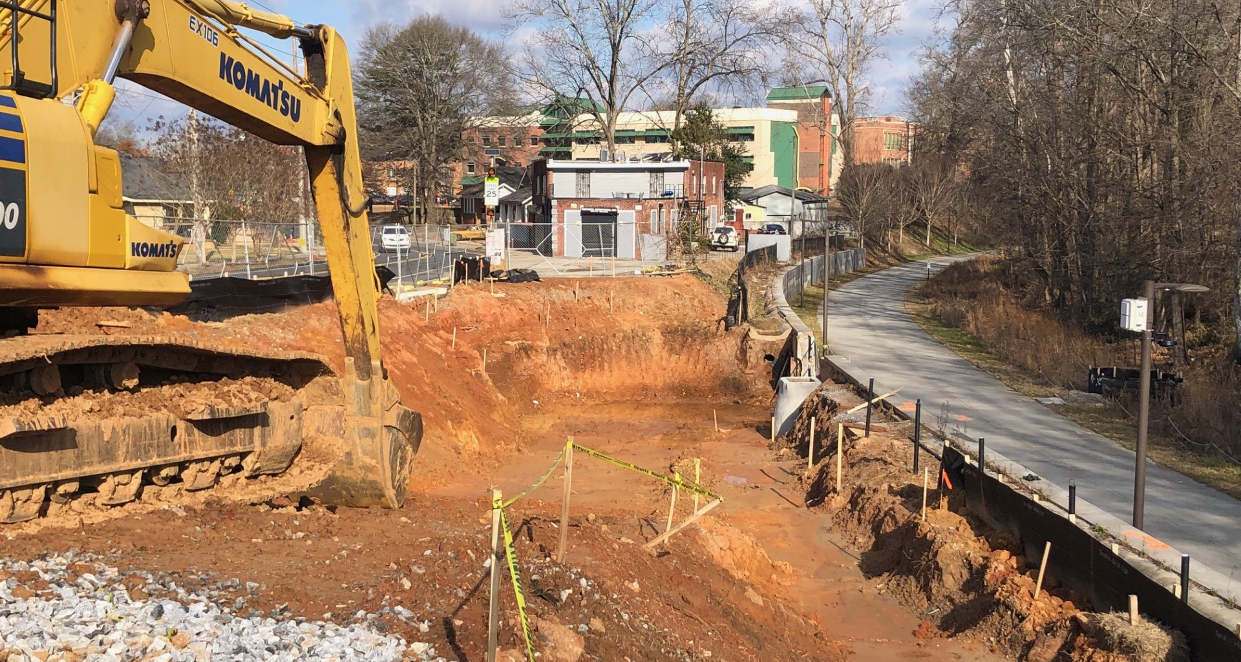
WELCOME > RDA ACCESS POINT > COMPLETE STREETS PROJECT > ENOTA PARK > Q&A > WRAP UP
Thank you!

